Slide 1
Stakeholder Toolkit – Translated Resources
This pack contains a selection of downloadable translated resources and direct links to information on how to stay COVID Safe in the community and specific resources for businesses
Last updated 25 August 2020

Slide 2
Contents
Where to get the latest information | 2
Arabic | 3 – 6
Simplified Chinese | 7 – 10
Traditional Chinese | 11 – 14
Korean | 15 – 18
Vietnamese | 19 – 22
Thai | 23 - 25
Hindi | 26 - 27
Polish | 28 – 29
Greek | 30 – 32
Italian | 33 – 35
Spanish | 36
Punjabi | 37

Slide 3
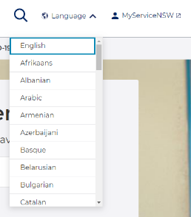
Where to get the latest translated information
Go to nsw.gov.au
The nsw.gov.au website can be translated into over 50 languages via the ‘Language’ option in the top right hand corner
The content on this website is being continuously updated with the latest information
This is also where you will find answers to commonly asked questions
There is a translated resource page, which has a search functionality as well as being able to filter by language https://www.health.nsw.gov.au/Infectious/covid-19/Pages/multilingual.aspx
A digital resource library is available to browse translated materials https://www.health.nsw.gov.au/Infectious/covid-19/Pages/digital-resources.aspx

Slide 4
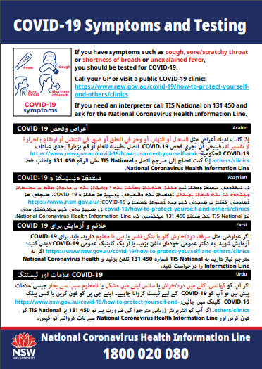
Arabic: COVID Safe community information
Links to translated PDF documents to download:
How to stop the spread – poster
If you have symptoms – poster
Tell staff if you have
symptoms – poster

Slide 5
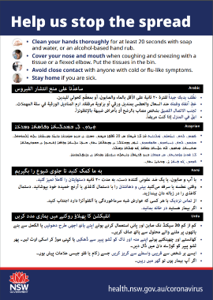
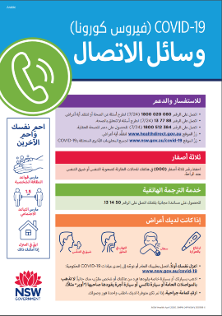
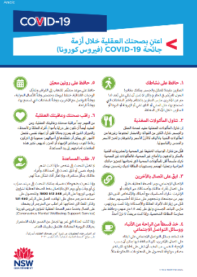
Arabic: COVID Safe community information
How to stop the
spread – brochure
Physical distancing – poster
COVID-19 – who to call – poster
Look after your mental health during COVID-19 – factsheet

Slide 6
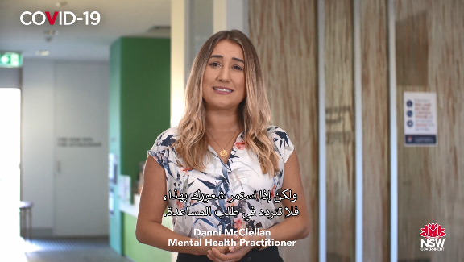
Arabic: Media campaign assets
Get tested (clinics) radio ad
Distancing radio ad
Border entry social ad
Stay safe family gatherings press ad
Continue healthcare video
Get tested press ad
Mental wellbeing video

Slide 7
Arabic: COVID Safe business information
Show your commitment to COVID Safety and keeping our community safe. Complete a COVID-19 Safety Plan and register as a COVID Safe business.
Links to translated COVID Safe Plans for businesses:
Example of the Arabic COVID-Safe poster received on registration
General
Beauty, Nail, Waxing, Tanning and Hairdressing Salons
Restaurants and Cafes including food courts
For more information on COVID Safe businesses, go to www.nsw.gov.au/covid-19/covid-safe-business

Slide 8
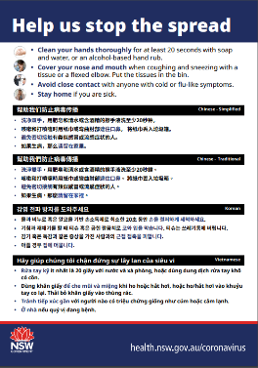
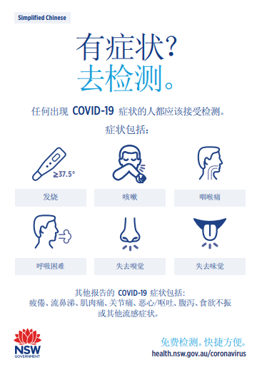
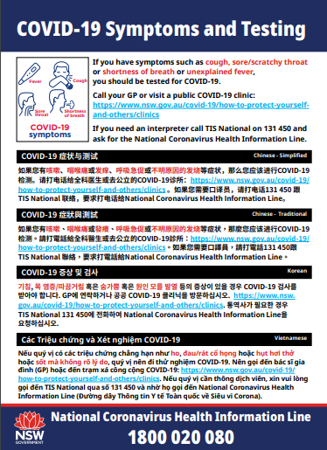
Simplified Chinese: COVID Safe community information
Links to translated PDF documents to download:
How to stop the spread – poster
Physical distancing – poster
If you have symptoms – poster
Tell staff if you have
symptoms – poster

Slide 9
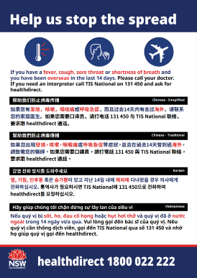
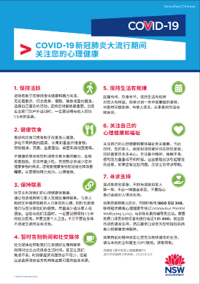
Simplified Chinese: COVID Safe community information
COVID-19 – help us stop the spread - poster
COVID-19 – who to call – poster
Look after your mental health during COVID-19 – poster

Slide 10
Simplified Chinese: COVID Safe business information
Show your commitment to COVID Safety and keeping our community safe. Complete a COVID-19 Safety Plan and register as a COVID Safe business.
Links to translated COVID Safe Plans for businesses:
Example of the Simplified Chinese COVID-Safe poster received on registration
General
Beauty, Nail, Waxing, Tanning and Hairdressing Salons
Restaurants and Cafes including food courts
For more information on COVID Safe businesses, go to www.nsw.gov.au/covid-19/covid-safe-business

Slide 11
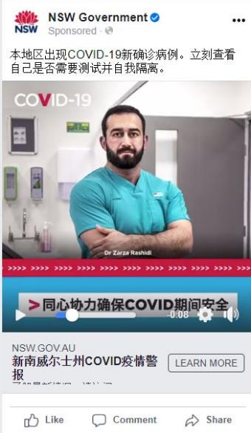
Simplified Chinese: Media campaign assets
Get tested (clinics) radio ad
Distancing radio ad
Stay safe family gatherings press ad
Dr Pak – Get tested clinics video
Get tested high alert social ad
Get tested press ad
Dr Pak – Get tested symptoms video

Slide 12
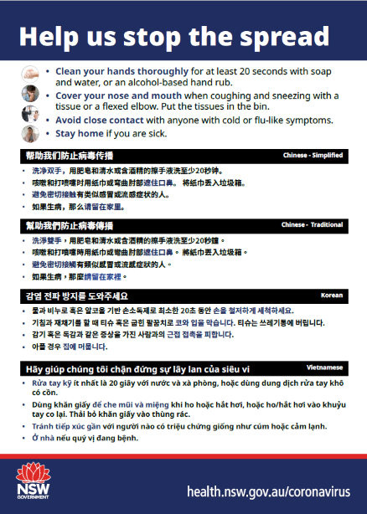
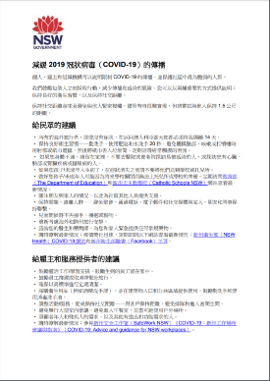
Traditional Chinese: COVID Safe community information
Links to translated PDF documents to download:
How to stop the spread – poster
How to slow the
spread – factsheet
If you have symptoms – poster

Slide 13
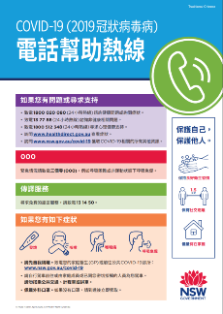
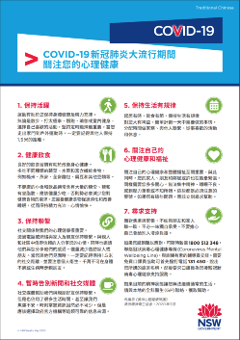
Traditional Chinese: COVID Safe community information
COVID-19 – Help us stop the spread - poster
COVID-19 – who to call – poster
Avoid large family gatherings
Look after your mental health during COVID-19 – poster
Additional resources:
Physical distancing – poster

Slide 14
Traditional Chinese: COVID Safe business information
Show your commitment to COVID Safety and keeping our community safe. Complete a COVID-19 Safety Plan and register as a COVID Safe business.
Links to translated COVID Safe Plans for businesses:
Example of the Traditional Chinese COVID-Safe poster received on registration
General
Beauty, Nail, Waxing, Tanning and Hairdressing Salons
Restaurants and Cafes including food courts
For more information on COVID Safe businesses, go to www.nsw.gov.au/covid-19/covid-safe-business

Slide 15
Traditional Chinese: Media campaign assets
Get tested (clinics) radio ad
Distancing radio ad
Border Entry social ad
Stay safe family gatherings press ad
Continue healthcare video
Get tested press ad
Mental wellbeing video

Slide 16
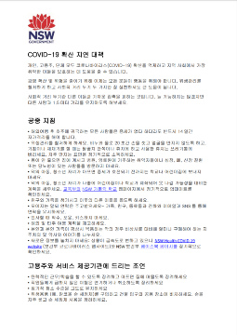
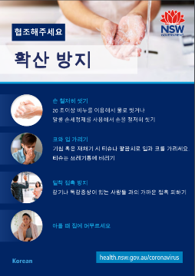
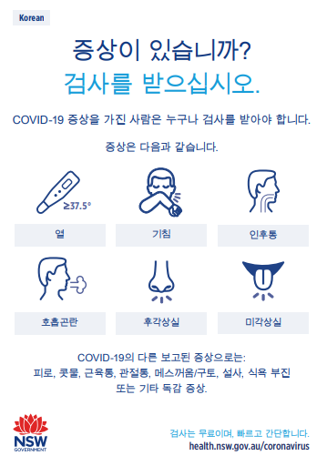
Korean: COVID Safe community information
Links to translated PDF documents to download:
COVID-19 – Help us stop the spread - poster
How to slow the spread – factsheet
Hygiene etiquette to stop the spread – poster
Tell staff if you have symptoms – poster

Slide 17
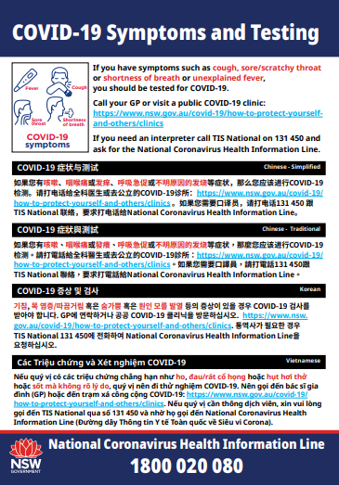
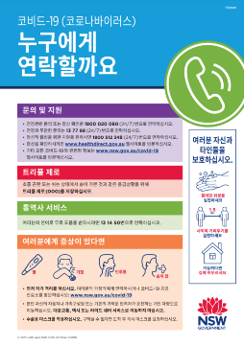
Korean: COVID Safe community information
If you have symptoms – poster
Avoid large family gatherings
Physical distancing – poster
COVID-19 – who to call – poster
Additional resources:
Look after your mental health during COVID-19 – poster

Slide 18
Korean: COVID Safe business information
Show your commitment to COVID Safety and keeping our community safe. Complete a COVID-19 Safety Plan and register as a COVID Safe business.
Links to translated COVID Safe Plans for businesses:
Example of the Korean COVID-Safe poster received on registration
General
Beauty, Nail, Waxing, Massage and Tattoo parlours, Tanning, and Hairdressing Salons
Restaurants and Cafes including food courts
For more information on COVID Safe businesses, go to www.nsw.gov.au/covid-19/covid-safe-business

Slide 19
Korean: Media campaign assets
Get tested press ad
Continue healthcare press ad
Get tested (clinics) radio ad
Distancing radio ad

Slide 20
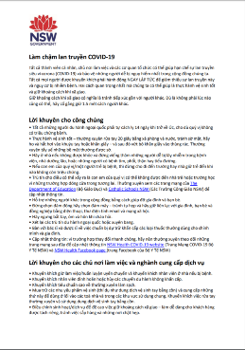
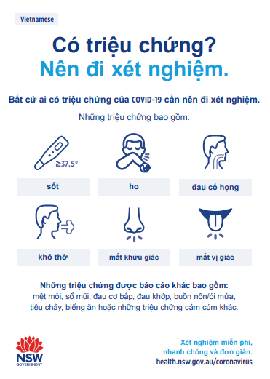
Vietnamese: COVID Safe community information
Links to translated PDF documents to download:
COVID-19 – Help us stop the spread - poster
How to slow the spread – factsheet
Hygiene etiquette to stop the spread – poster
If you have symptoms – poster

Slide 21
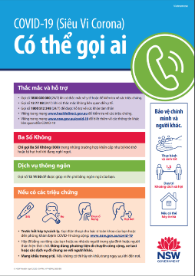
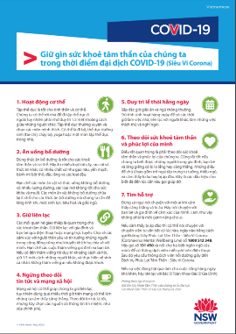
Vietnamese: COVID Safe community information
Avoid large family gatherings
Physical distancing – poster
COVID-19 – who to call – poster
Look after your mental health during COVID-19 – poster
Additional resources:
Tell staff if you have symptoms – poster

Slide 22
Vietnamese: COVID Safe business information
Show your commitment to COVID Safety and keeping our community safe. Complete a COVID-19 Safety Plan and register as a COVID Safe business.
Links to translated COVID Safe Plans for businesses:
Example of the Vietnamese COVID-Safe poster received on registration
General
Beauty, Nail, Waxing, Tanning and Hairdressing Salons
Restaurants and Cafes including food courts
For more information on COVID Safe businesses, go to www.nsw.gov.au/covid-19/covid-safe-business

Slide 23
Vietnamese: Media campaign assets
Get tested (clinics) radio
Distancing radio
Border Entry social ad
Stay safe family gatherings press ad
Get tested press ad
Mental wellbeing video
Continue healthcare video

Slide 24
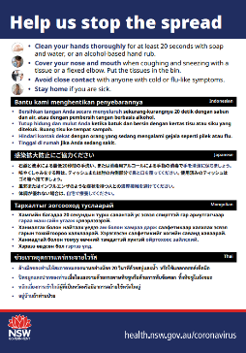
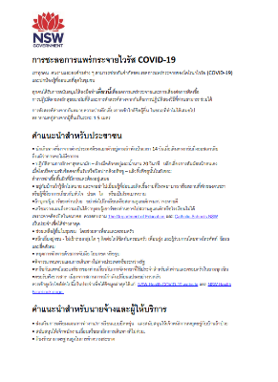
Thai: COVID Safe community information
Links to translated PDF documents to download:
Help us stop the spread – brochure
Slowing the spread - factsheet
Tell staff if you have symptoms - poster
Hygiene etiquette to stop the spread - poster

Slide 25
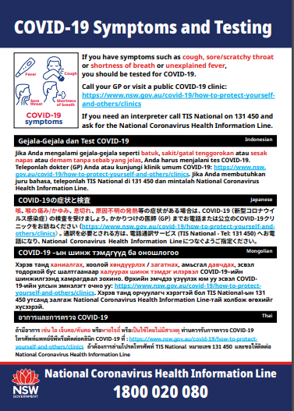
Thai: COVID Safe community information
If you have symptoms - poster
Physical distancing - poster
Who to call - poster
Avoid large family gatherings

Slide 26
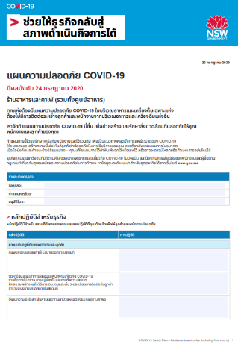
Thai: COVID Safe business information
Show your commitment to COVID Safety and keeping our community safe. Complete a COVID-19 Safety Plan and register as a COVID Safe business.
Links to translated COVID Safe Plans for businesses:
Example:
General
Restaurants and Cafes including food courts
Beauty, Nail, Waxing, Tanning and Hairdressing Salons
For more information on COVID Safe businesses, go to www.nsw.gov.au/covid-19/covid-safe-business

Slide 27
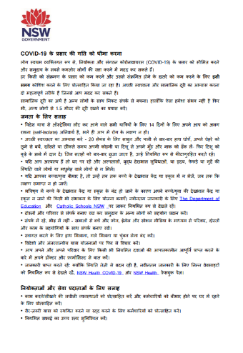
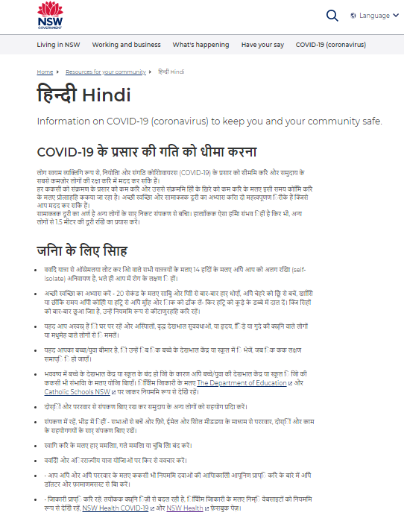
Hindi: COVID Safe community information
Slowing the spread – factsheet
Information on COVID-19

Slide 28
Hindi: Media campaign assets
Get tested (clinics) radio
Get tested (symptoms) radio
Stay safe family gatherings press ad
(English for Indian press)
Distancing press ad
(English for Indian press)

Slide 29
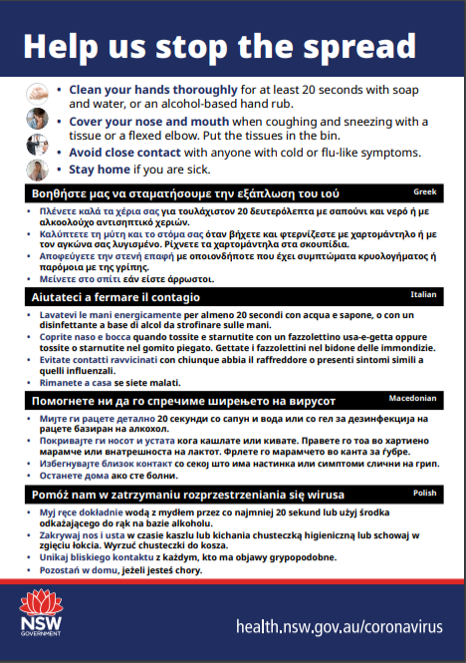
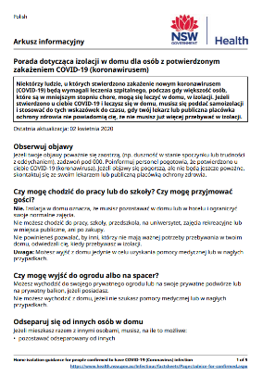
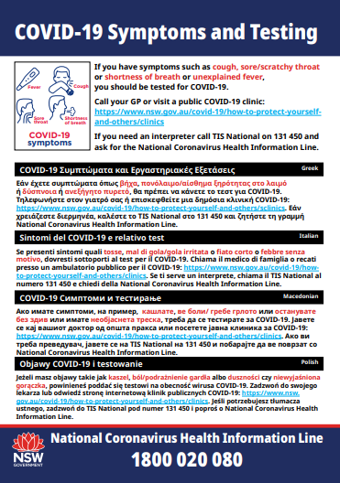
Polish: COVID Safe community information
Links to translated PDF documents to download:
Help us stop the spread – brochure
Home isolation guide – factsheet
Physical distancing – poster
Tell staff if you have symptoms – poster

Slide 30
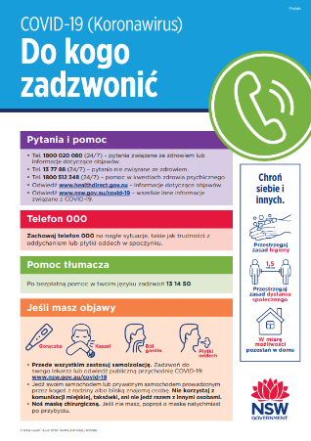
Polish: COVID Safe community information
COVID-19 – who to call – poster
Avoid large family gatherings

Slide 31
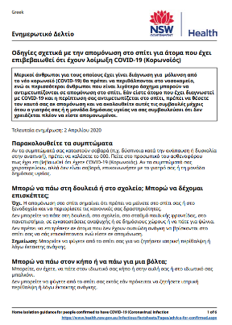
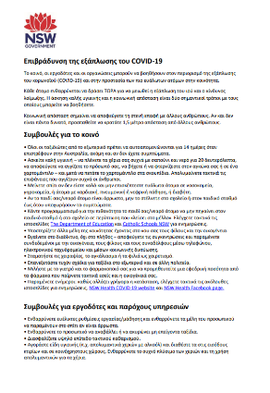
Greek: COVID Safe community information
Links to translated PDF documents to download:
Help us stop the spread – brochure
Home isolation guidelines for people confirmed to have COVID-19 infection – factsheet
Slowing the spread of COVID-19 – factsheet
Hygiene etiquette – help us stop the spread – poster

Slide 32
Greek: COVID Safe community information
If you have COVID-19 symptoms, call your doctor – poster
Tell staff if you have COVID-19 symptoms – poster
Avoid large family gatherings
Keeping everyone safe: physical distancing – poster
COVID-19: Who to call – poster
Look after your mental health during the COVID-19 pandemic – poster

Slide 33
Greek: Media campaign assets
Get tested press ad
Continue healthcare press ad
Get tested (clinics) radio
Distancing radio

Slide 34
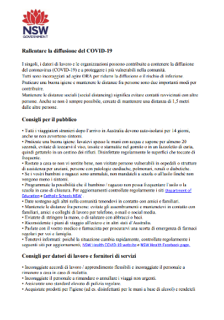
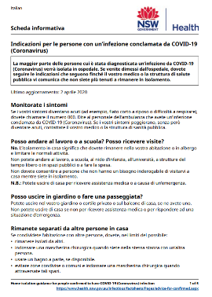
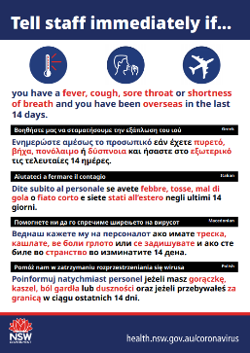
Italian: COVID Safe community information
Links to translated PDF documents to download:
Help us stop the spread – brochure
Slowing the spread of COVID-19 – factsheet
Home isolation guidelines for people confirmed to have COVID-19 infection – factsheet
Tell staff if you have COVID-19 symptoms – poster

Slide 35
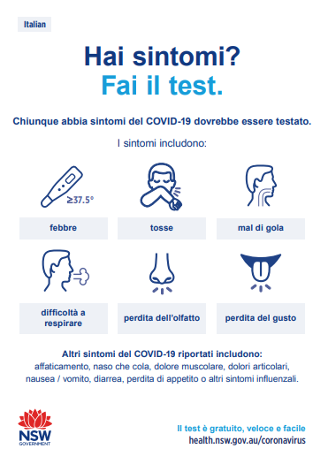
Italian: COVID Safe community information
If you have COVID-19 symptoms, call your doctor – poster
Tell staff if you have COVID-19 symptoms – poster
Avoid large family gatherings
Keeping everyone safe, physical distancing – poster
COVID-19, who to call – poster
Look after your mental health during the COVID-19 pandemic – poster
Hygiene etiquette – help us stop the spread – poster

Slide 36
Italian: Media campaign assets
Stay safe family gatherings press ad
Get tested press ad
Distancing radio
Get tested (clinics) radio

Slide 37
Spanish: Media campaign assets
Get tested press ad
Continue healthcare press ad
Get tested (clinics) radio
Get tested (symptoms) radio

Slide 38
Punjabi: Media campaign assets
Get tested (symptoms) radio
Get tested (clinics) radio

Slide 39
Thank you

