Slide 1
NSW / VIC border region Social content and more information
September 2020

Slide 2
What are the changes to the border?
From Friday 4 September:
There is now a single border region and there’s no longer a border zone.
The border region has been extended out on each side of the border
Residents now included in the expanded border region can apply for a new border region resident permit to travel within the region.
Border zone resident permits or critical service border region permits received before Friday 4 September will continue to be valid until the permit’s date of expiry. When these expire, residents can apply for the new border region permit.
The new permit will allow a resident within the border region to enter NSW:
to obtain necessary goods or services (this means you can go out and shop for items for your everyday needs)
for care or other compassionate reasons
to attend work or obtain educational services (where it is not reasonable for the person to work or obtain educational services from their state of residence)
to move to a new place of residence.
A border region resident who is a NSW resident:
is authorised to enter Victoria only for the reason allowed in the permit
must not travel to any part of Victoria that is outside of the border region or is a COVID-19 area of concern.
A border region resident who is a Victorian resident:
is authorised to enter and remain in NSW only for the reason allowed in the permit
must not travel to any part of NSW that is outside of the border region
must comply with Victorian COVID-19 restrictions
must not enter NSW if the resident had travelled in Victoria in a restricted area (which is currently Greater Melbourne), or a COVID-19 area of concern in Victoria within the previous 14 days.

Slide 3
Infographic for sharing
Changes have been made to the NSW-VIC border to help local people and businesses. Here’s what’s changed: • a single border region has been reinstated (extended either side of the border) • a new ‘border region resident’ permit came into effect on Friday 4 September. More info https://www.nsw.gov.au/covid-19/nsw-vic-border-residents

Slide 4
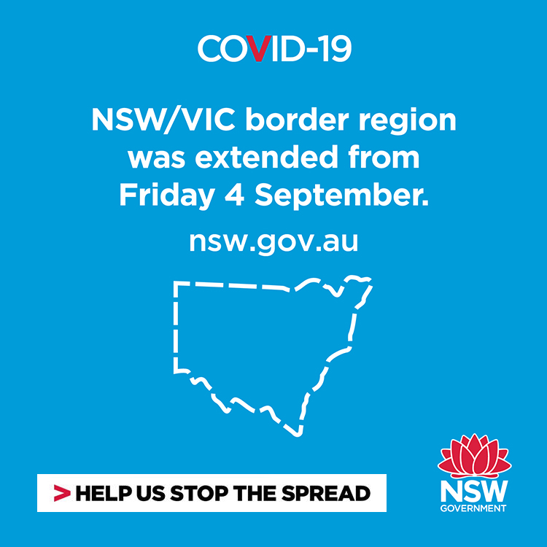
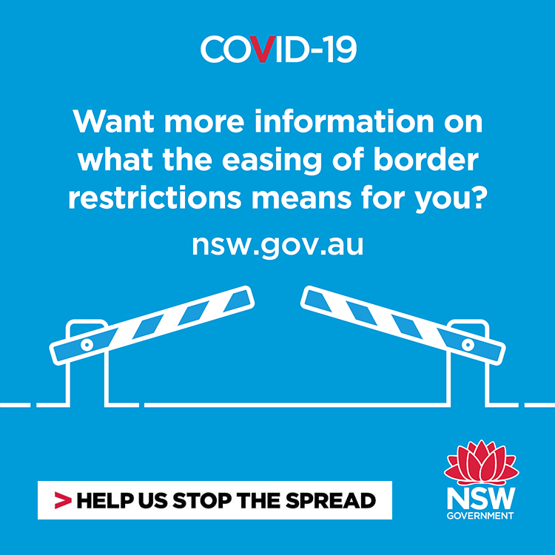
More infographics for sharing
Tiles:

Slide 5
NSW Government Facebook posts for sharing
Links to NSW Government Facebook posts you can share with your networks
https://www.facebook.com/197070314013807/posts/1467456073641885/?dco_ad_id=23845769003660674
https://www.facebook.com/197070314013807/posts/1450080175379475/?dco_ad_id=23845549069770674
https://www.facebook.com/197070314013807/posts/1467456956975130/?dco_ad_id=23845769024400674
https://www.facebook.com/197070314013807/posts/1467456936975132/?dco_ad_id=23845769110080674

Slide 6
Social copy
Channel | Suggested copy
Facebook/LinkedIn | Given the reduced risk of community transmission in regional VIC, and the efforts of our border communities. The NSW/VIC border region was extended from Friday 4 September. Border region residents can travel within the area for work, school, care and to access necessary services, but will need a permit. Visit www.nsw.gov.au/covid-19/nsw-vic-border-residents for more information
Twitter | New extended border region & permit in place. For more info visit www.nsw.gov.au/covid-19/nsw-vic-border-residents
Instagram | The NSW/VIC border region has been extended. Border region residents can travel within the area for work, school, care and to access necessary services, but will need a permit. For more information visit www.nsw.gov.au/covid-19/nsw-vic-border-residents

Slide 7
More information
More information:
For information about COVID-19 and border closures and entry permits, go to www.nsw.gov.au/covid-19/nsw-vic-border-residents.
There is also a Closing the NSW border easy to read guide available.
Use the border region address check tool to check which areas are now included in the extended border region.
Call the Service NSW contact centre on 137788.

