Slide 1
COVID Safe Check-in Communications pack for businesses
For any high res images or for more information contact bradley.matthews@customerservice.nsw.gov.au

Slide 2
COVID Safe Check-in launched
The NSW Government has launched a safe and easy digital check-in tool for businesses and customers.
The Service NSW app now features a COVID Safe Check-in tool to allow customers to check in at venues across NSW.
To help communicate this free tool with businesses and contacts in your network, we have developed this pack with content for you to use and share.

Slide 3
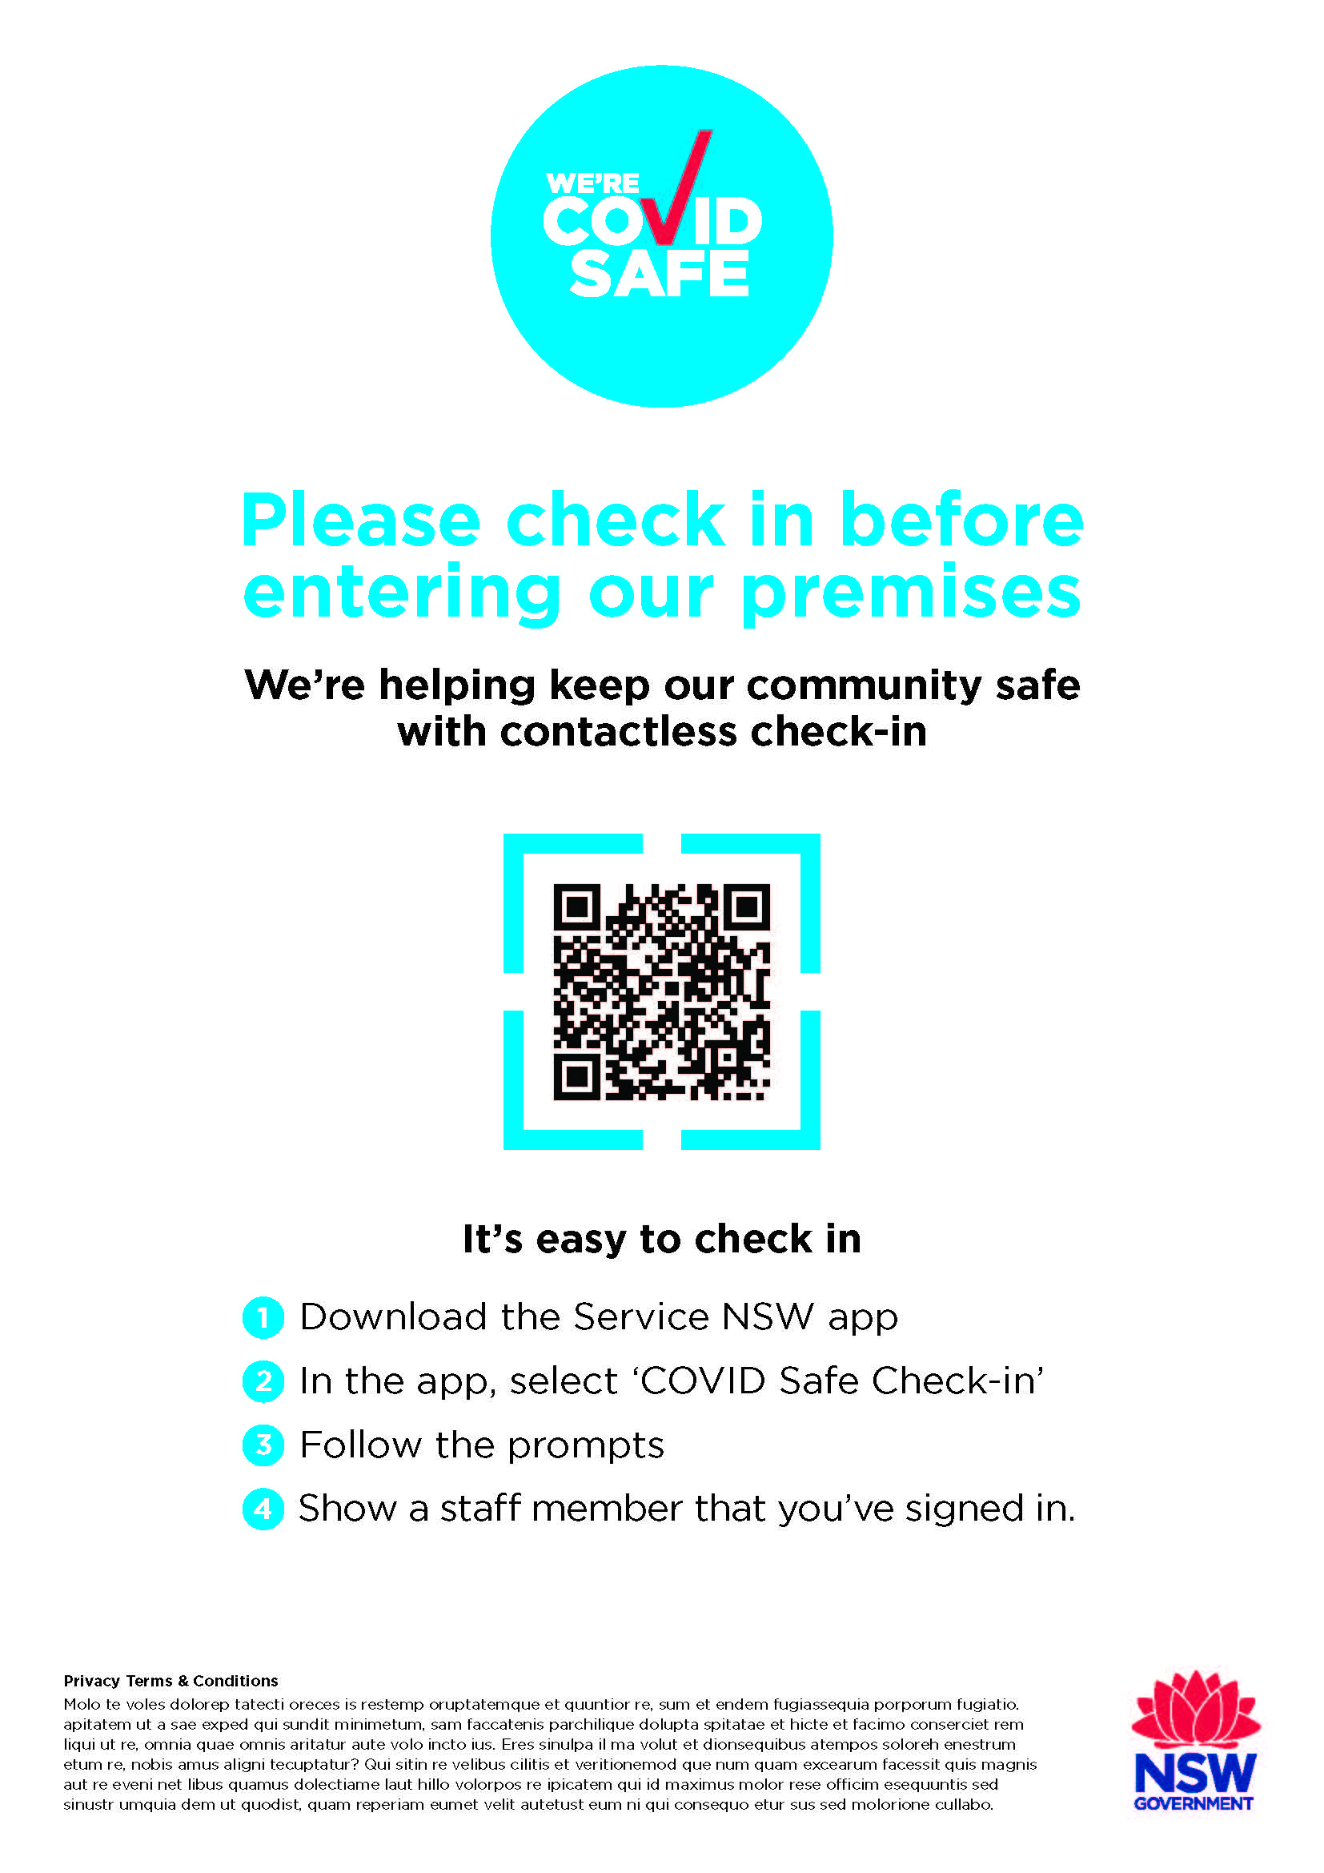
What does this mean for me?
Example of a QR code
Businesses
Customers
Record keeping is mandatory for many businesses.
COVID Safe businesses can download and display their unique COVID Safe Check-in QR Code at their venue for customers to use.
Participation is voluntary.
Customers use the COVID Safe Check-in feature on their Service NSW app to check in.
It’s quick, easy and contactless.

Slide 4
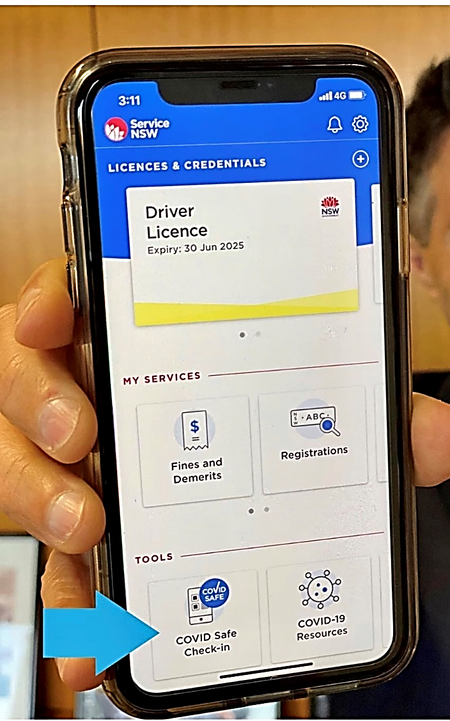
How the COVID Safe Check-in will work
When a business registers as COVID Safe at nsw.gov.au​, they will be given a unique QR code to display in their store.
When a customer visits, they simply scan the QR code to check-in.
The customer will be prompted to download and install the Service NSW app if they need to.
The Service NSW app will then verify the customer and register them as being at the business.
Customers can use the app to check in quickly and easily. It’s contactless (so they don’t need to share a pen) and their personal data is stored securely.
Businesses will find the app is a free, secure, easy way to meet requirements for the collection and storage of customer contact details, which may be used for contact tracing purposes if required.
The NSW Government has developed a free digital registration tool called the COVID Safe Check-in, on the Service NSW app.
This tool will help businesses to remain COVID safe and meet requirements for the collection and storage of customer contact details.

Slide 5
More messages for customers and businesses
Customers:
We’ve seen how quickly COVID can spread and the impact it can have on businesses, community and the economy.
To help stop the spread of COVID-19, most businesses must keep a record of who has visited their premises. This information may be used by NSW Health to assist with contact tracing. Contact tracing is one of the most powerful tools to stop the spread of COVID-19 in our community.
The COVID Safe Check-in has gone live across NSW. Many businesses are already participating.
All you need to do is scan the COVID Safe Check-in QR code with your phone's camera when you enter any business with the COVID Safe Check-in QR code displayed.
It’s a simple step, but one of the most important things you can do to protect yourself and the community.
Business:
Keeping records of those who have entered a business is key to stopping the spread of COVID-19. It enables NSW Health to conduct vital contact tracing and stop the spread of COVID-19 within the community.
To help businesses with this record keeping, the NSW Government is offering a new COVID Safe Check-in feature in the Service NSW App.
The COVID Safe Check-in has gone live across NSW. Many businesses are already participating.
Businesses registered as a COVID Safe business will receive an email with their unique QR code.
All businesses must to do the right thing if we are to keep the virus in check.
Registering as COVID Safe is mandatory for many businesses and strongly encouraged for all. It’s an important way that every business can support the community and help our economy recover.
As customers are verified by the app, businesses can be confident that accurate customer details have been stored for NSW Health to access for contact tracing purposes, if required.

Slide 6
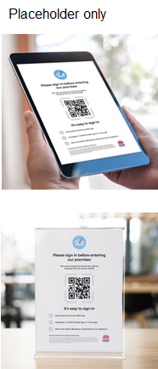
COVID Safe Check-in copy for a newsletter, eDM or web
COVID Safe businesses can use a new QR code check-in system
The new COVID Safe Check-in makes COVID Safe record keeping easier for businesses and sign-in quick and contactless for customers.
Businesses who have registered as COVID Safe at nsw.gov.au will receive an invitation from the NSW Government to download their unique COVID Safe Check-in QR code, to display in their stores.
Customers use their Service NSW app to scan the QR code and the check-in automatically captures the date, time and location, and stores them securely on a NSW Government database for the sole purpose of COVID-19 contact tracing. After 28 days, the data is destroyed.
This tool provides a voluntary option for interested businesses and anyone who has been unable to access this type of system. Businesses already using QR codes can continue to do so.
Customers will find the app is quick and simple to use. It’s contactless and their personal data is secure.
Electronic record-keeping is encouraged for all businesses and is compulsory for many industries. COVID Safe Check-in provides a free, secure, accurate and easy way to meet the requirements for the collection and storage of customer details.
Registering when you enter a business could help stop the spread of COVID-19 in our community. We’ve seen how quickly COVID-19 can spread and the impact it can have on businesses, community and the economy. It’s a simple step, but one of the most important things you can do to protect yourself and the community.
Example images - high res available on request

Slide 7
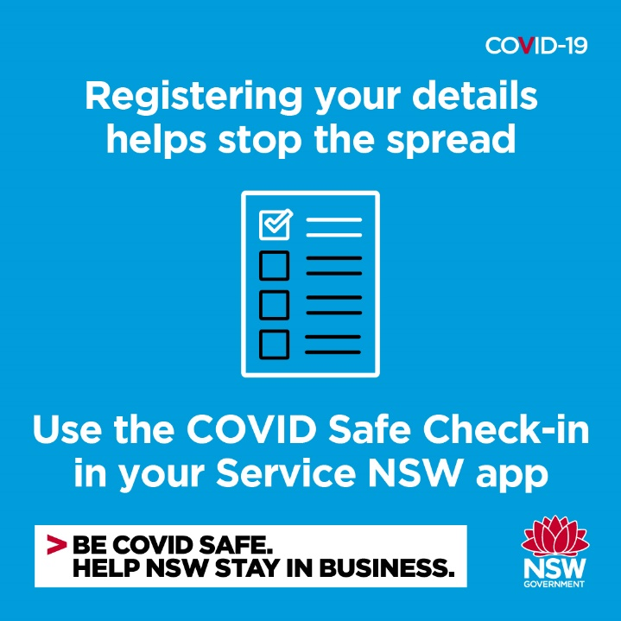
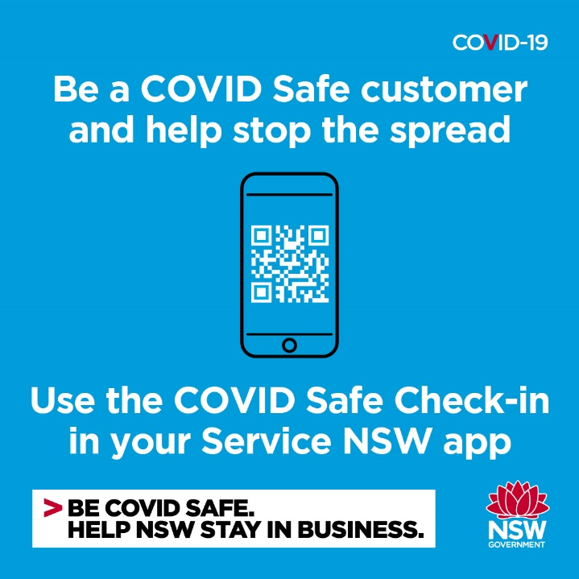
Social posts targeting customers
Registering when you enter a business can help to stop the spread of COVID-19 in our community. The Service NSW app has a new COVID Safe Check-in designed to make this easier. Try it out.
We all need to ensure we are COVID Safe customers. Part of this means registering when you visit our business. Make sure you have the Service NSW app downloaded so you can simply scan and register without the need for forms.
To make it easier to register when you enter a business, use the COVID Safe Check-in feature on your Service NSW app so you can scan in without having to fill out forms.

Slide 8
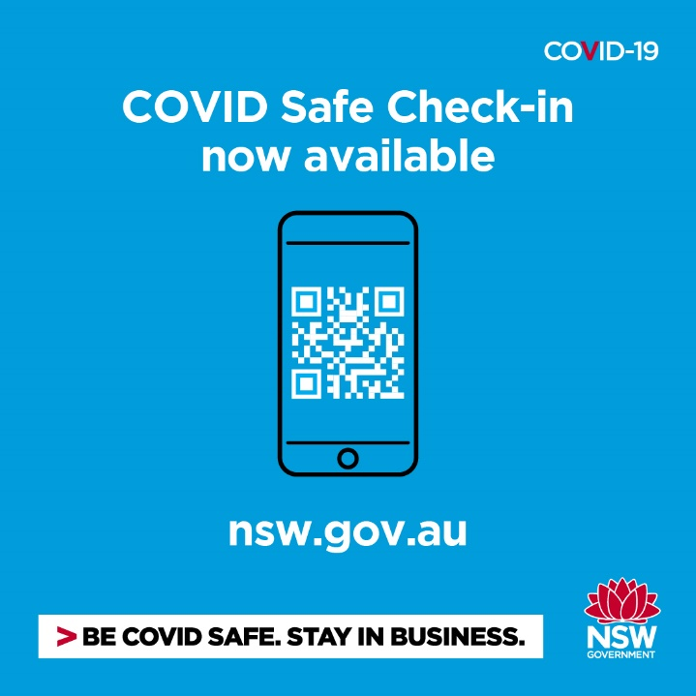
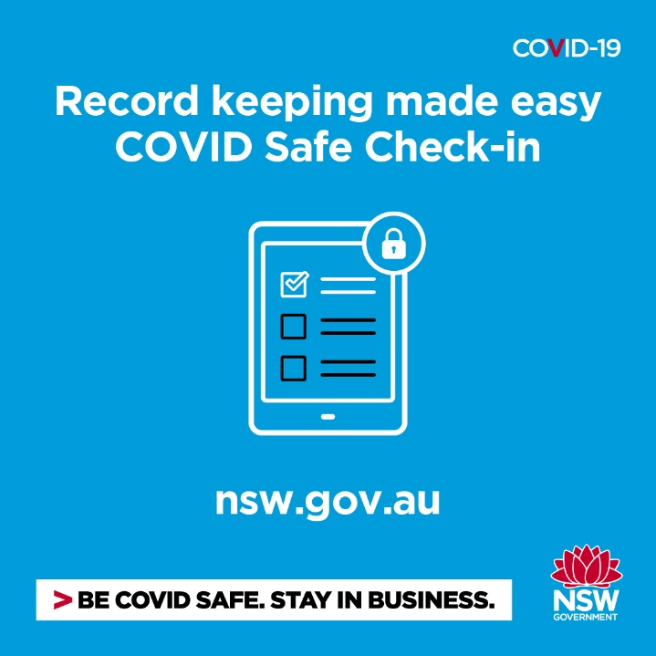
Social posts targeting businesses
Electronic record-keeping is now compulsory for many businesses. Need a way to do this? Register as a COVID safe business to receive your unique NSW Government QR code for safe customer check-ins.
Record-keeping is a key part of keeping businesses open and the community safe. The COVID Safe Check-in is a free QR code-based registration system run through the Service NSW app to capture customer details for contact tracing purposes.
COVID Safe Check-in is a simple QR code-based system to help make your record keeping easy. Register as a COVID Safe business today to get access to the system.

