Slide 1
Three types of Public Health Alerts toolkit
There are three types of Public Health Alerts NSW Health might issue to a community regarding cases of COVID-19 in its local area.
These are:
Increased testing alert
Casual contact location alert to monitor for symptoms
Close contact location alert self-isolate and get tested immediately
This pack contains communications material you can use should any of these scenarios occur in your community plus Mental Health and Wellbeing support material.

Slide 2
Scenario 1: Increased testing alert
If an area or suburb is identified by NSW Health as having a growing number of COVID cases, or are places where NSW Health wants to increase testing to find any cases in that area, for example if an area has been exposed to a COVID-19 case during the infectious period or if there has been community transmission with unknown links, an ‘increased testing alert’ will be issued for that community to stay vigilant for symptoms.
Encouraging people to stay vigilant by monitoring and undertake testing for even the mildest symptoms is critical to our COVID response.
The following messaging and content (both branded and unbranded) has been designed to help you communicate this to your community.
Locations are identified listed and updated daily on nsw.gov.au.

Slide 3
Increase testing alert: Example messaging
These messages are designed to include at least one of the three elements in each communication.
What is the situation?
NSW Health will issue an alert for areas where case numbers are growing, or where there are unlinked cases to encourage increased vigilance from that community. This is called an “increased testing alert”.
Due to a growing number of cases in [insert area/suburb], NSW Health has identified our community as needing increased vigilance to stop the spread.
Remaining alert to symptoms and increased testing is the quickest way to identify cases in our community and contain the spread of the virus.
What should the community do?
If you show any symptom of COVID-19, even if mild, get tested immediately. Even if you have been tested before.
Symptoms of COVID-19 include fever (≥37.5), cough, sore/scratchy throat, shortness of breath (difficulty breathing), runny nose, loss of smell and loss of taste. Other symptoms include joint pain, muscle pain, headache, diarrhoea, nausea/vomiting and loss of appetite.
Testing is available at pop-up or drive through clinics, your GP, a COVID-19 clinic or hospital. Find your nearest COVID-19 testing clinic, wear a mask to and from the clinic and importantly, you must go straight home and self-isolate while you wait for your results
Visit nsw.gov.au/covid-19 to learn more about being COVID Safe and looking after your mental health and wellbeing during this time
You can subscribe to RSS to keep up to date with the latest media releases from NSW Health or follow NSW Health on Facebook.
Why is it necessary to act now?
The next few weeks are important for our community. The more people in [insert area/suburb] who get tested, the better we can tackle the spread of this virus.
By getting tested and isolating if you are sick, you are protecting your loved ones and others in our community from catching the virus. You are also helping local business stay open, our community to continue to play sport, ensuring family and friends can see each other in a COVID Safe way.
We can’t be complacent. We are at a critical point of the pandemic and testing plays a crucial role in helping us stop the curve from rising again.

Slide 4
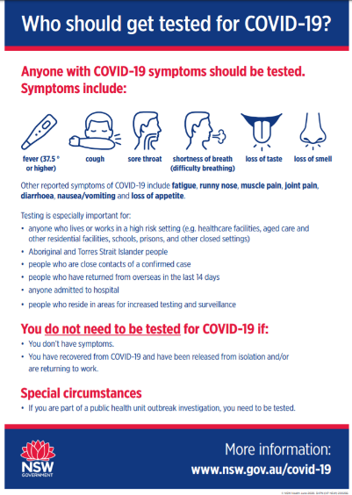
Increase testing alert: Example newsletter / website copy
Increase testing needed to combat growing number local COVID cases
As part of the measures in place to keep COVID-19 numbers in check, NSW Health has alerted us that our area is an area requiring increased testing.
For this reason, all residents are urged to get tested if you experience even the mildest COVID-19 symptom, such as a runny nose.
Testing is the quickest way we can identify cases in our community and keep the spread of the virus contained. We can’t be complacent. We are at a critical point of the pandemic and testing plays a crucial role in helping us stop the curve from rising again.
If you show any symptom of COVID-19, even if mild, get tested immediately. Even if you have been tested before. The main symptoms of COVID-19 are fever, cough, sore/scratchy throat, shortness of breath, loss of smell, loss of taste and runny nose. Other symptoms include joint pain, muscle pain, headache, diarrhoea, nausea/vomiting and loss of appetite.
NSW Health recommends that anyone with these symptoms get tested for COVID-19 at pop-up or drive through clinics, your GP, a COVID-19 clinic or hospital. Find your nearest testing clinic.
The next few weeks are critical. The more people in [insert area/suburb] who get tested, the better we can tackle the spread of this virus.
It’s never been more important to do the right thing. By getting tested and isolating if you are sick, you are protecting your loved ones and others in our community from catching the virus.
You are also helping local business stay open, our community to continue to play sport, ensuring family and friends can see each other in a COVID Safe way.
Link to download

Slide 5
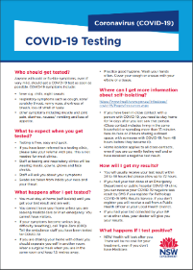
Increase testing numbers: Example script and Q&A for call centre operators
Due to a growing number of confirmed COVID-19 cases in the community NSW Government is calling on all residents in [area/Suburb] to be extra vigilant and get tested even with just the slightest symptoms. This is an important part to ensuring the virus can stay in check and to stop the spread in our community.
Testing centers are located at [locations].
Even if you have no symptoms you need to be extra vigilant during this time. Being COVID Safe means choosing to stay 1.5m apart from those we don’t live with, washing your hands regularly to prevent the spread, wearing a mask in areas where it is hard to keep 1.5m distance, and being alert to any symptoms.
Thank you for helping our community stay COVID Safe.
Q: Why has NSW Government listed [area/suburb]?
A: Due to a growing number of cases [insert date] NSW Gov identified [insert area] as an area where increased vigilance is needed to control the spread of COVID-19, with residents urged to get tested if they experience even mild symptoms.
Q: What are the symptoms I should be looking out for?
A: Symptoms of COVID-19 include fever (≥37.5), cough, sore/scratchy throat, shortness of breath, loss of smell, loss of taste and runny nose. Other symptoms include joint pain, muscle pain, headache, diarrhoea, nausea/vomiting and loss of appetite.
Q: Where do I go to get tested?
A: [ask for postcode an use the testing clinic finder tool: https://www.nsw.gov.au/covid-19/how-to-protect-yourself-and-others/clinics]
Q: Will [area/suburb] have to go back into lock down?
A: If all [area/suburb] residents get tested with even the mildest symptoms, we will be able to perform contact tracing and manage case levels, and should be able to continue as we have been.
Q: How can I keep track of what areas have cases of COVID-19?
A: Locations are identified by NSW Health and listed and updated daily on nsw.gov.au or you can call 13 77 88
The most up to date information can be found at nsw.gov.au or by calling 13 77 88.
COVID-19 Testing factsheet
Link to download
Translations

Slide 6
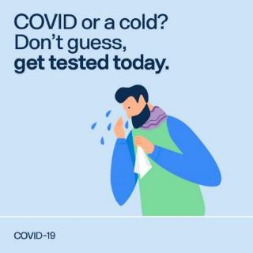
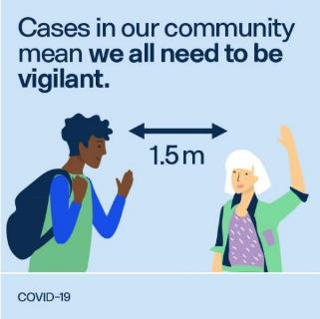
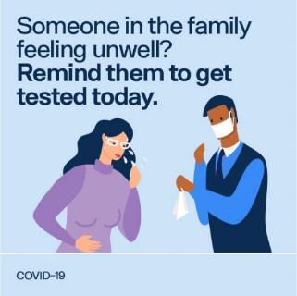
Increase testing numbers: Example social posts (non branded)
Tiles:
LOGO HERE
LOGO HERE
LOGO HERE
Post
Post
Post
Even mild symptoms like a cough can be a sign of COVID-19. Get peace of mind by getting tested. Find a testing clinic near you. https://www.nsw.gov.au/covid-19/how-to-protect-yourself-and-others/clinics
We need to keep testing numbers up to get through this together. If you’re feeling unwell, get tested and stay home while you wait for your results. https://www.nsw.gov.au/covid-19/how-to-protect-yourself-and-others/clinics
Even if your symptoms are mild you should get tested and stay home. Find your nearest testing clinic https://www.nsw.gov.au/covid-19/how-to-protect-yourself-and-others/clinics

Slide 7
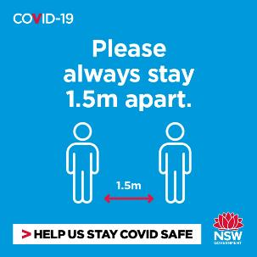
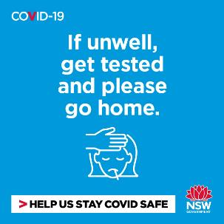
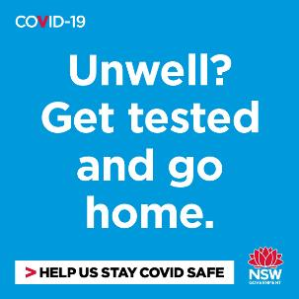
Increase testing numbers: NSW Government social posts
Tiles:
Post
Post
Post
Even if you have no symptoms we all need to be extra vigilant during this time. This means choosing to stay 1.5m apart from those we don’t live with, washing your hands, wearing a mask in busy areas, and being alert to any symptoms.
It’s never been more important to do the right thing. By getting tested and isolating if you are sick, you are protecting your loved ones and others in our community from catching the virus. https://www.nsw.gov.au/covid-19/how-to-protect-yourself-and-others/clinics
Testing is the quickest way we can identify cases in our community and keep the spread of the virus contained. If you experience any symptoms you should get tested. Find your nearest testing clinic: https://www.nsw.gov.au/covid-19/how-to-protect-yourself-and-others/clinics

Slide 8
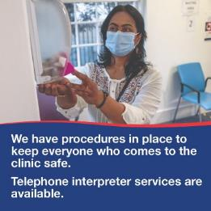
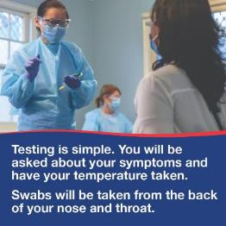
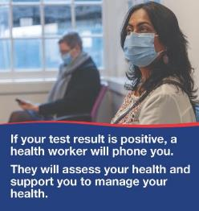
Increase testing numbers: NSW Government social posts and translation links
Tiles (canbe shared as a carousel post on instagram or facebook):
Link to download
Translations available

Slide 9
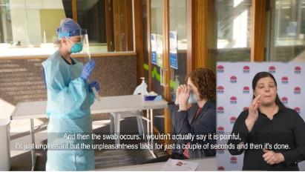
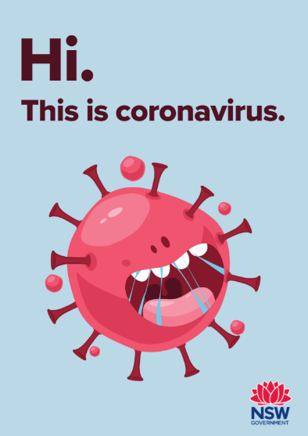
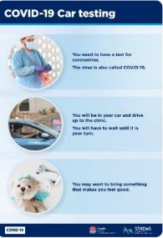
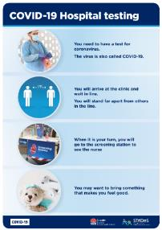
Increase testing numbers: What to expect
COVID-19 test: What to expect video Link to download
Children’s book Link to download
Easy read guide links
Car testing
Hospital testing

Slide 10
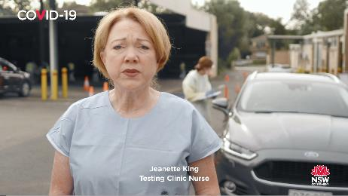
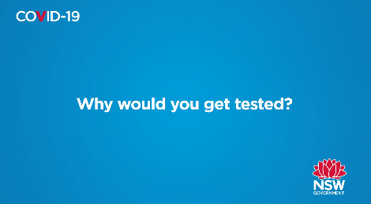
Increase testing alert: Videos for web and social
Link to download
Link to download
Link to download
Link to download

Slide 11
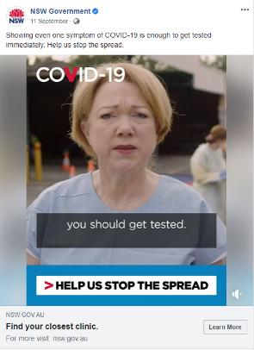
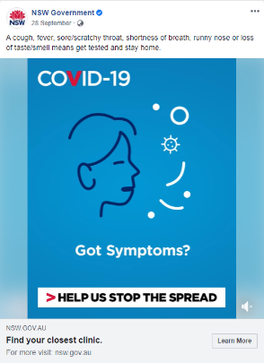
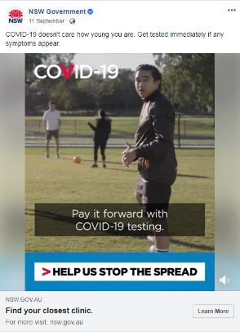
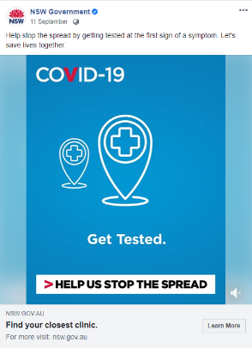
Increase testing numbers: NSW Government social links to share
Link
Link
Link
Link

Slide 12
Scenario 2: Casual contact location alert to monitor for symptoms
NSW Health contact tracers will identify locations visited by a confirmed case while possibly infectious. Locations can be a venue or public transport.
Individuals who were at that location but:
did not have direct close contact, or
were there for less than 15 minutes, or
were there at a different time
to the confirmed case are classified as casual contacts.
A ‘Monitor for Symptoms’ alert is issued for casual contacts to encourage them to be vigilant for symptoms and undergo testing if required.
Locations are listed and updated daily on nsw.gov.au, and will remain on the website for 14 days after the confirmed case was in attendance.
The following messaging and content (both branded and unbranded) has been designed to help you communicate this to your community.

Slide 13
Monitor for symptoms: Example messaging
Example messaging (these messages are designed to include at least one of the three elements in each communication)
What is the situation?
Confirmed cases of COVID-19 have been recorded in our local area, please see the locations/public transport routes they visited during the possible infection period
While the confirmed case may not have been in direct contact with anyone at the location/s evidence shows there is still a risk of contracting COVID-19
Testing is the quickest way we can identify cases in our community and keep the spread of the virus contained
We can’t be complacent. We are at a critical point of the pandemic and testing plays a crucial role in helping us stop the curve from rising again
What should the community do?
Anyone who visited these locations or travelled on nominated public transport routes during the time and date indicated is considered a casual contact of the confirmed case and is encouraged to monitor for symptoms of COVID-19 and get tested even if the symptoms are mild.
Symptoms of COVID-19 include fever (≥37.5), cough, sore/scratchy throat, shortness of breath (difficulty breathing), runny nose, loss of smell and loss of taste. Other symptoms include joint pain, muscle pain, headache, diarrhoea, nausea/vomiting and loss of appetite.
Testing is available at pop-up or drive through clinics, your GP, a COVID-19 clinic or hospital. Find your nearest COVID-19 testing clinic, wear a mask to and from the clinic and importantly, you must go straight home and self-isolate while you wait for your results
Visit nsw.gov.au/covid-19 to learn more about being COVID Safe and looking after your mental health and wellbeing during this time.
You can subscribe to RSS to keep up to date with the latest media releases from NSW Health or follow NSW Health on Facebook.
Why is it necessary to act now?
The next few weeks are critical. The more vigilant and alert to possible symptoms we are, the better we can tackle the spread of this virus.
By getting tested and isolating if you are sick, you are protecting your loved ones and others in our community from catching the virus. You are also helping local business stay open, our community to continue to play sport, ensuring family and friends can see each other in a COVID Safe way.
We can’t be complacent. We are at a critical point of the pandemic and testing plays a crucial role in helping us stop the curve from rising again.

Slide 14
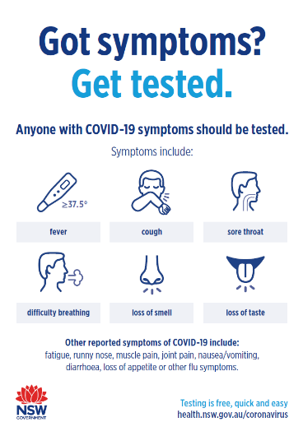
Monitor for symptoms: Example newsletter/website copy
Monitor for symptoms alert issued to casual contacts of COVID-19 case
Health authorities are advising visitors to [insert location/locations] to be extra vigilant after a confirmed case of COVID-19 visited [insert location/locations] in the [insert area] area during a possible infection period. As a community we have worked hard to put the health of NSW first to keep COVID-19 in check, and we need to keep this up.
While the confirmed case may not have been in direct contact with anyone at that venue evidence shows there is still a risk of contracting COVID-19.
Anyone who visited these locations during the indicated dates and times is considered a casual contact and should monitor for symptoms and get tested and self-isolate if they experience even the mildest symptoms.
As a community we need to remain vigilant, now more than ever. That means that we all need to be looking out for symptoms, and that anyone with respiratory symptoms, loss of sense of smell or taste, or unexplained fever should get tested for COVID-19.
Find your nearest testing clinic
The most up to date information can be found at nsw.gov.au or by calling 13 77 88.
If a family or friend is feeling unwell, remind them to get tested. No matter how mild the symptom.
By all playing our part and taking the right course of action, we have the best chance of containing the virus.
We don’t want our community to return to the restrictions we faced at the start of the pandemic.
By all doing the right thing we can continue to recover during the pandemic and protect the lives and livelihoods of those in NSW.
Link to download
Links to translations

Slide 15
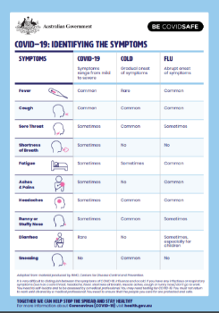
Monitor for symptoms: example script and Q&A for call centre operators
Due to a confirmed case of COVID-19 visiting [insert location/locations] in the [insert area] area during a possible infection period, health authorities are advising visitors to [insert location/locations] to be extra vigilant and monitor for any symptoms. This is an important part to ensuring the virus can stay in check and to stop the spread in our community.
Testing centres are located at [locations].
Even if you have no symptoms you need to be extra vigilant during this time. Being COVID Safe means choosing to stay 1.5m apart from those we don’t live with, washing your hands regularly to prevent the spread, wearing a mask in areas where it is hard to keep 1.5m distance, and being alert to any symptoms.
Thank you for helping our community stay COVID Safe.
Q: Which locations have been linked to a case of COVID-19?
A: On [insert date] a confirmed case of COVID-19 visited [insert venues] within [insert area] during a possible infection period, and so anyone who also visited this venue is advised to be extra vigilant and monitor for symptoms of COVID-19. To find the full list of locations and indicated dates and times go to https://www.nsw.gov.au/covid-19/latest-news-and-updates#monitor-for-symptoms-if-youve-been-to-these-locations.
Q: I’ve visited one of these locations on the list during the indicated date and time, what should I do?
A: Visitors to these locations are considered a casual contact of the confirmed case and are advised to monitor for any symptoms of COVID-19, and get tested and self-isolate if symptoms appear.
Q: What does a casual contact to a confirmed case of COVID-19 mean?
A: A casual contact is someone who may have been in the same venue/location as someone with a confirmed case of COVID-19 during a possible infection period. While the confirmed case may not have had direct contact with other people at that location evidence shows there is still a risk of contracting COVID-19 and so extra vigilance is required.
Q: What are the symptoms I should be looking out for?
A: Symptoms of COVID-19 include fever (≥37.5), cough, sore/scratchy throat, shortness of breath (difficulty breathing), runny nose, loss of smell and loss of taste. Other reported symptoms include fatigue, muscle pain, joint pain, headache, diarrhoea, nausea/vomiting or loss of appetite.
Q: Will [area/suburb] have to go back into lock down?
A: If all [area/suburb] residents get tested with even the mildest symptoms, we will be able to effectively contact trace and manage case levels, and should be able to continue as we have been.
Q: Where do I go to get tested?
A: [ask for postcode an use the testing clinic finder tool: https://www.nsw.gov.au/covid-19/how-to-protect-yourself-and-others/clinics ]
Q: How can I keep track of what areas have cases of COVID-19?
A: Locations are identified by NSW Health and listed and updated daily on nsw.gov.au or you can call 13 77 88
Identifying the symptoms
COVID-19 factsheet
Link to download
The most up to date information can be found at nsw.gov.au or by calling 13 77 88.

Slide 16
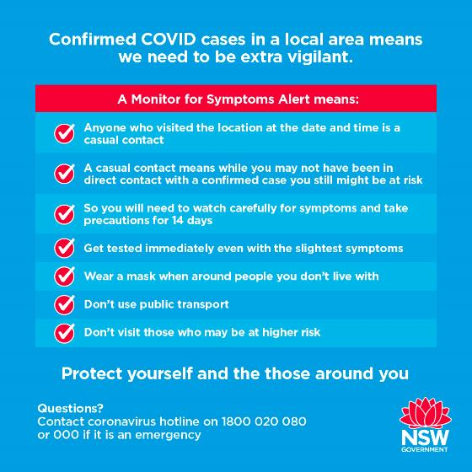
Monitor for symptoms: Infographic

Slide 17
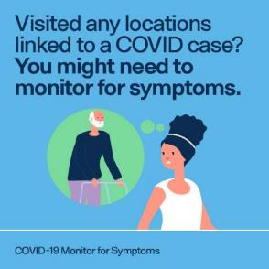
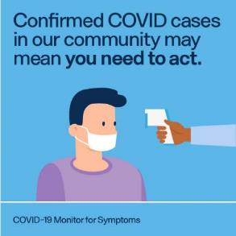
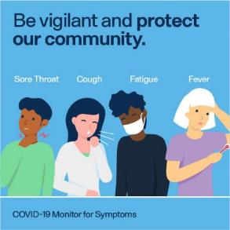
Monitor for symptoms: Example social posts (non branded)
Tiles:
LOGO HERE
LOGO HERE
LOGO HERE
Post
Post
Post
If you have been to [insert locations, dates, times] you are advised to stay home and monitor for symptoms. Find out the latest information at nsw.gov.au
Cases in the area mean we all need to be vigilant. Check whether you might have been in the same location as a case and stay home and monitor for symptoms. Find out more: nsw.gov.au
If you’ve been in close contact with a confirmed or suspected case of COVID-19, the best thing you can do is stay home and monitor for symptoms. Find information on nearby cases at https://www.nsw.gov.au/covid-19/latest-news-and-updates#latest-covid-19-case-locations-in-nsw

Slide 18
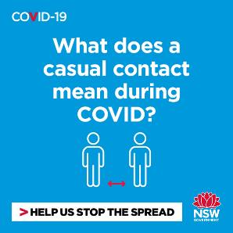
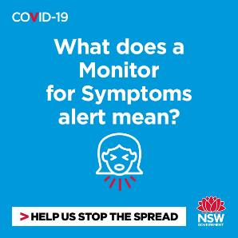
Monitor for symptoms: Example social posts
Tiles:
Tiles:
Post
Post
Post
A casual contact is considered someone who has been in the same location as a confirmed case of COVID-19 during a possible infection period. While the confirmed case may not have had direct contact with other people at that location evidence shows there is still a risk of contracting COVID-19 and so extra vigilance is required. Find out more: nsw.gov.au
A Monitor for Symptoms alert is issued when a confirmed case of COVID-19 has been to a location during a possible infection period. The alert is issued to help the community be extra vigilant when they need to be, and help organisations protect their staff and customers. Find out more: nsw.gov.au
Check if you’ve visited a location on the Monitor for Symptoms alert list. The more vigilant and alert to possible symptoms we are, the better we can tackle the spread of this virus. Testing is the quickest way we can identify cases in our community and keep the spread of the virus contained. Nsw.gov.au

Slide 19
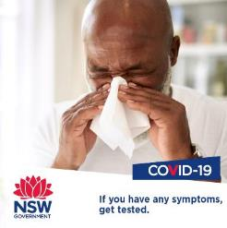
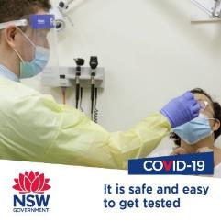
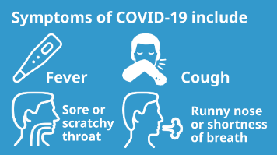
Monitor for symptoms: NSW Government social posts and translation links
Tiles:
Link to download
Link to download
Link to download
Link to download
GIF:
Link to download

Slide 20
Scenario 3: Close contact location alert self-isolate and get tested immediately
In some circumstances, NSW Health may classify individuals who visited the same location as a confirmed positive case as a ‘close contact’.
In this instance, a ‘Self-Isolate and Get Tested Immediately’ alert will be issued.
Individuals classified as a close contacts must immediately self-isolate and get tested, even if they have no symptoms. Once tested they must continue to self isolate until the date specified by a public health official (usually two weeks), regardless of a positive or negative test result.
The following messaging and content (both branded and unbranded) has been designed to help you communicate this to your community.
Locations are listed and updated daily on nsw.gov.au, and will remain on the website for 14 days after the confirmed case was in attendance.

Slide 21
Self-isolate and get tested: Example messaging
Example messaging (these messages are designed to include at least one of the three elements in each communication)
What is the situation?
Due to a confirmed case of COVID-19 visiting [insert location/locations] in the [insert area] area during a possible infection period, a self-isolate and get tested alert has been issued.
If you have visited [insert location/locations], health authorities consider you a close contact and it is critical that you get tested and immediately self-isolate.
See all the locations/public transport routes linked to cases
What should the community do?
If you visited one of the locations it is extremely important that you self-isolate immediately and get tested, even if you’re not experiencing symptoms.
You can be tested through your local doctor, or at a designated COVID testing clinic and should wear a mask to and from the clinic.
Find your nearest COVID-19 testing clinic
You must self-isolate for 14-days, even if your test result is negative, as it can take 14 days before you show symptoms or test positive.
Visit nsw.gov.au/covid-19 to learn more about being COVID Safe and looking after your mental health and wellbeing during this time.
You can subscribe to RSS to keep up to date with the latest media releases from NSW Health or follow NSW Health on Facebook.
Why is it necessary to act now?
The next few weeks are critical. By following the guidance to self isolate and get tested we are giving our community the best chance of tackling the spread of this virus.
It’s never been more important to do the right thing. By getting tested and isolating, you are protecting your loved ones and others in our community from catching the virus.
By all doing the right thing we can continue to recover during the pandemic and protect the lives and livelihoods of those in NSW.
We can’t be complacent. We are at a critical point of the pandemic and following this guidance plays a crucial role in helping us stop the curve from rising again.

Slide 22
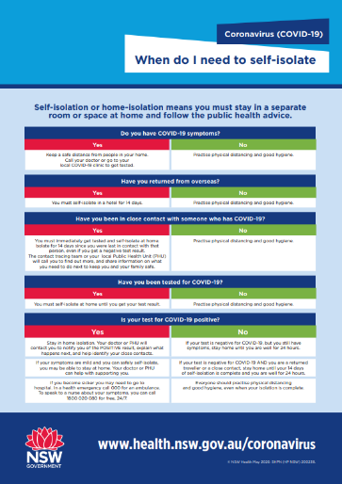
Self-isolate and get tested: Example newsletter / website copy
New cases in community – advice for close contacts to self-isolate and get tested
Health authorities are asking anyone who visited [insert location/locations] to self-isolate and get tested as soon as possible after a confirmed case of COVID-19 visited [insert location/locations] in the [insert area] area during a possible infection period and is considered to have been in close contact with others.
As a community we have worked hard to put the health of NSW first to keep COVID-19 in check, and we need to keep this up.
It is extremely important that anyone who visited these locations during the indicated dates and times should get tested and self-isolate even if they experience no symptoms.
Following testing, you must self-isolate and continue to do so for 14-days, even if your test result is negative as it can take 14 days before you may show symptoms or test positive.
As a community we need to remain vigilant, now more than ever. That means that we all need to be looking out for symptoms, and that anyone with respiratory symptoms, loss of sense of smell or taste, or unexplained fever should be tested for COVID-19.
If a family or friend is feeling unwell, remind them to get tested. No matter how mild the symptom.
By all playing our part and taking the right course of action, we have the best chance of containing the virus.
Find your nearest testing clinic
The most up to date information can be found at nsw.gov.au or by calling 13 77 88.
Link to download

Slide 23
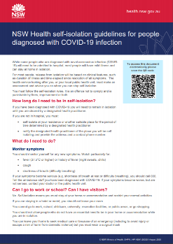
Self-isolate and get tested: example script and Q&A for call centre operators
Due to a confirmed case of COVID-19 visiting [insert location/locations] in the [insert area] area during a possible infection period and likely coming in close contact with others, health authorities are advising visitors to [insert location/locations] to get tested and self-isolate immediately. This is an important part to ensuring the virus can stay in check and to stop the spread in our community.
Testing centres are located at [locations].
Even if you have no symptoms it is extremely important that you get tested and self-isolate.
Thank you for helping our community stay COVID Safe. Following testing, you must self-isolate and continue to do so for 14-days, even if your test result is negative as it can take 14 days before you may show symptoms or test positive.
Q: Which locations have been linked to a case of COVID-19?
A: A confirmed case of COVID-19 visited [insert specific spots] on [insert date] during a possible infection period and is considered to have come in close contact with others. To find the full list of locations and indicated dates and times go to https://www.nsw.gov.au/covid-19/latest-news-and-updates#self-isolate-and-get-tested-immediately-if-youve-been-to-these-locations
Q: I’ve visited one of these locations on the list during the indicated date and time, what should I do?
A: It is extremely important that any visitors to these locations should get tested and self-isolate immediately, regardless of whether symptoms are experienced. You should wear a mask to and from the testing clinic and then continue to self-isolate for 14 days, even if your test result is negative.
Q: What if I visited one of these locations but not at the date/time indicated?
A: You should monitor for symptoms and get tested even if you experience the mildest symptoms. You should also tell your family and people you live with to do the same.
Q: Why should I self-isolate if I’ve had a negative test result?
A: It can take 14 days before you may show symptoms or test positive.
Q: Where do I go to get tested?
A: [ask for postcode an use the testing clinic finder tool: https://www.nsw.gov.au/covid-19/how-to-protect-yourself-and-others/clinics ]
Q: Will [area/suburb] have to go back into lock down?
A: If all [area/suburb] residents get tested with even the mildest symptoms, we will be able to perform contact tracing and manage case levels, and should be able to continue as we have been.
Q: How can I keep track of what areas have cases of COVID-19?
A: Locations are identified by NSW Health and listed and updated daily on nsw.gov.au or you can call 13 77 88
Q: What are the symptoms I should be looking out for?
A: Symptoms of COVID-19 include fever (≥37.5), cough, sore/scratchy throat, shortness of breath (difficulty breathing), runny nose, loss of smell and loss of taste. Other reported symptoms include fatigue, muscle pain, joint pain, headache, diarrhoea, nausea/vomiting or loss of appetite.
Q: Is that business safe to visit again?
A: If someone who has later tested positive to COVID-19 the business will be notified. After that they will be advised of what they need to do to reopen in a COVID Safe way as quickly as possible. It’s important for our community to support these businesses so they can keep their doors open during the pandemic.
COVID-19 self isolation guidelines and information
The most up to date information can be found at nsw.gov.au or by calling 13 77 88.

Slide 24
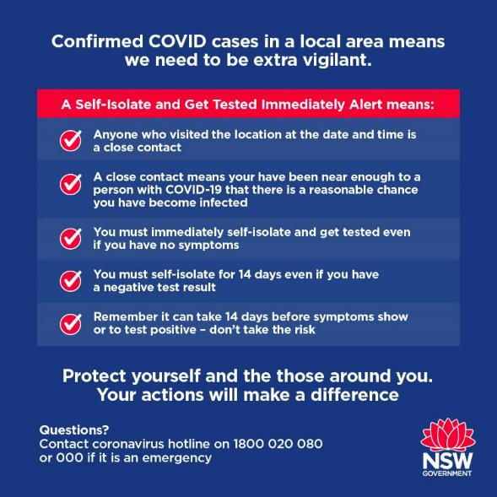
Self-isolate and get tested: Infographic

Slide 25
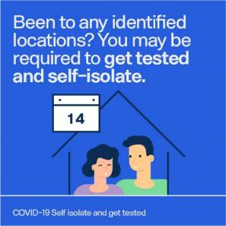
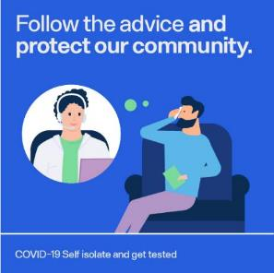
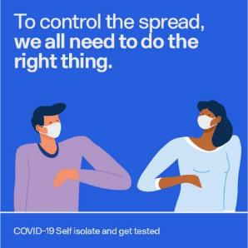
Self-isolate and get tested: Example social posts (non branded)
Tiles:
LOGO HERE
LOGO HERE
LOGO HERE
Post
Post
Post
If you have been to [insert locations, dates, times] you may have been in close contact with a COVID-19 case and must get tested as soon as possible and self-isolate. Find out the latest information at nsw.gov.au
Cases in the area mean we all need to be vigilant. Check whether you might have been in the same location as a case and follow the advice to get tested and self-isolate. Find out more: nsw.gov.au
If you’ve been in close contact with a confirmed or suspected case of COVID-19, the best thing you can is to get tested and self-isolate. Find information on nearby cases

Slide 26
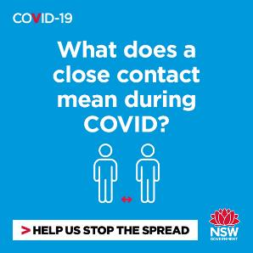
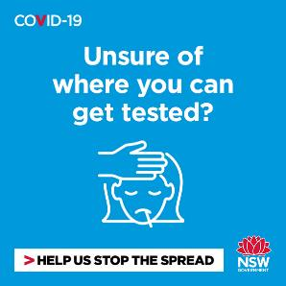
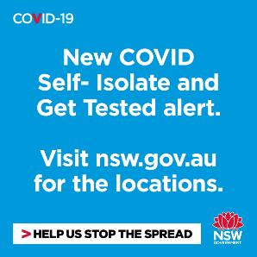
Self-isolate and get tested: Example social posts
Tiles:
Content
Content
Content
A close contact is someone who’s been near enough to a person with COVID-19 to increase their risk of contracting the virus. While you may not have symptoms, you must get tested and self-isolate straight away as it can take days for symptoms to occur. Find out more: nsw.gov.au
You can be tested through your local doctor, at a designated COVID testing clinic or at a COVID drive-through and are advised to wear a mask to and from the clinic. Find your nearest COVID-19 testing clinic
Check if you’ve visited a location on the Self-Isolate and Get Tested alert list. If you have visited one of the impacted spots you are considered to be a close contact and it is important that you self-isolate and get tested as soon as possible.

Slide 27
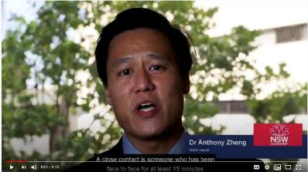
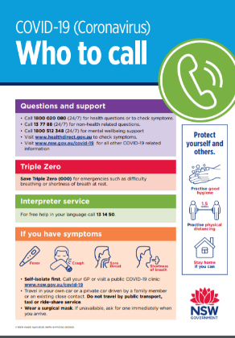
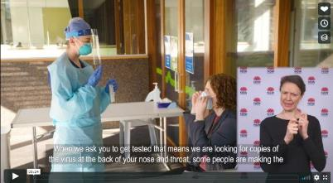
Self-isolate and get tested: Resources
Close contact - what does it mean?
Who to call for support fact sheet
Link to share
Self-Isolation for 14 days
Link to download
Link to share

Slide 28
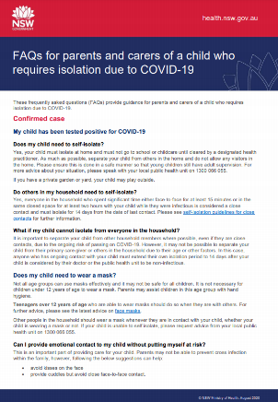
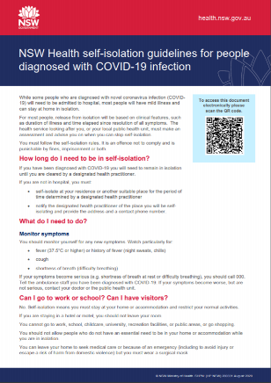
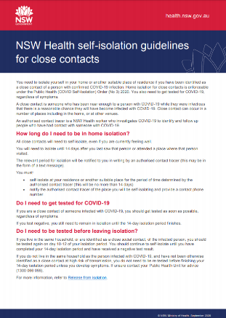
Self-isolate and get tested: Resources
COVID-19 self isolation guidelines and information
Link to guides

Slide 29
Mental Health and Wellbeing support
While we focus on COVID-19 and protecting our community from the virus it is also important that we focus on supporting our own mental health and wellbeing and that of those around us.
Following is a series or resources to help promote mental health and wellbeing in your community and let people know where they get help and what they can do to help those around them

Slide 30
Mental Health and Wellbeing: Resources
Black Dog Institute
is a free online clinic providing a mental health assessment tool and other support services
Head to Health
can help you find digital mental health and wellbeing resources
Lifeline
provides crisis support and suicide prevention services - phone 13 11 14 - operates 24/7
Beyond Blue
Coronavirus Mental Health Wellbeing Support Service advice and strategies to help you manage your wellbeing and mental health during this time (1800 512 348)
ReachOut.com Australia
provides practical tools and support to help young people get through everything from everyday issues to tough times
Kids Helpline Official
Kids Helpline (1800 55 18 00 - operates 24/7) is a telephone counselling support line for children and young people ages 5 to 25
NSW Mental Health Line
(1800 011 511 - operates 24/7) can connect you to a mental health service if you are concerned about the mental wellbeing of yourself or someone else.
For a free telephone interpreter, please contact TIS National on 131 450 say the language you need. You can then ask the interpreter to connect you to the mental health service you wish to speak with.

Slide 31
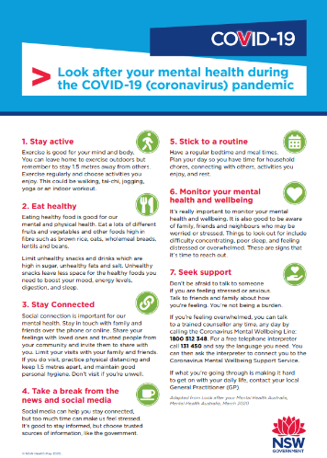
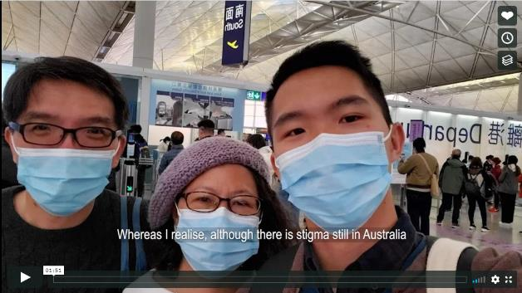
Mental Health and Wellbeing: Resources
Look after your mental health
Mental health and COVID-19
Translations available
Link to share
Link to download
Translations

Slide 32
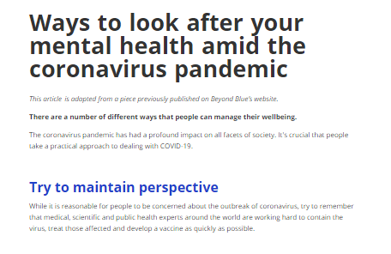
Mental Health and Wellbeing: Resources
Beyond Blue – how to look after your mental health
Beyond Blue – social posts
Link to share
Link to share
Link to share
Link to share

Slide 33
Mental Health and Wellbeing: NSW Government videos and social links
Link
Link
Link
Link

