Slide 1
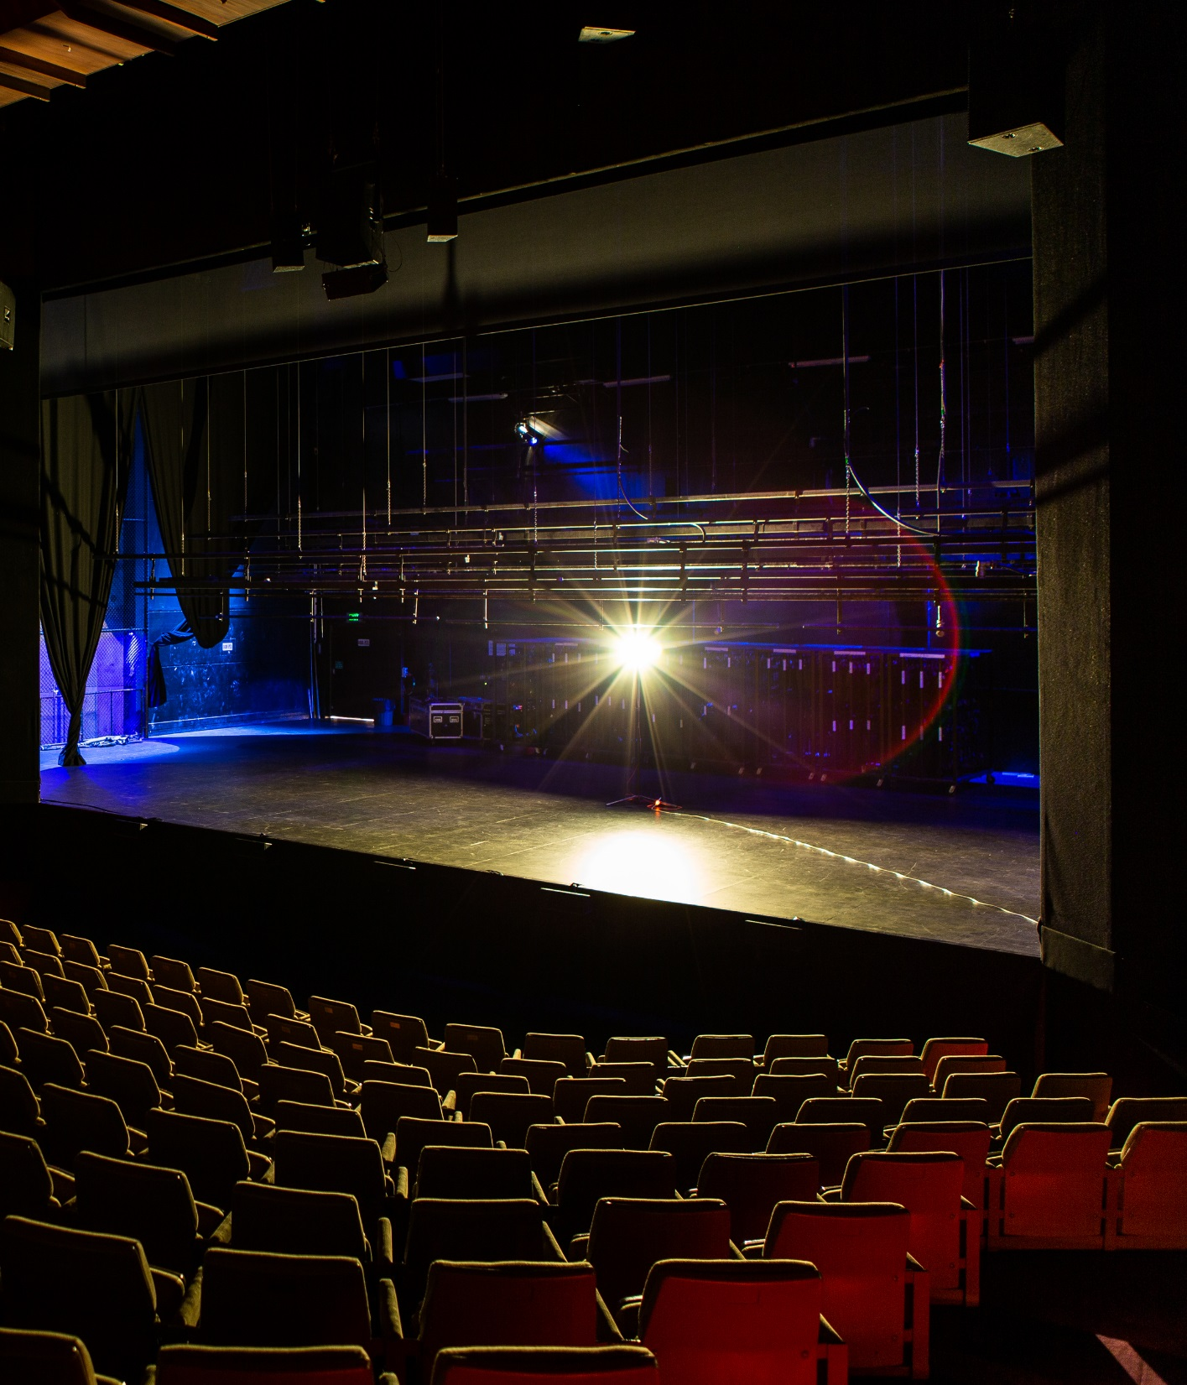
Virtual Member Town Hall
October 2020
Ghost light, Arts Centre Melbourne. Photo: Mark Gambino.

Slide 2
Agenda
1
COVID-19: National update​ LPA's roadmap to reopening theatres and live productions​, discussions with government ​
Priorities for future government support and advocacy
Negotiations with MEAA ‘Failure to produce’, Performers' Collective Agreement (PCA), digital agreements
New Live Performance Award
Refunds and exchanges (COVID-19)
Revised Ticketing Code
Q&A
2
3
4
5
6
7

Slide 3
COVID-19: National update
LPA Roadmap
COVIDSafe Guidelines
Collaboration with LEIF
Discussions with MEAA
Liaison with Government (Home Affairs, Office of the Arts)
Consultation with ACCC / Revised Ticketing Code
Creative Economy Taskforce
Regular Member updates

Slide 4
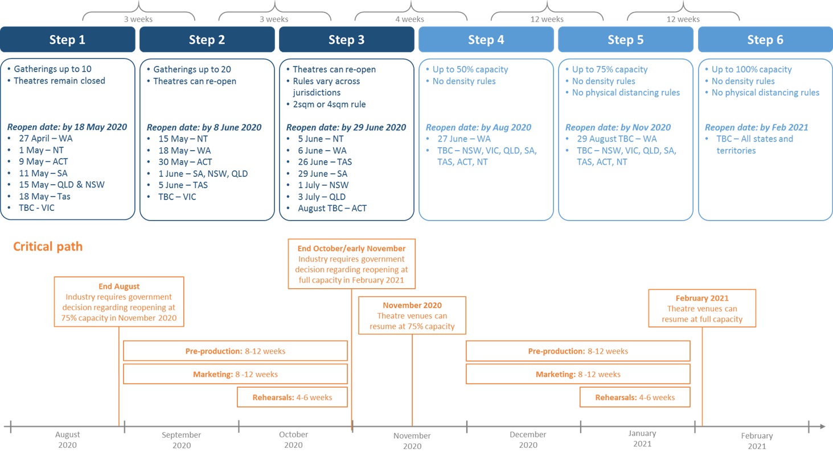
LPA Roadmap to reopening theatres

Slide 5
Discussions with government about reactivation
Victorian outbreak: Impacted government responses across the country in mid-July
Each state and territory: Moving at different speeds, differing perspectives and mitigation responses
NSW: Recently eased restrictions; advocating for further easing by end 2020
Shift in national narrative: Health vs economic pressures; economic impact driving reassessment
2021: Lots of unknowns

Slide 6
Key issues for our industry
Lost revenue and job losses
Significant industry restructuring and resizing in 2020 and 2021
Managing risk in a ‘COVID Normal’ world
Financing and investment challenges
Consumer sentiment

Slide 7
Priorities for government support
JobKeeper extension
Live Entertainment Business Interruption Fund
Tax incentives for live theatre production
Quarantine and travel protocols
408 visa fees waiver
Additional funding for Australia Council
Build consumer sentiment

Slide 8
Advocacy priorities
Continue working closely with states and territories re further easing restrictions; travel and border issues
Live Entertainment Business Interruption Fund
Tax Incentives for live theatre production
Parliamentary Inquiry into Australia's creative and cultural industries and institutions
Pre-Budget proposal for May 2021 Budget
2021: pre-election work federally

Slide 9
Negotiations with MEAA
Fail to produce
or present
LPA is currently negotiating with MEAA for a reduction in the minimum payment to performers in the event that a production is cancelled at no fault of the producer
Performers'
Collective
Agreement (PCA)
LPA consulted Members and the Workplace Relations Committee drafted & presented a log of claims to the MEAA
MEAA has advised LPA that its members are not in a position to negotiate a new PCA in 2020
Digital
agreements
MEAA – LPA Template Recording Agreement (COVID-19) 2020
Educational Accessibility Recording Agreement

Slide 10
New Live Performance Award
Definitions
Inclusion of “local show” definition
Inclusion of “musician” definition
“Whole time performance” defined
New Clause
Time off in Lieu (TOIL) instead of overtime
Travelling allowance
Clarification that daily meals and incidental allowances are derived by dividing the weekly allowances by 5
Inclusion of a cash allowance in lieu of accommodation for periods of less than 1 week
Types of employment
Only general employment conditions contained in this section
Specific issues relating to performers/dancers, musicians, and production and support staff now contained in each part of the Award

Slide 11
New Live Performance Award
Performers / company dancers
Performances of less than 1 hour – casuals
Not paid 3 hours per performance
3 hour call performer can undertake a number of performances
Adequate rest breaks to be given between performances
Meal break after 4 pm
1.5 hour break can be reduced to 1 hour by agreement between cast and employer
Break between rehearsals / performance
1.5 hour break to be given between a full rehearsal and another rehearsal OR
Break can be reduced to 1 hour with agreement between majority of employees and employer
Overtime for casual employee
Casual employees can work two 3 hour calls per day
Third and subsequent calls paid time and one half (Sunday double time applies to all calls)

Slide 12
New Live Performance Award
Musicians
Clarification of allowances including doubling, supply of music and upkeep allowances
Production & support staff
Provision change to pay 1/10th of weekly wage when travelling on a Sunday or other rostered day off

Slide 13
Immigration
Travel
Exemptions
International performers, creatives and crew can apply for a Travel Exemption based on the requirement for people with critical skills to perform work in Australia
408 Visa
Applications
If an application for a Travel Exemption is approved, a 408 visa will then be required to travel
The 408 visa application process has not changed
LPA Resources
LPA Guide: COVID-19 Travel Exemption Request
LPA Guide: 408 Visa Information Pack

Slide 14
Refunds and exchanges (COVID-19)
Safety first
Two-way trust
Positively influence consumer behaviour
Supporting industry sustainability
Evolving
Offer refund/exchange/credit
No refund/exchange/credit
Required to self-isolate or quarantine
Confirmed COVID-19 case
Close contact of confirmed case
Living/been in high risk area
Returned from overseas
Awaiting test results
Feeling unwell with COVID-19 symptoms
Fear of exposure to COVID-19
Feeling unwell (except COVID-19 illness or symptoms)
Group at higher risk of COVID-19
Denied entry
Leaves partway through event due to feeling unwell

Slide 15
Revised Ticketing Code
ACCC’s key concerns
No intent to reschedule ‘postponed’ events
Rescheduled events look substantially different
Regular communications
Key changes
Intervening circumstances
Refund ‘window’
Timeframe for announcing new date of rescheduled events
Eighth edition of the Ticketing Code will come into effect on 1 January 2021

Slide 16
Q&A
NSW
Q1: Can I present a dance or theatre event outdoors with up to 500 people?
VIC
Q2: Theatres can be open for the purpose of ‘broadcast’. Does that only include livestreaming? Or can it include recording of any kind in a venue (without an audience)?
Q3: What is the recommended COVID Safe distance between the front row of audience members and the performers on stage or in an orchestra pit for various genres?
National / sector-wide
Q4: How could a workforce bubble apply to our industry, when there may be crew who work across multiple sites?

Slide 17
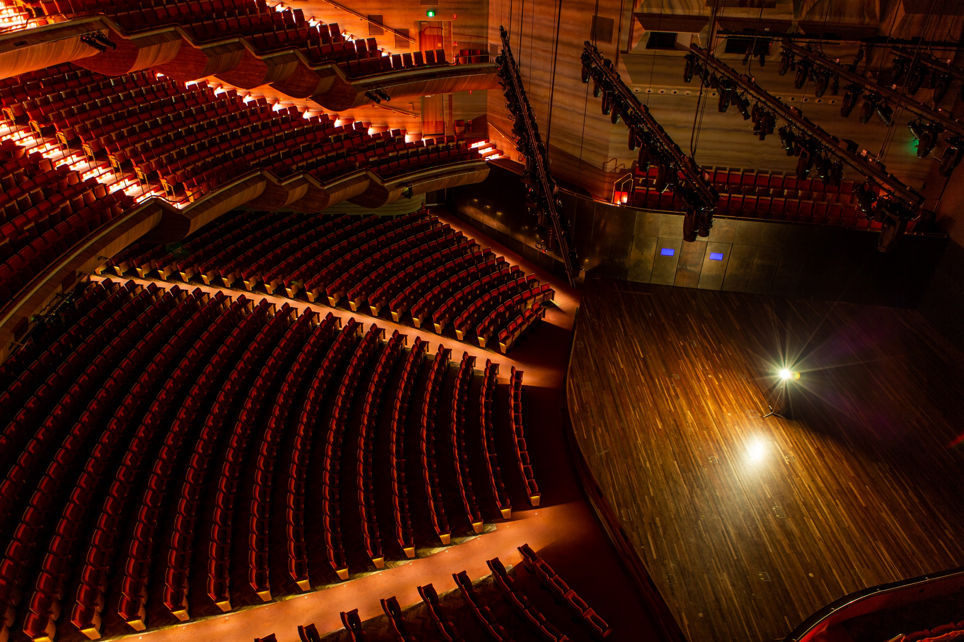
Thank you!
Thank you!
Ghost light, Arts Centre Melbourne. Photo: Mark Gambino.

