Slide 1
Stakeholder communications toolkit
NSW / VIC border reopening

Slide 2
Purpose - stakeholder toolkit
The NSW and Victoria border reopens from Monday 23 November
The reopening will help people on both sides of the border make plans and reunite with family
This toolkit contains communication materials that you can share, as well as use on your own channels. It explains how we can open the border and remain COVID Safe.
It includes example messaging, newsletter/website copy and social media assets for wider NSW and border communities
It should be used in conjunction with information at nsw.gov.au, which is being updated continuously. This is also where you will find answers to commonly asked questions

Slide 3
General key messages: NSW / VIC border reopening
We are taking another step forward
The NSW Government is reopening the border with Victoria at 12.01am on Monday 23 November
We have protected each other and our local community by being COVID Safe
Victoria has worked hard to get the virus under control
Now we are ready to reopen, to give people confidence to make plans and reunite with family in the lead up to the holidays
We want to thank you for your patience, particularly those communities and businesses in border areas
Let’s do the right thing
Now that borders are open, there will more visitors to NSW, so we must continue to be vigilant
We can start doing more of the things we love, however, we all still need to be Covid Safe
Be aware when you travel outside of NSW, don’t bring COVID-19 back with you
Help us keep NSW, and each other safe
The most up-to-date information on what to do in NSW can be found at nsw.gov.au, and in VIC at www.coronavirus.vic.gov.au
We know what needs to be done to maintain the path we are on
Our priority remains protecting the health and safety of our community while our economy gets back on track
We are confident the Victorian Government, and the people of the State, are on the right track
But all states remain at risk of renewed outbreaks
It’s great to be back together – so let's be vigilant and stay COVID Safe

Slide 4
Key messages: for visitors to NSW
General:
Welcome to NSW, we’re open for business
Let’s all have a great time but remember to follow the rules and practice COVID Safe behaviour such as washing your hands frequently, keeping 1.5m distance or wearing a mask when you can't
If you’re feeling unwell, please cancel or defer your plans to visit NSW
While you’re here, if you feel unwell, please get tested immediately and self-isolate in your accommodation until you receive a negative test result
COVID-19 testing is free for everyone, easy and safe, and you should receive a result within 24 hours
Whether you’re in NSW to socialise, sightsee, or visit friends and family, remember to check in at venues, stay 1.5m from others or wear a mask when you can’t
Help us stay COVID Safe

Slide 5
Key messages: for NSW visitors and residents
Testing:
If you experience even the slightest symptom, get tested
There are more than 300 testing clinics in NSW – find your nearest clinic: https://www.nsw.gov.au/covid-19/how-to-protect-yourself-and-others/clinics
Covid-19 testing is free for everyone, easy and safe, and you should receive a result with 24 hours
Gatherings / Out and About
When out and about with family and friends, remind them of how we stay COVID Safe in NSW
When planning get-togethers, whether at home or at a venue, having it outdoors or with windows and doors open, is safer
If you or anyone in your household feels unwell, don’t socialise
Stay 1.5m away from others
Avoid crowded spaces
Wear a mask if you can’t physically distance, such as while on public transport, in taxis or ride shares, supermarkets, shops, places of worship, and entertainment venues

Slide 6
Key messages: for NSW visitors and residents
Check in/support businesses:
Always plan ahead and make hospitality or event bookings where you can
It is mandatory in NSW to check in electronically, for example by QR code, at hospitality and many other venues, so please encourage everyone to check in, every time
Checking in properly helps our contact tracers and means that we can stay on top of outbreaks
Wherever you go, choose spaces and venues that have COVID Safe measures in place, such as QR code check in and enough space for you to physically distance – it will keep us all safe
Where you can, use the Service NSW app for secure, easy and contactless check in
Stay informed
Stay up to date with the latest news and information regarding COVID-19, including where community transmission may have occurred and what this means for you and your family
For the latest COVID-19 information and guidance, visit nsw.gov.au

Slide 7
Newsletter/website copy (for local government)
NSW-VIC border reopening: getting our communities back together
The NSW Government is reopening the border with Victoria at 12.01am on Monday 23 November.
We have protected each other and our local community by staying COVID Safe. And we’ve seen Victoria work hard to get the virus under control.
Now we are ready to reopen, to give people confidence to make plans and reunite with family in the lead up to the holidays.
Thank you for your patience, particularly those communities and businesses in border areas.
Let’s remain vigilant
We all have a part to play in keeping COVID Safe. We're asking everyone in the community – in both NSW and Victoria – to ensure they're familiar with the current COVID-19 restrictions and to follow COVID Safe best practice wherever they are.
Stay home if you have any symptoms and getting tested. Check-in when you visit a venue or business where required. Stay 1.5m apart from others or wear a mask when you can’t. Wash your hands frequently. And if you’re a business, make sure you have a COVID Safe plan.
The most up to date information on what to do in NSW can be found at nsw.gov.au, and in VIC at www.coronavirus.vic.gov.au
It’s great to be back together – let’s remain COVID Safe.

Slide 8
Newsletter/website copy (for business stakeholders)
NSW-VIC border reopening: getting our communities back together
The NSW Government is reopening the border with Victoria at 12.01am on Monday 23 November.
We have protected each other, and our economy is getting back on track because we’ve been COVID Safe. Everyone has worked hard to get the virus under control.
Now we are ready to reopen, to give people confidence to make plans, do business and reunite with family in the lead up to the holidays.
We want to thank you for your patience, particularly those businesses in border areas.
Let’s remain vigilant
We all have a part to play in keeping COVID Safe. We're asking everyone – in both NSW and Victoria – to ensure they're familiar with the current COVID-19 restrictions and to follow COVID Safe best practice wherever they are.
Stay home if you have any symptoms and get tested. Check-in when you visit a venue or business where required. Stay 1.5m apart from others or wear a mask when you can’t. Wash your hands frequently. Make sure your business has a COVID Safety plan.
The most up to date information on what to do in NSW can be found at nsw.gov.au, and in VIC at www.coronavirus.vic.gov.au.
It’s great to be back together – let’s remain COVID Safe and kick start business between our two States.

Slide 9
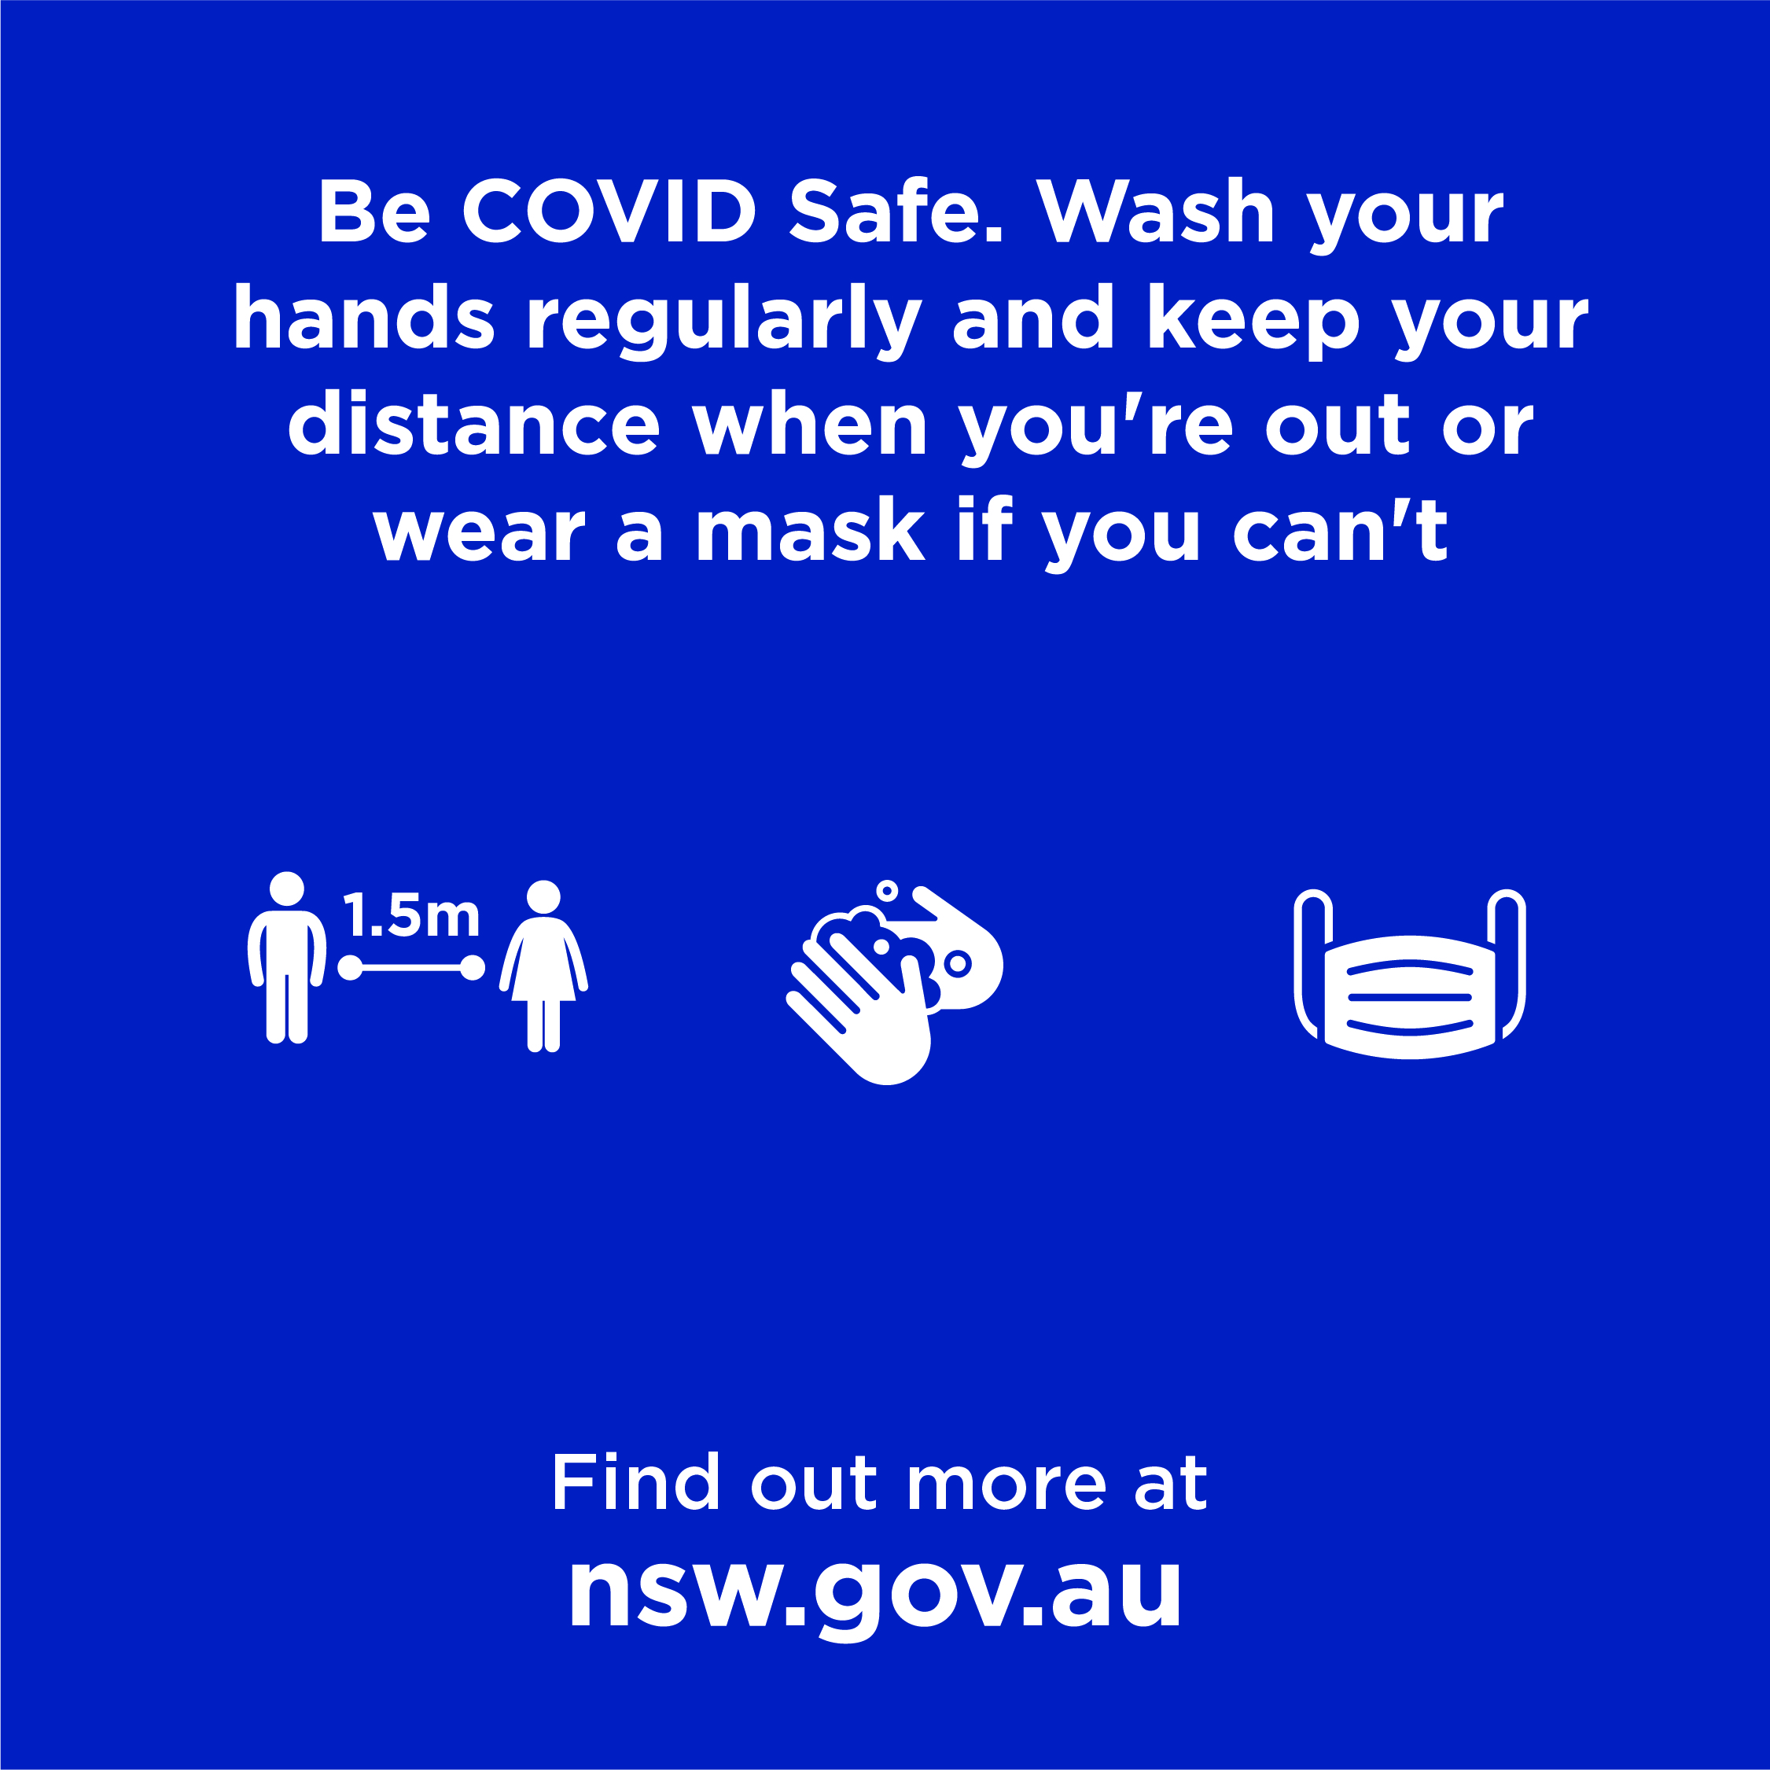
Social posts (for local government targeting the community)
Tiles:
Post:
If you have any symptoms, the best way for you to support your local community and your State is to stay home and get tested as soon as possible. To find your nearest testing clinic, visit nsw.gov.au
Post:
Even though we are back together, keeping your distance wherever you are is a small step to help prevent the spread of COVID-19.
Post:
Being COVID Safe ensures we can keep our States open and our communities together. This means washing your hands regularly and keeping 1.5m away from others or wear a mask if you can't. Check out the latest restrictions at nsw.gov.au

Slide 10
Social posts (targeting businesses)
Tiles:
Post:
When the border between NSW and VIC opens, businesses can make plans to welcome visitors. Let’s make sure everyone does so in a COVID Safe way.
Post:
Being COVID Safe ensures we can keep our States open and our communities together. This means anyone visiting your premises should keep their distance, regularly wash their hands and check in on arrival.
Post:
Being COVID Safe ensures we can keep doing business and welcome Victorians. Make sure you have a COVID Safety plan and keep a record of who visits your premises. For more information, visit nsw.gov.au

Slide 11
Social posts (targeting NSW travellers heading to VIC)
Tiles:
Post:
If you’re taking a trip to Victoria, make sure you’re up to date with the latest COVID-19 restrictions. Everything you need to know can be found on the Victorian Department of Health and Human Services website: www.coronavirus.vic.gov.au
Post:
The COVID-19 restrictions are different in Victoria. Know the rules before you cross the border. The latest restrictions can be found at www.coronavirus.vic.gov.au

Slide 12
Social posts (targeting VIC travellers entering NSW)
Tiles:
Post:
COVID-19 restrictions are in place to keep you safe while you’re in New South Wales. Visit nsw.gov.au for the most up to date information.
Post:
We want you to enjoy your time in New South Wales. That’s why we’re asking everyone to be COVID Safe. Learn how you can play your part and keep up to date with the latest restrictions. Visit nsw.gov.au

Slide 13
Border community assets

Slide 14
Newsletter/website copy (local government to border communities)
NSW-VIC border reopening: getting our communities back together
Free movement between NSW and Victoria will begin at 12:01am on Monday 23 November, as announced by NSW Premier.
We want to thank you for your patience during this difficult time. We have protected each other and our local community by being COVID Safe.
Now we are ready to reopen, to give people confidence to make plans and reunite with family in the lead up to the holidays.
Let’s remain vigilant
We all still have a part to play in keeping COVID Safe. We're asking everyone in the community – in both NSW and Victoria know the rules and to follow COVID Safe best practice wherever they are.
The most up-to-date information on what to do in NSW can be found at nsw.gov.au, and in VIC at www.coronavirus.vic.gov.au
And don't forget to: stay home if you have any symptoms and get tested or re-tested. Check-in when you visit a venue or business if required. Stay 1.5m apart from others or wear a mask when you can’t. Wash your hands frequently. And if you’re a business, make sure you have a COVID Safety plan.
The NSW Government has worked closely with the Victorian Government throughout the border closure and has strengthened processes to support contact tracing across the two States. Full details on border crossing rules can be found here https://www.nsw.gov.au/covid-19/what-you-can-and-cant-do-under-rules/border-restrictions#border-entry-rules
It’s great to be back together – let’s remain COVID Safe.

Slide 15
Social posts (local government to border communities)
Tiles:
Post:
We all have a part to play in keeping COVID Safe. We're asking everyone in the community – in both NSW and Victoria – to know the local rules and to follow COVID Safe guidelines.
Post:
The NSW Government is reopening the border with Victoria at 12.01am on Monday 23 November. We want to thank you for your patience during this difficult time. We have protected each other and our local community by being COVID Safe.
Post:
The NSW Government has opened the border with Victoria as of 12.01am on Monday 23 November. We thank you for your patience during this difficult time. But we mustn't be complacent. Don’t forget to stay home if you have any symptoms and get tested, stay 1.5m apart from others or wear a mask if you can't.

