Slide 1
Mandatory electronic check in
This toolkit contains content to help you communicate the new mandatory electronic check in requirements

Slide 2
Contact tracing for businesses
Contact tracing is an important part of stopping community transmission of the COVID-19 virus
Digital check in tools (such as a QR code or web form) offer the best option for contact tracing for venues and will help businesses to remain COVID safe by meeting requirements for the collection and storage of customer contact details
The NSW Government has launched a safe and easy digital check-in tool for businesses and customers
The Service NSW app features a COVID Safe Check-in tool to allow customers to check in at venues across NSW

Slide 3
Mandatory electronic check in – industries and events
From 23 November, mandatory electronic check in applies to staff and patrons at these venues:
Amusement centres
Aquariums
Auction houses
Crematoria
Drive-in cinemas
Entertainment facilities
Events, incl. corporate events, funeral and memorial services, and wedding services
Function centres
Funeral homes
Gyms
Hairdressers
Hospitality venues, incl. casinos, food and drink premises, micro-breweries and cellar doors, pubs, small bars and registered clubs
Information/education facilities (not libraries)
Massage and tattoo parlours
Nail and beauty salons
Party buses
Places of worship
Properties operated by the National Trust or Historic Houses Trust
Public swimming pools
Recreation facilities (indoor)
Recreation facilities (major)
Sex on premises venues
Sex services premises
Spas
Strip clubs
Vessels used for hosting functions or for commercial tours
Zoological parks and reptile parks

Slide 4
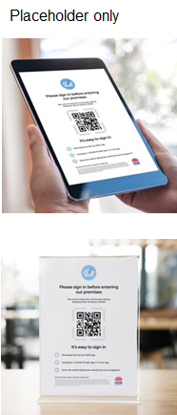
How does the COVID Safe Check-in work?
Businesses
Customers
Businesses or organisations register as COVID Safe at nsw.gov.au.
COVID Safe businesses can then download and display their unique COVID Safe Check-in QR Code at their venue for customers to use.
Customers use the COVID Safe Check-in feature on their Service NSW app to check in.
It’s quick, easy and contactless.

Slide 5
Benefits of the COVID Safe Check-in
Businesses
Customers
COVID Safe Check-in is a free record keeping tool, available to COVID Safe registered businesses and organisations
Registering as a COVID Safe business or organisation shows the community you’re looking after their safety
Easy, secure way to meet requirements for the collection and storage of customer contact details
Enables accurate customer record keeping
Quick and easy – using the app is the fastest check in option available
No cost – using the app is free
Customers don't need to repeatedly provide personal information at each check-in
Customer’s mobile number is verified to assist contact tracing efforts
After check-in, customer contact details stored securely by the NSW Government and destroyed after 28 days

Slide 6
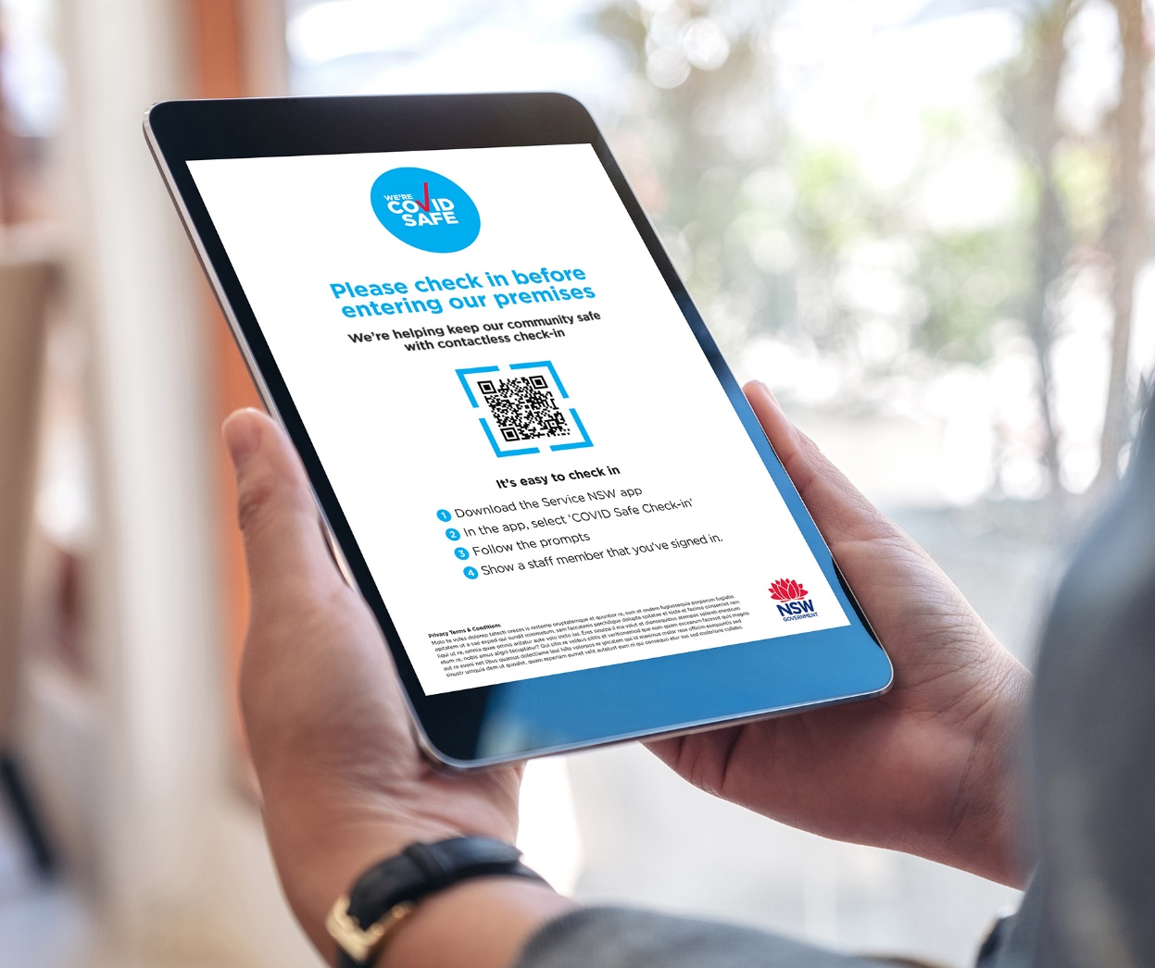
COVID Safe Check-in – upcoming features
For customers who don’t have a mobile device or the Service NSW app, you can display a device (e.g. iPad) at your venue to digitally record contact details and time of entry
To more accurately identify the time period of customers in a particular location, a voluntary check-out function has been added
Customers can now also check-in dependents (e.g. children and the elderly) as part of a streamlined check in process

Slide 7
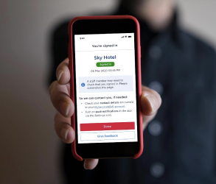
How to get the COVID Safe Check-in
Once a business registers as a COVID Safe business, a unique QR code is emailed along with the official COVID Safe badge and posters that can be displayed
The business can print the unique QR code and customer instructions or display them on a screen e.g. a tablet
The customer will need to download and/or open the Service NSW app, then follow the prompts in the COVID Safe Check-in tool to scan the code

Slide 8
Security
The contact details submitted via the COVID Safe Check-in are stored securely on a NSW Government database for the sole purpose of COVID-19 contact tracing
The data is held for a minimum 28 day period
Access to the data is restricted to authorised personnel in Service NSW and the Ministry of Health

Slide 9
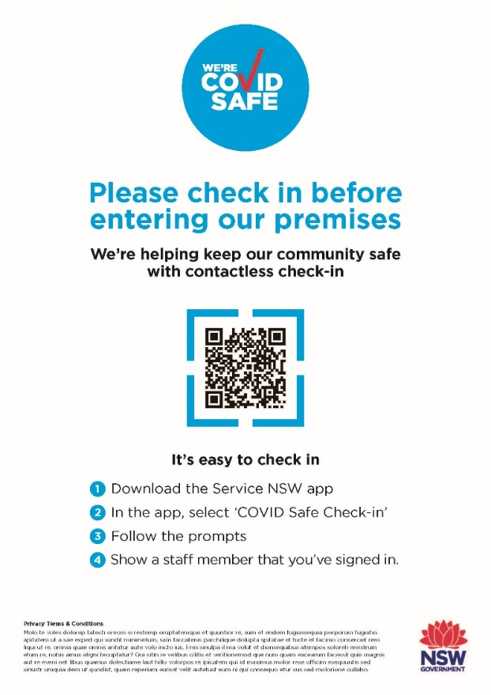
Promoting the COVID Safe Check-in
A promotional toolkit with social media posts, newsletter content, videos and key messages is also available for registered COVID Safe businesses using the COVID Safe Check-in
Poster example
Social media posts for customers and businesses
Partner Post: From November 23, mandatory electronic check-in, such as a QR code or web form, that records patrons’ names and contact details will apply for more businesses in NSW. Find out how to prepare your business at nsw.gov.au
Service NSW Post: From November 23, it will be mandatory for more businesses and venues will be required to have electronic check-in in place. Businesses without digital records risk penalties. Learn what you need to do at nsw.gov.au

Slide 10
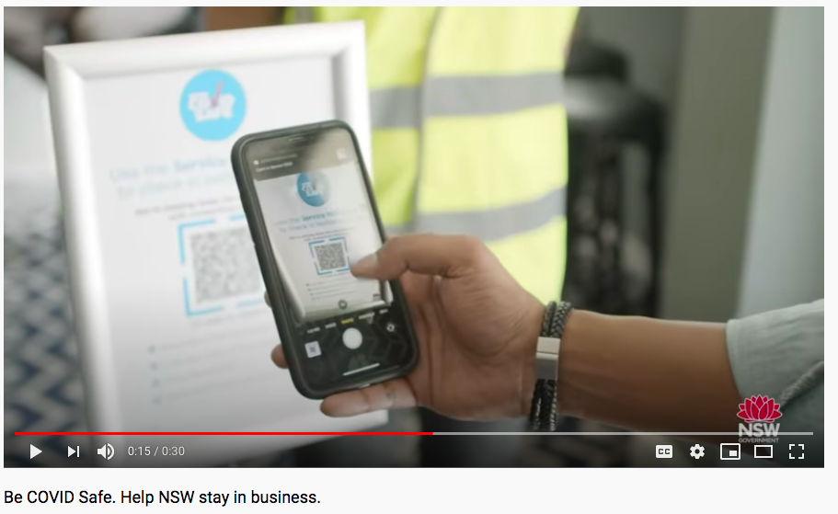
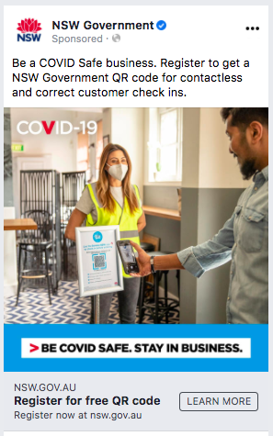
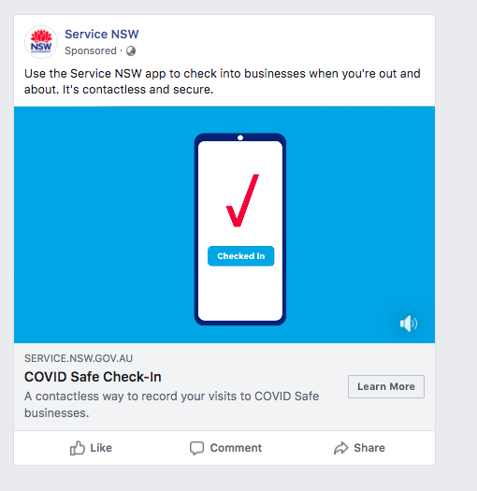
COVID Safe Check-in advertising campaign
The NSW Government is supporting businesses and communities to promote the COVID Safe Check-in through an extensive advertising campaign.
Promoted on:
Television
Radio
Press advertising
Social media
Digital and search

Slide 11
EDM / Website copy
Digital registrations now mandatory for more businesses, venues and events
From November 23, electronic check-in systems, such as a QR code or web form, that records patrons' names and contact details will be mandatory for more businesses in NSW.
Electronic check-in systems are a fast and precise way to support contact tracing - one of the most important tools we have to keep the virus in check and businesses open.
All businesses who have registered as COVID Safe with NSW Government have access to the free COVID Safe Check-in which allows customers to check-in via a QR code through the Service NSW app.
COVID Safe Check-in captures the business name, address and the customer’s contact details. The information is securely stored for 28 days for the sole purpose of contact tracing and can be instantly accessed by NSW Health in the event of an outbreak. After this time, data is destroyed.
For patrons who do not have access to a smartphone, venues need to record their details upon entry using a digital device.
All business are encouraged to register as COVID Safe and for many it is mandatory. Support is available to help businesses ensure they are COVID Safe, including a personalised Concierge Service for those impacted by bushfires and COVID-19.
For more information visit:
QR code information www.nsw.gov.au/covid-19/covid-safe/qr-codes
COVID Safe registration www.nsw.gov.au/covid-19/covid-safe
Concierge Service mybusiness.service.nsw.gov.au/concierge

Slide 12
Key contacts
For more information about COVID Safe Check-in and how to register your business contact:
Belgin Tran​
Director, Program Delivery​
Service NSW​
E: belgin.tran@service.nsw.gov.au
For more information about the COVID Safe Check-in promotional toolkit contact:
Yvette Laurence
Stakeholder Engagement Manager
Department of Customer Service
E: yvette.laurence@customerservice.nsw.gov.au

