Slide 1
Approaching the Holiday Season Staying COVID Safe
December 2020

Slide 2
Purpose
The NSW Government is focused on keeping COVID-19 under control to protect our economy and the NSW community’s health and quality of life.
To assist with communications over the holiday period, the NSW Government has prepared this toolkit which contains adaptable communication materials to guide the local community’s safe engagement in public and private gatherings, including those to celebrate the festive season and other holiday events. It contains information for businesses and others that might be hosting celebrations.
We hope this toolkit will be useful for you to communicate with your community and other stakeholders to ensure safety and enjoyment for everyone.
It should be used in conjunction with information at nsw.gov.au which is being updated continuously. This is also where you will find answers to commonly asked questions.
We appreciate your role in helping protect the community and keeping NSW COVID Safe.

Slide 3
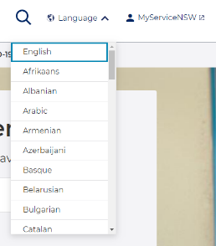
Where to get the latest translated information
Go to nsw.gov.au
The nsw.gov.au website can be translated into over 55 languages via the ‘Language’ option in the top right-hand corner
The content on this website is being continuously updated with the latest information
This is also where you will find answers to commonly asked questions
There is a translated resource page, which has a search functionality as well as the ability to filter by language, resource type and topic www.health.nsw.gov.au/Infectious/covid-19/Pages/multilingual.aspx

Slide 4
COVID Safe Holiday Season
Community messaging and newsletter copy
Business messaging and newsletter copy

Slide 5
Overarching messages: staying COVID Safe this Summer - Community
Example key messages have been developed to support your communication around the upcoming festive and holiday season. They explain what the community can do to respond, how together we can keep the community safe and why we need to stay focused. We encourage you to include some of the three elements in each communication where possible​.
What is the current community risk?
NSW has made great progress, but it's important we don't become complacent, particularly at gatherings and as the holiday season approaches.
It’s never been more important to make sure we stay COVID Safe – to maintain our focus so we can get together, go to a stadium, a gig, celebrate birthdays, religious occasions and enjoy summer.
To stay ahead of the virus, we must continue to respond quickly and behave in COVID Safe ways.
We are at a critical point and need to continue to work together to stop the virus from spreading and protect the NSW community.
How can we play our role?
To continue doing the things we love in NSW, we must continue to be COVID aware and safe. For the latest information and guidance about gatherings, check nsw.gov.au.
If you have symptoms, even mild, get tested immediately and stay home. The main symptoms of COVID-19 are fever, cough, sore/scratchy throat, shortness of breath, runny nose, loss of smell or loss of taste.
Get re-tested immediately each time you feel unwell. There is no limit to the number of tests you can have.
Stay home until a negative COVID-19 test result is received, and until feeling well again, to keep your family, friends and colleagues safe.
In planning festive season and holiday gatherings remember to stay COVID Safe - outdoor where possible.
If the weather means you hold an indoor event, take COVID Safe precautions. Choose a large well-ventilated room and open doors and windows if possible.
If you’re gathering with family and friends at home, stay safe by washing your hands regularly, maintaining your distance and keeping doors and windows open where possible.
If you have interstate guests, tell them what the COVID Safe behaviours are for NSW.
Check in electronically when you enter venues such as cafes, restaurants, gyms and in taxis so you can be easily contacted if potentially exposed to a COVID-19 case. If you see a check in QR code, scan it with your phone and encourage everyone you are with to do the same.
If we follow the health advice and guidance, we’ll have an enjoyable holiday season.
Why we need to stay COVID focused
COVID-19 is still here.
We know what needs to be done to maintain the path we are on.
NSW is not free from the risk of renewed outbreaks, so we must remain vigilant and COVID aware.
If we want to keep our community safe, to continue to open businesses, to be able to gather and celebrate the festive season, we must all do what is needed.
Let's protect our family, friends and community by being COVID Safe – we will get through this together.

Slide 6
Newsletter/web copy: community
Staying safe this holiday & festive season
We know this summer is going to be different. To keep doing the things we enjoy in NSW, we need to continue to be COVID aware and safe as we begin to plan gatherings and celebrate the festive season.
With positive media reports of vaccines and treatments for COVID-19, we may be tempted to become complacent, particularly at gatherings and with friends and family, but it’s important to stay vigilant and COVID Safe.
When planning the festive season and holiday gatherings or attending events this summer, remember to stay COVID Safe. Choose gatherings at parks, beaches and open spaces as places to relax, exercise and enjoy the outdoors. Now is a good time to explore our less-travelled areas as we share and enjoy our beautiful outdoors and venues safely.
If the weather means you hold an indoor event, take extra COVID Safe precautions; wash your hands regularly, maintain your distance, choose large, well-ventilated spaces and try and keep doors and windows open. It might be hard to say ‘no' to a hug, especially at this time of year, but it’s how we can keep our loved ones safe.
If you’re heading to a venue or restaurant, check for availability and make a booking. At ticketed events, follow the COVID Safe event rules and instructions from event staff. If you don’t have a ticket, stay home. Check in when you arrive and ensure everyone you are with checks in too.
If you’re unwell, or anyone in your household is unwell, don’t entertain or head out. Instead, get tested and stay home until a negative COVID-19 test result is received, and until you’re feeling well again, to keep your family, friends and colleagues safe. There is no limit to the number of tests you can have and most people in NSW receive their test results within 24 hours.
For the latest information and guidance about gatherings, check nsw.gov.au
COVID-19 is still here. To stay ahead of the virus, we all need to play our part and continue to respond quickly and safely this holiday season. Let’s get through this together and keep our friends, family and community safe.
Link to download: COVID-19 digital resources - COVID-19 (Coronavirus) (nsw.gov.au)

Slide 7
Overarching messages: staying COVID Safe this Summer - Business
Example key messages have been developed to support your communication around the upcoming festive and holiday season with local businesses. They explain what businesses can do to respond, how together we can keep the community safe and why we need to stay focused. We encourage you to include some of the three elements in each communication where possible​.
What is the current risk for business?
It's important to avoid becoming complacent as 2020 draws to a close and the holiday season approaches.
The people of NSW have demonstrated that by working together and following COVID Safe protocols, restrictions can be eased, and we can enjoy doing the things we love.
We are at a critical point and need to continue to work together to stop the virus from spreading and protect the NSW community.
How can we play our role?
COVID Safe businesses are committed to getting back to work while protecting the community, keeping up the highest standards and preventing the spread of COVID-19.
Registration as a COVID Safe business is quick and easy and shows staff and customers you’re committed to their safety. For some businesses and organisations, it is mandatory to register as COVID Safe under the Public Health Orders (gyms, hospitality venues, funeral homes, places of public worship).
Electronic check-in to collect details of all staff, patrons and contractors visiting premises is now mandatory for many venues. One option is to use the Service NSW COVID Safe Check-in which is a free, secure and convenient system.
Encourage customers and patrons to download the Service NSW app for contactless check in.
Businesses using a QR code check-in system should have an alternative form of electronic check-in for patrons without smartphones.
Hospitality venues should check the relevant COVID Safety Plan for the latest capacity allowances and requirements. As employees return to the office, workplaces are encouraged to have COVID Safe plans. Employers are encouraged to stagger staff starting and finishing times to reduce the impact on public transport. Customers using public transport should wear a mask.
Wash your hands regularly, maintain your distance and try and keep doors and windows open.
If you, any staff or patrons have any COVID-19 symptoms, even mild, get tested immediately and stay home until a negative COVID-19 test result is received. There is no limit to the number of tests you can have. The main symptoms of COVID-19 are fever, cough, sore/scratchy throat, shortness of breath, runny nose, loss of smell, or loss of taste. Most people in NSW receive their test results within 24 hours.
If you have interstate visitors to your premises be sure to tell them what the COVID Safe behaviours are for NSW.
For the latest information about COVID-19 restrictions check nsw.gov.au.
Why we need to stay COVID focused
COVID-19 is still here. NSW is not free from the risk of renewed outbreaks, so we have to remain vigilant and COVID aware.
If we want to keep our community safe, to continue to open businesses, to be able to gather and celebrate the festive season, we must all do what is needed.
Let's protect our family, friends and community by being COVID Safe – we will get through this together.

Slide 8
Newsletter/website copy: businesses and organisations
Keeping your business, staff, patrons and contractors COVID Safe
Our priority for everyone in (INSERT AREA) is their safety. By working together and following COVID Safe protocols, restrictions have been eased by the NSW Government as we head into the holiday and festive season.
The NSW Government wants to boost the economy and is encouraging people to get out and about in a COVID Safe way.
To stay open for business, we need to continue to be COVID aware and safe as we prepare for the increase in community movement during the holiday and festive season.
All businesses and organisations are required to meet the current NSW Government COVID-19 requirements, which can be found at www.nsw.gov.au/covid-19. Registration as a COVID Safe business is quick and easy and shows staff and customers you’re committed to their safety and for many businesses and organisations (e.g., gyms, hospitality venues, funeral homes, places of public worship) it is mandatory.
Electronic check-in to collect details of all staff, patrons and contractors visiting premises is now mandatory for more businesses. The Service NSW COVID Safe Check-in is strongly recommended as a free, secure and convenient system available through the Service NSW app, but you are free to choose any electronic system that meets the record keeping requirements.
To find out what you need to have in place, visit www.nsw.gov.au/covid-19/covid-safe.
Encouraging COVID Safe practices by your staff, patrons & contractors
If you, any staff or patrons have symptoms, even mild, get tested immediately and stay home until a negative COVID-19 result is received. There is no limit to the number of tests you can have and most people in NSW receive their test results within 24 hours.
Encourage customers and patrons to download the Service NSW app for contactless check in. Have an alternative form of electronic check-in for patrons without smartphones.
To remind everyone of COVID Safe practices, the NSW Government has put together a collection of social media tiles and website/newsletter copy that you can share through your own channels.

Slide 9
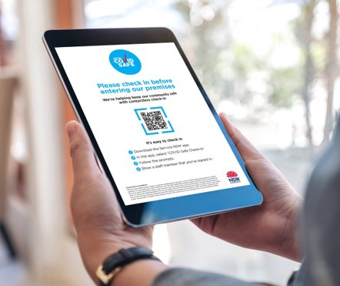
Newsletter / web copy: electronic check-in
Staying COVID Safe this holiday season with electronic check-in Our priority for everyone in (INSERT AREA) is their safety and by working together and following COVID Safe protocols we can stay ahead of the virus.
To stay open for business, we need to continue to be COVID aware and safe as we prepare for the increase in community movement during the holiday and festive season.
Electronic check-in is mandatory for a wide range of businesses. You can choose any electronic system that meets the record keeping requirements and the Service NSW COVID Safe Check-in is a free record keeping tool, available to COVID Safe registered businesses and organisations.
Registration as a COVID Safe business is quick and easy and shows staff and customers you’re committed to their safety and for many businesses and organisations (e.g., gyms, hospitality venues, funeral homes, places of public worship) it is mandatory.
Once a business registers as a COVID Safe business, a unique QR code is emailed along with the official COVID Safe badge and posters that can be displayed.
The business can print the unique QR code and customer instructions or display them on a screen e.g., a tablet.
Customers will then be able to check-in through the Service NSW app or by filling out the web form. Have an alternative form of electronic check-in for patrons without smartphones.
Remember to display the conditions of entry for your customers.
To find out what you need to have in place, visit www.nsw.gov.au/covid-19/covid-safe.

Slide 10
Events inside the home
Messaging
Newsletter / web copy
Social content
Tips and tricks
COVID Safe party invitation
Printable posters for your home

Slide 11
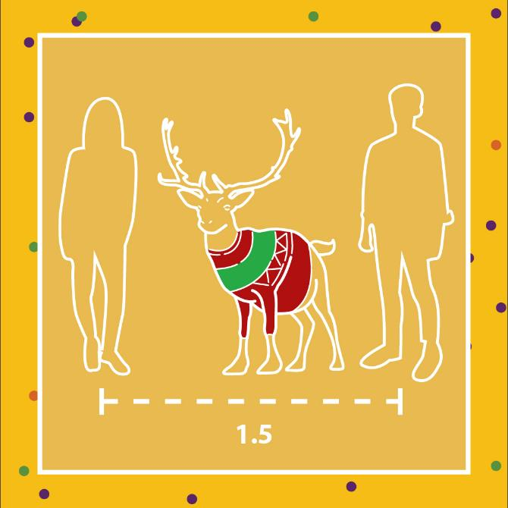
Events inside the home: messaging
How to manage an indoor festive or holiday gathering
COVID-19 spreads easily through social gatherings, so it's important we continue to be COVID Safe with friends and extended family
Limit the number of people you entertain at home. Find the latest information and advice on allowed numbers at gatherings at nsw.gov.au
Plan outdoor gatherings at home to make the most of the season and be COVID Safe
If the weather moves you inside, choose large, well-ventilated spaces and try and keep doors and windows open
Stay 1.5m away from people you don’t live with, even friends and extended family
Don't entertain if unwell, or anyone in your household is unwell. Instead, get tested immediately even if symptoms are mild and self-isolate until you receive a negative COVID-19 test result. There is no limit to the number of tests you can have and most people in NSW receive their test results within 24 hours. The main symptoms of COVID-19 are fever, cough, sore/scratchy throat, shortness of breath, runny nose, loss of smell or loss of taste.
Stay safe, wash your hands regularly, avoid touching your face and minimise close physical contact with people you don’t live with. A wave is safer.
It might be hard to say ‘no' to a hug, but it’s how we can keep our loved ones safe this festive season
Keep a list of your visitors and guests including their contact details so you can help NSW Health contact tracers get in touch quickly and easily if needed
Avoid sharing food or utensils with people you don't live with
Regularly cleaning and disinfecting surfaces in your home can help stop the spread

Slide 12
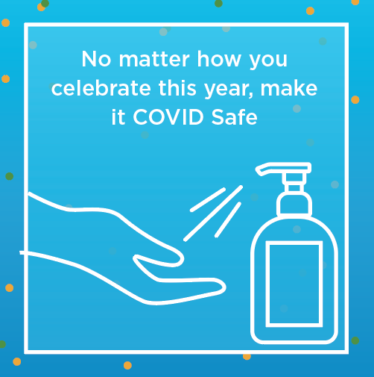
Events inside the home: newsletter / web copy
Entertaining at home this holiday & festive season
To stay ahead of the virus and continue to enjoy the quality of life we have in NSW, we need to continue to be COVID aware and safe as we plan gatherings and celebrate the festive season.
If you’re planning a gathering at home, limit the number of guests. For the latest information and guidance on numbers at gatherings, check out nsw.gov.au.
Try to gather outdoors. If the weather moves you inside, take extra COVID Safe precautions; wash your hands regularly, maintain your distance, choose large, well-ventilated spaces and try and keep doors and windows open. Avoid touching your face and minimise close physical contact with people you don’t live with. A wave is safer. It might be hard to say ‘no' to a hug, especially at this time of year, but it's how we can keep our loved ones safe this festive season.
Keep a list of your visitors and guests including their contact details so you can help NSW Health contact tracers get in touch quickly and easily if needed.
Avoid sharing food or utensils with people you don't live with. Rather than having common platters, give each person an individual portion. Make sure you practice good hand hygiene and wash or sanitise your hands regularly.
If you’re unwell, or anyone in your household is unwell don’t entertain or head out. Instead, get tested immediately, even if symptoms are mild and stay home until a negative COVID-19 test result is received, and you’re feeling well again. There is no limit to the number of tests you can have and most people in NSW receive their test results within 24 hours.
COVID-19 is still here. We all need to play our part and be COVID Safe this holiday season so we can continue doing the things we love in 2021.

Slide 13
Events inside the home: social posts - general
Tiles – To download the tiles, right click on the image and choose ‘Save Media As’
Post: To stay ahead of the virus this Summer, we must continue to be COVID aware and safe. For the latest information and guidance about gatherings, visit nsw.gov.au
Post: If you or anyone in your household is unwell, don't entertain or go out. Get tested immediately and stay home until you receive your test results. To find your nearest testing clinic, visit nsw.gov.au
Post: Planning a gathering at home this holiday season? Make the most of the warmer weather and host it outside. Moving your party to the backyard is one of the ways that you can be COVID Safe.

Slide 14
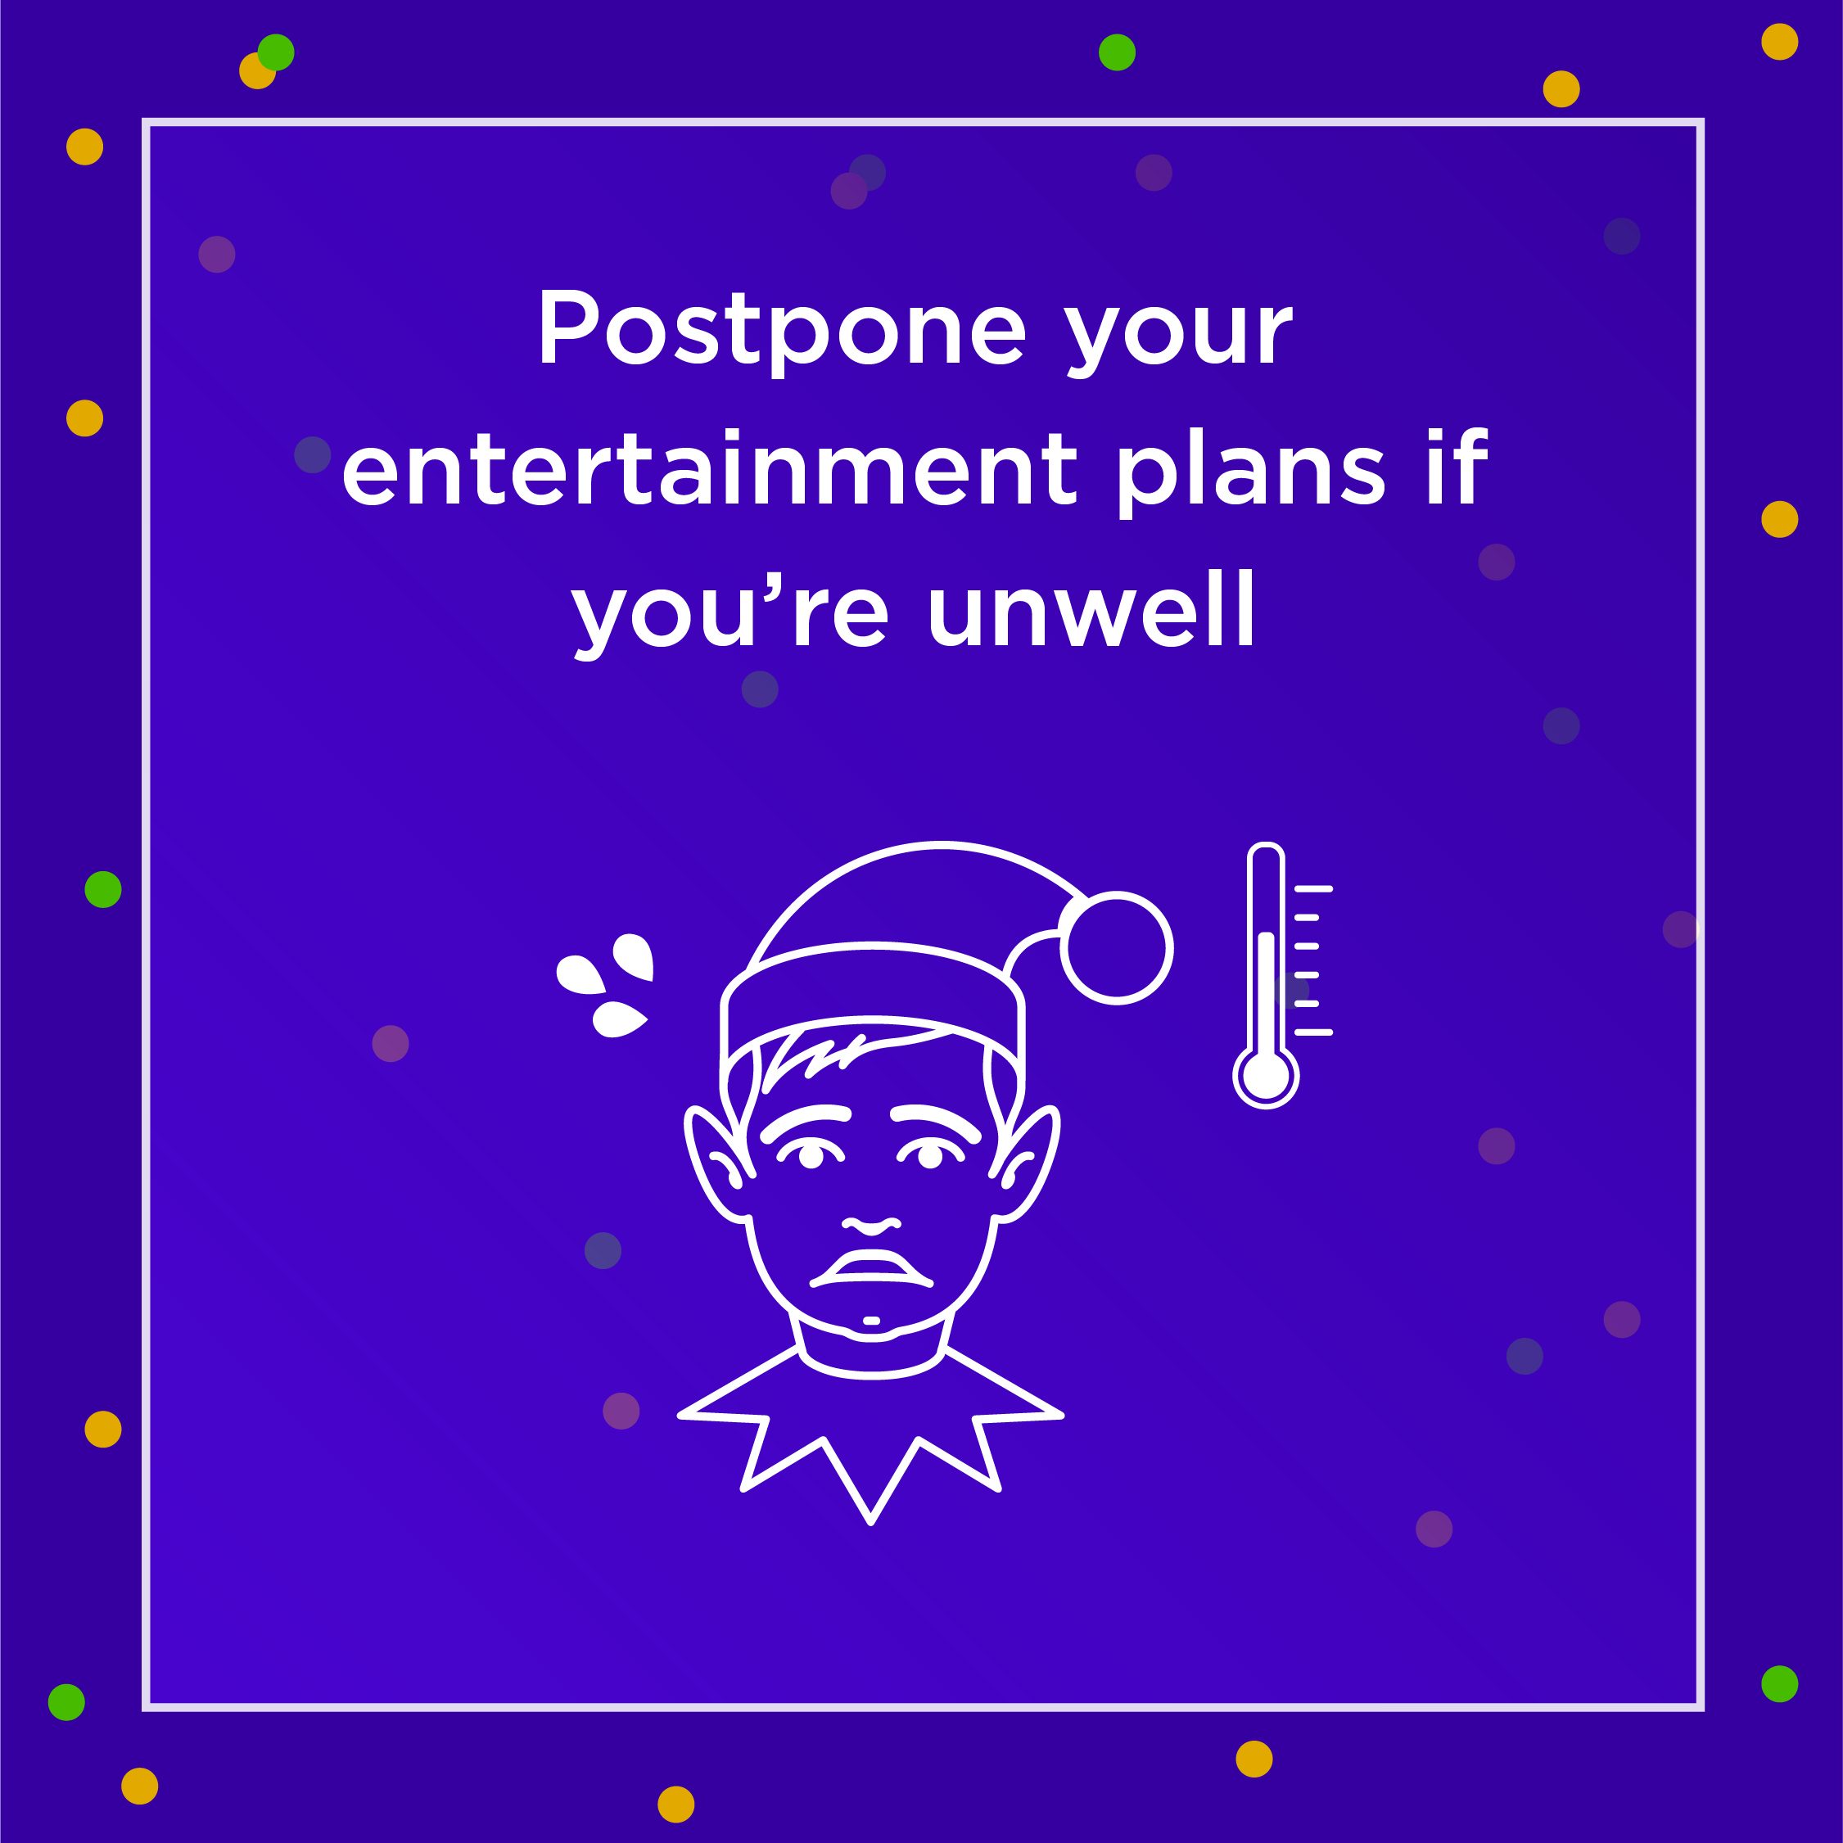
Events inside the home: social posts - Christmas
Tiles – To download the tiles, right click on the image and choose ‘Save Media As’
Post: Remember to keep 1.5m (or roughly one reindeer) apart from others when attending events this Christmas. And if you can't keep your distance, wear a mask.
Post: Don't entertain if you or anyone in your household is unwell. Instead, get tested immediately even if symptoms are mild and self-isolate until you receive a negative COVID-19 test result.
Post: Saying ‘no’ to hugs from loved ones is hard - but it's a small thing that you can do to keep everyone safe this festive season.

Slide 15
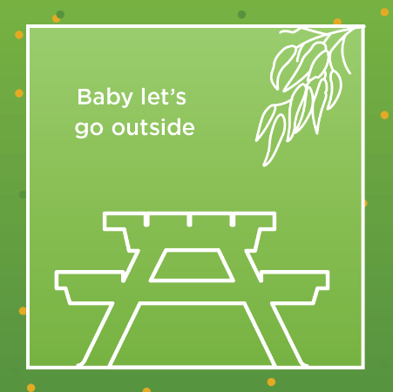
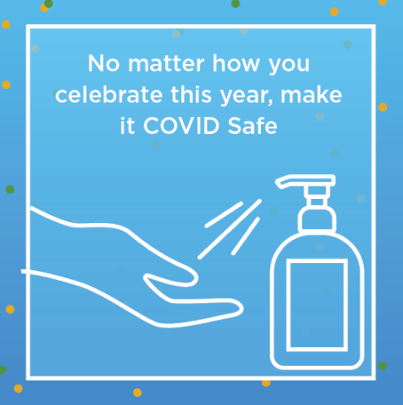
Events inside the home: social posts - NYE
Tiles – To download the tiles, right click on the image and choose ‘Save Media As’
Post: Baby it's (not) cold outside. If you’re having friends and family over to bring in the new year, why not take advantage of the weather and move the party outside? It’s one of the ways to be COVID Safe.
Post: The midnight fireworks will be broadcast live on ABC TV so you can watch them from the comfort of your own home. For more information visit nsw.gov.au/nye
Post: New Year's Eve celebrations will look a bit different this year. No matter how you choose to celebrate it, make it a COVID Safe one. Wash your hands, keep 1.5m apart or wear a mask if you can’t. For more information visit nsw.gov.au

Slide 16
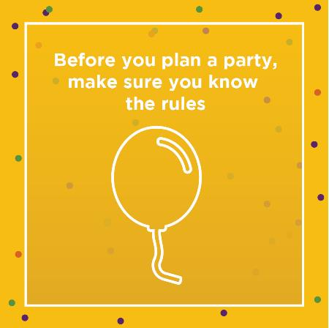
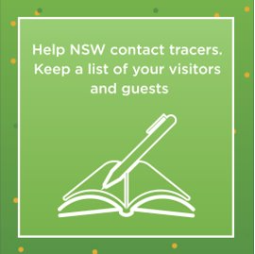
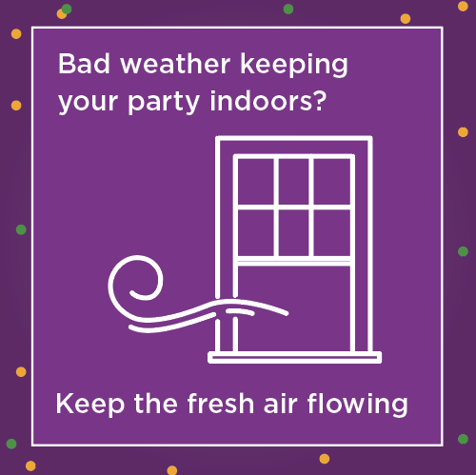
Events inside the home: social posts - Parties
Tiles – To download the tiles, right click on the image and choose ‘Save Media As’
Post: To keep doing the things we love this Summer, we must continue to be COVID aware and safe. For the latest information and guidance about gatherings visit nsw.gov.au
Post: If you’re hosting a party over the Summer, keep a list of your visitors and guests including their contact details so you can help NSW Health contact tracers get in touch easily if needed.
Post: If bad weather stops you from holding your party outdoors, try to keep doors and windows open. It's a small thing you can do to help keep NSW COVID Safe.

Slide 17
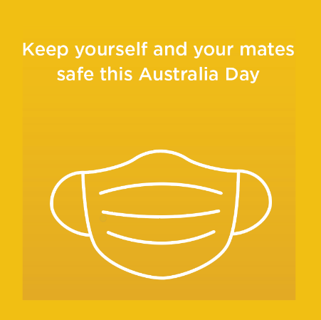
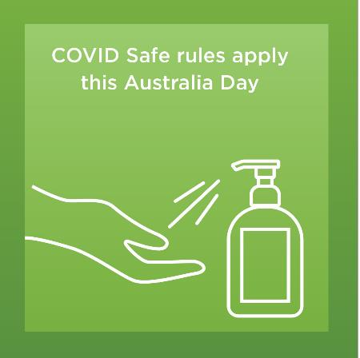
Events inside the home: social posts – Australia Day
Tiles – To download the tiles, right click on the image and choose ‘Save Media As’
Post: If you’re throwing a party this Australia Day, keep yourself and your mates safe by ensuring you wash your hands, keep 1.5m apart or wear a mask if you can’t.
Post: No matter how you celebrate Australia Day, make sure you do it in a COVID Safe way.

Slide 18
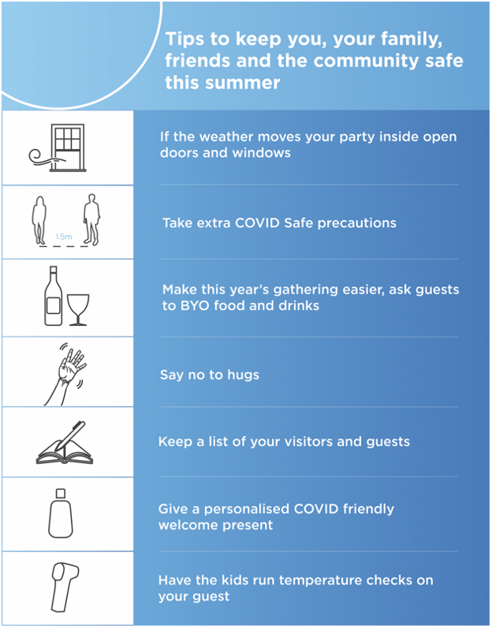
Events inside the home: Tips and tricks infographic
This summer's festivities and social gatherings at home are going to be different
Tips to keep you, your family, friends and the community safe:
Try hosting your event in the backyard, deck or verandah or if weather moves you inside, choose a large, well-ventilated space and open all doors and windows where possible.
Take extra COVID Safe precautions; wash your hands regularly, keep 1.5 metres apart from people you don’t live with, and try and keep doors and windows open if you are inside.
Make this year’s gathering easier, ask guests to BYO food and drinks.
Say ‘no' to hugs; it's hard to do especially at this time of year, but it’s how we can keep our loved ones safe.
Keep a list of your visitors and guests including their contact details so you can help NSW Health contact tracers get in touch quickly and easily if needed.
Provide hand sanitiser for your guests but remember to keep it out of reach of young children.
To download the infographic, right click on the image and choose ‘Save Media As’

Slide 19
Events inside the home: example invitation (from hosts to event attendees)
Looking forward to seeing you
at our COVID Safe party
Please join us to help celebrate …..
Things are a little different this year and we wanted to reassure you while we're planning a great celebration, we're keen to keep everyone safe.
We're aiming to be outside to enjoy our celebrations and the summer weather, so bring some protective gear (a hat and some shades/or if it's cool bring a wrap). We're asking everyone to bring their own food and drink so we can minimise sharing of plates. We'll supply the tunes (as well as cutlery, cups, hand sanitiser and spare masks) so we can have a great time.
We're also asking that you stay home if you are unwell in any way and get tested if you have any COVID-19 symptoms, but we don't want you to miss out which is why we'll be setting up a video link for those who can't be here in person.
We can't wait to celebrate with you.

Slide 20
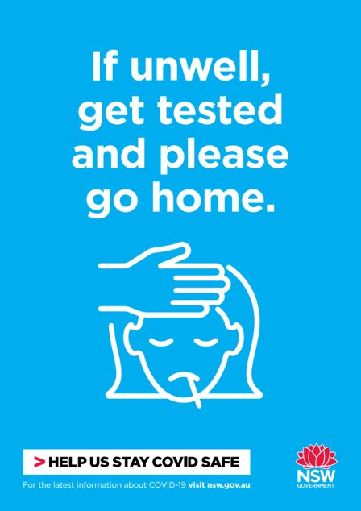
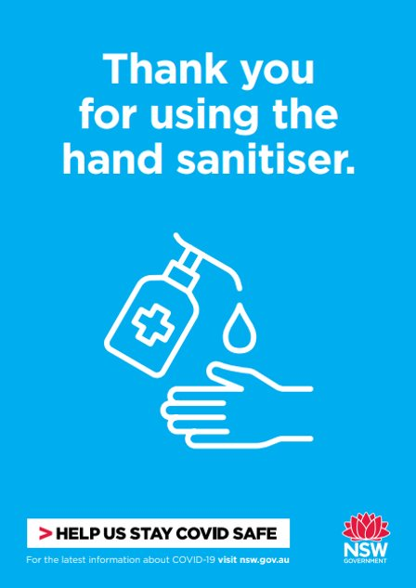
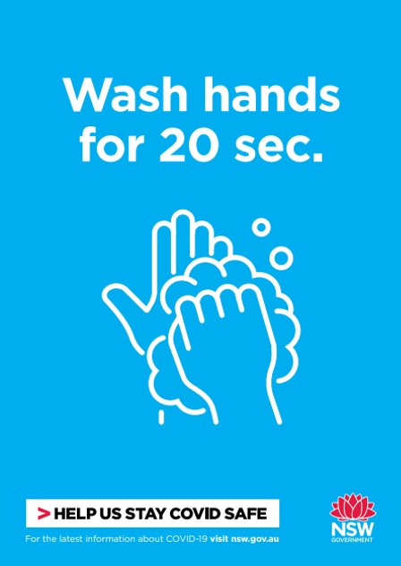
Events inside the home: printable posters for your home
Find the full range of posters at nsw.gov.au​
Click here to download
If unwell, get tested and please go home​
Click here to download
Thank you for using the hand sanitiser​
Click here to download
Wash hands for 20 sec

Slide 21
Events outside of the home
Messaging
Public controlled outdoor events for Councils
Private events outside the home for consumers
Private events outside the home for businesses
Newsletter / web copy
Social content

Slide 22
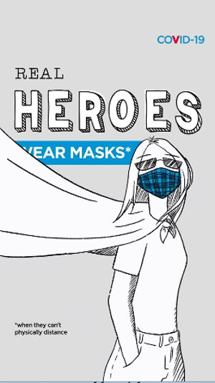
Events outside the home: public outdoor events - messaging
Carols, markets or New Year’s Eve
We know this summer is different and as we consider the usual community carols evenings, open air markets and New Year’s celebrations the community’s safety is paramount: stay COVID aware and safe.
The people of NSW have demonstrated that by working together and following COVID Safe protocols, restrictions can be eased. For the latest information on allowed numbers at events and the guidelines in place to keep performers and audience members safe at events, check www.nsw.gov.au/covid-19
Controlled outdoor events
Organiser must have and comply with a COVID-19 Safety Plan.
Permitted to have:
the lesser of one person per 2 square metres or 5,000 people if seating is assigned, or
the lesser of one person per 2 square metres or 3,000 people if allocated seating areas are used.
Must be fenced, ticketed, seated and less than 5 hours duration.
Must electronically collect records. The Service NSW COVID Safe Check-in is recommended as a free, secure and convenient system but councils are free to choose any electronic system that meets the record keeping requirements.
Outdoor rehearsal and performance
Organiser must have and comply with a COVID-19 Safety Plan.
Permitted to have the lesser of one person per 2 square metres or 3,000 people with no limit on duration.
No time limit. Patrons do not need to be seated; however, dancefloors outdoors can only have one person per 4 square metres to a maximum of 500 people. Alcohol is not permitted on any dancefloors.
Strongly encouraged to collect contact details electronically where practicable.
Singing and chanting remains a high-risk activity for transmission. Please visit nsw.gov.au for the most up to date information.
Non-food markets
Organiser must have and comply with a COVID-19 Safety Plan.
Permitted to have one customer per 2 square metres of space, with no limit on attendees or time.
Non-food markets including artisan, clothing and craft markets.
COVID-19 is still here. To keep doing the things we love we all need to play our part and continue to respond quickly and safely this holiday season. Let's protect our family, friends and community by being COVID Safe – we will get through this together.
Link to download – Facebook (in feed)
Link to download – Instagram (stories)
Link to download – SnapChat

Slide 23
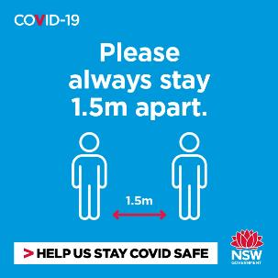
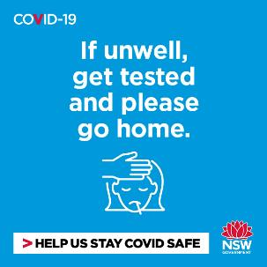
Private events outside the home: messaging
Planning or attending an outdoor gathering
To keep doing the things we love in NSW, we need to continue to be COVID aware and safe as we plan gatherings and celebrate the festive season.
Parks and open spaces are places where we can relax, exercise and enjoy the outdoors. We just have to use them in a COVID Safe way.
Limit the number of guests in your group when at outdoor spaces and venues. For the latest information and guidance on gatherings, check www.nsw.gov.au/covid-19.
We all need to be considerate of others and share public spaces. Limit your time at the beach/parks/cafes/restaurants so everyone can enjoy our beautiful outdoors and venues safely.
Plan your day in advance. Stay up to date with beach/park closures and book other activities and venues where you can.
If you arrive at your destination and cannot maintain physical distancing, try somewhere less crowded. Wear a mask when you can’t physically distance.
Now is a good time to explore our less-travelled parks, trails and spaces. Discover somewhere new and find your own safe space.
If you’re unwell, or anyone in your household is unwell, stay home. Instead, get tested immediately and self-isolate. There is no limit to the number of tests you can have and most people in NSW receive their test results within 24 hours.
Stay safe, wash your hands regularly and keep 1.5 meters apart from people you don’t live with.
It might be hard to say ‘no' to a hug, but it’s how we can keep our loved ones safe this festive season.
Suggest BYO picnic rugs and chairs along with food and avoid sharing utensils with people you don't live with.
Keep a diary, photos or social media posts to record who joined you, as contact tracing helps stop the spread of COVID-19 in our community.

Slide 24
Private events outside the home: New Year’s Eve
New Year's Eve in Sydney CBD
Social media tile – to download, right click on the image and choose ‘Save Media As’
New Year’s Eve celebrations in Sydney are going to look different this year so we can keep everyone safe
This includes the fireworks: there will be no 9pm fireworks and the midnight fireworks will be shorter than previous years
Vantage points around Circular Quay will be reserved for frontline workers as a token of appreciation
There will be COVID Safe measures in place around the city to keep everyone safe
If you're planning to celebrate in the CBD, you will need to book ahead
Anyone wishing to enter areas around the Harbour will require a New Year's Eve pass
New Year's Eve passes can be downloaded for those with confirmed bookings via Service NSW
For more information visit www.nsw.gov.au/NYE
Post: New Year's Eve celebrations in the CBD are going to look different this year to keep everybody safe. You will need a New Year's Eve pass to enter restricted areas around the Harbour. For more information visit www.nsw.gov.au/NYE

Slide 25
Private events outside the home: messaging for businesses
Hosting private events
We know the holiday season means big business for our businesses. To keep doing the things we love in NSW, we need to continue to be COVID aware and safe as we plan gatherings and celebrate the festive season.
All businesses that prepare and serve food on premise or for take away are required to have a COVID-19 safety plan in place.
Electronic check-in is now mandatory for more businesses. COVID Safe registered businesses have access to the free Service NSW COVID Safe Check-in tool but businesses are free to choose any electronic system that meets the record keeping requirements.
There are density limits in place to protect you and your customers, so make sure you’re up to date with the latest guidelines. Check out nsw.gov.au for the latest information and guidance.
If any staff or patron is unwell, ask them to go home, get tested immediately, even if symptoms are mild, and stay home until they receive a negative COVID-19 test result. The main symptoms of COVID-19 are fever, cough, sore/scratchy throat, shortness of breath, loss of smell, loss of taste and runny nose. Most people in NSW receive their test results within 24 hours.
Stay safe, wash your hands regularly and keep 1.5 metres apart from people you don’t live with.
The pandemic is not over. NSW is not immune from the risk of renewed outbreaks, so we have to remain vigilant and COVID aware.

Slide 26
Events outside the home: Changes to liquor laws for businesses
24-hour economy liquor reforms
Social media tile – to download, right click on the image and choose ‘Save Media As’
A range of changes to NSW liquor laws to support nightlife and encourage a vibrant and safe 24-hour economy begin to rollout from 11 December 2020
Initial changes will encourage live music and entertainment, arts and cultural events, support small bars and make licensee obligations clearer. Most other changes start in 2021
For detailed information about the changes, please visit www.liquorandgaming.nsw.gov.au/news-and-media/24-hour-economy-liquor-reforms-whats-changing
Post: New 24-hour economy liquor laws to encourage live music, support small bars and make licensee obligations clearer as we head into summer started from 11 December. Other changes will start in 2021 and 2022. Learn more at liquorandgaming.nsw.gov.au

Slide 27
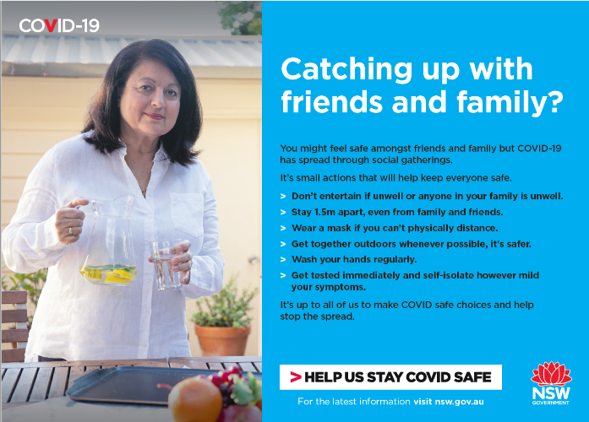
Events outside the home: newsletter/web copy
Organising an outdoor catch up with family & friends
To stay ahead of the virus and continue to enjoy the quality of life we have in NSW, we need to continue to be COVID aware and safe as we plan gatherings and celebrate the festive season.
Parks and open spaces are great places where we can relax, exercise and enjoy the outdoors. We just have to use them in a COVID Safe way.
Find the latest information and advice on allowed numbers at outdoor gatherings in public spaces at nsw.gov.au
Take your own picnic food and drink, as well as a picnic rug to ‘mark’ your safe space. For the latest information on allowed numbers at gatherings, check nsw.gov.au.
Keep 1.5 metres apart from people you don’t live with and wash or sanitise your hands regularly. It might be hard to say ‘no' to a hug, especially at this time of year, but it’s how we can keep our loved ones safe.
We all need to be considerate of others and share public spaces. Limit your time at the beach/parks/cafes/restaurants so everyone can enjoy our beautiful outdoors and venues safely, especially when visiting regional NSW.
Plan your day in advance. If you arrive at your destination and cannot maintain physical distancing, try somewhere less crowded. Wear a mask when you can’t physically distance.
Now is a good time to explore our less-travelled parks, trails and spaces. Discover somewhere new and find your own safe space.
Stay safe and be respectful of the communities you visit. Protect yourself, your family and the NSW community.
If you’re unwell, or anyone in your household is unwell, don’t head out. Instead, get tested and stay home until a negative COVID-19 result is received, and you’re feeling well again. There is no limit to the number of tests you can have and most people in NSW receive their test results within 24 hours.
The pandemic is not over. We all need to play our role and do the right things this holiday season so 2021 is safe for us all.

Slide 28
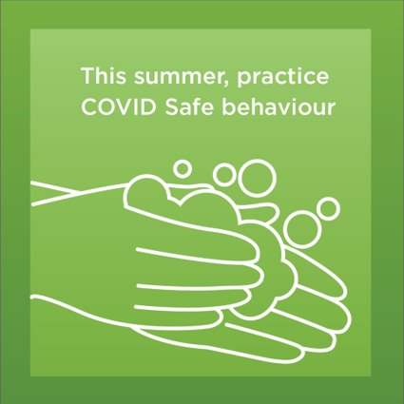
Events outside the home: social posts - general
Tiles – To download the tiles, right click on the image and choose ‘Save Media As’
Post: We know this summer is going to be different. To keep doing the things we love, let’s all practice COVID Safe behavior and keep everyone safe.
Post: Planning a picnic in the park? Remember to stay COVID Safe and keep your distance from those you don’t live with.
Post: No matter what you’re doing to take a load off this summer, make sure you stay safe, wash your hands regularly and keep 1.5 metres apart from people you don’t live with.

Slide 29
Events outside the home: social posts – for businesses
Tiles – To download the tiles, right click on the image and choose ‘Save Media As’
Post: We know the holiday season means big business for our businesses. Make sure you have your COVID Safe plans in place. For more information visit nsw.gov.au
Post: Make sure you’re prepared to welcome customers this holiday season. For many businesses, this includes having a mandatory electronic check-in. Find out more at nsw.gov.au

Slide 30
Events outside the home: social posts – singing events
Tiles – To download the tiles, right click on the image and choose ‘Save Media As’
Post: Singing is a high-risk activity for transmission. There are guidelines in place to keep performers and audience members safe at both indoor and outdoor events. Visit nsw.gov.au for the most up to date information
Post: If the audience or congregation are likely to be singing at your event, anyone 12 years or over should be wearing a mask. Visit nsw.gov.au for the most up to date information

Slide 31
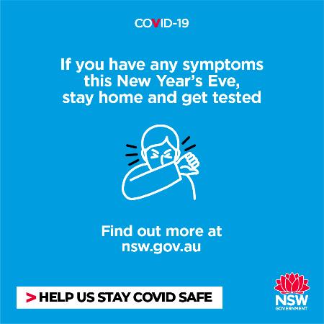
Events outside the home: social posts – New Year’s Eve
Tiles – To download the tiles, right click on the image and choose ‘Save Media As’
Post: We want everyone to have a safe and enjoyable New Year's Eve. That’s why it’s important if you have any COVID-19 symptoms, even mild, that you stay home and get tested as soon as possible. The midnight fireworks will be live on ABC TV, so you won’t miss out. For more information visit nsw.gov.au
Post: Fireworks viewing vantage points inside the Green Zone, including Sydney Opera House, Cahill Expressway, Campbell’s Cove and Mrs Macquarie’s Point will be reserved for frontline workers to thank them for their hard work this year. For more information visit nsw.gov.au
Post: No matter where you choose to celebrate New Year’s Eve this year, make it a COVID Safe one. Wash your hands, keep 1.5m distance or wear a mask if you can’t. Making sure we stay vigilant will help to keep us all safe. For more information visit nsw.gov.au

Slide 32
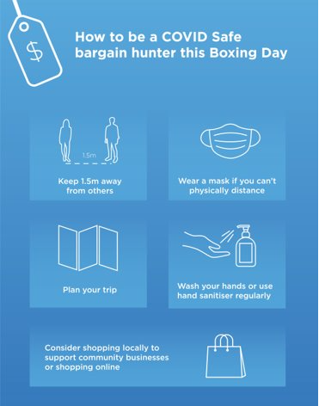
Events outside the home: how to be a COVID Safe bargain hunter this Boxing Day - infographic
To download the infographic, right click on the image and choose ‘Save Media As’
How to be a COVID Safe bargain hunter this Boxing Day:
Keep 1.5m away from others
Wear a mask if you can’t physically distance
Plan your trip
Wash your hands or use hand sanitiser regularly
Consider shopping locally to support community businesses or shopping online

Slide 33
Events outside the home: printable poster for businesses
Find the full range of posters at nsw.gov.au​
Click here to download
If unwell, get tested and please go home​
Click here to download
Thank you for using the hand sanitiser​
Click here to download
Wash hands for 20 sec

Slide 34
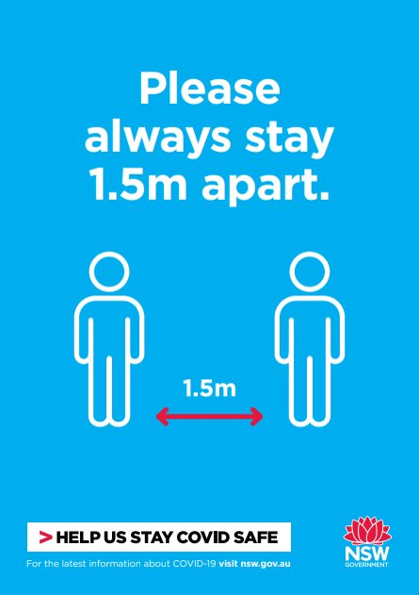
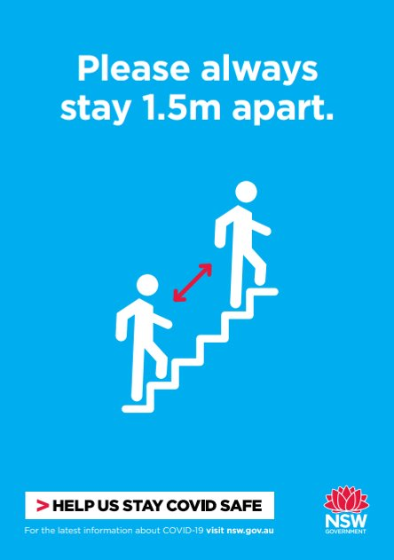
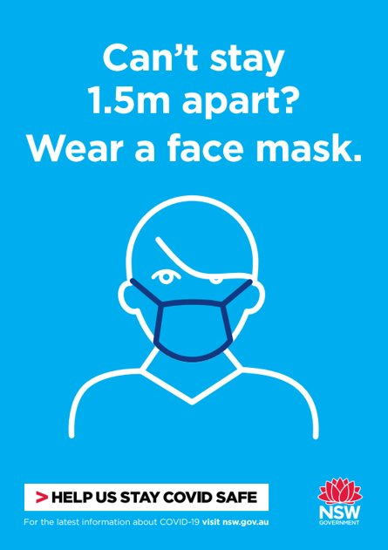
Events outside the home: printable poster for businesses
Find the full range of posters at nsw.gov.au​
Click here to download
Please always stay 1.5m apart​
Click here to download
Please always stay 1.5m apart
Click here to download
Can’t stay 1.5m apart? Wear a face mask​
34

