Slide 1
NSW/SA border stakeholder pack
December 2020

Slide 2
Purpose – stakeholder toolkit
Following the recent COVID-19 outbreak in South Australia, the NSW Government has made changes to the entry requirements for travellers coming to NSW from South Australia.
Travellers coming from South Australia must now complete a NSW entry declaration form. The form can be accessed at www.service.nsw.gov.au/transaction/complete-nsw-entry-declaration-form
This toolkit will help get the message about the border changes out. The adaptable content is designed to provide information and highlight how we can remain COVID Safe while keeping the border open.
It should be used in conjunction with information at nsw.gov.au which is being updated continuously.
Thank you for your support.

Slide 3
Key messages
What do I need to do?
NSW residents currently in SA wishing to return to NSW
If you have any COVID-19 symptoms, even if mild, or if you have been identified as a close contact associated with a confirmed case of COVID-19, please follow the advice from SA Health and do not travel to NSW. Get tested immediately and stay in your accommodation.
If you are a NSW resident and you have been in one of the areas of concern listed at https://www.nsw.gov.au/covid-19/what-you-can-and-cant-do-under-rules/border-restrictions/areas-of-concern-south-australia, ensure you get tested and immediately self-isolate for 14 days upon arrival in NSW
If you've been in SA in the last 14 days, you must complete a NSW entry declaration form within the 24 hours before or when you arrive back in NSW regardless of mode of transport. This will allow NSW Health to contact you quickly about any possible COVID-19 exposure.
The form is available at www.service.nsw.gov.au/transaction/complete-nsw-entry-declaration-form
If you're arriving at an airport, you will be required to go through a screening process
If you experience even mild COVID-19 symptoms on your return to NSW, get tested immediately and self-isolate until you receive a negative test result
COVID-19 testing is free for everyone, safe and easy. Most people receive their test result within 24 hours

Slide 4
Key messages
What do I need to do?
SA residents travelling to NSW
While the borders between NSW and SA remain open, it is recommended you delay all non-essential travel to NSW – this will keep us all safe
If you have any COVID-19 symptoms, even if mild, or have been identified as a close contact associated with a confirmed case of COVID-19, please follow the advice from SA Health and do not travel to NSW. Get tested immediately and stay home.
If you have been in one of the areas of concern listed at https://www.nsw.gov.au/covid-19/what-you-can-and-cant-do-under-rules/border-restrictions/areas-of-concern-south-australia you will be unable to enter NSW unless you are transiting through by the most direct route. Even if you are transiting through NSW you still need to complete a NSW entry declaration form.
You must complete a NSW entry declaration form within the 24 hours before or when you arrive in NSW regardless of mode of transport. This will allow NSW Health to contact you quickly about any possible COVID-19 exposure.
While you’re here, if you feel unwell, get tested for COVID-19 immediately and self-isolate in your accommodation until you receive a negative test result. There are more than 300 testing clinics in NSW. To find a clinic visit www.nsw.gov.au/covid-19/how-to-protect-yourself-and-others/clinics
For more information visit nsw.gov.au (www.nsw.gov.au/covid-19/what-you-can-and-cant-do-under-rules/border-restrictions/areas-of-concern-south-australia) or SA Health (www.covid-19.sa.gov.au/response)

Slide 5
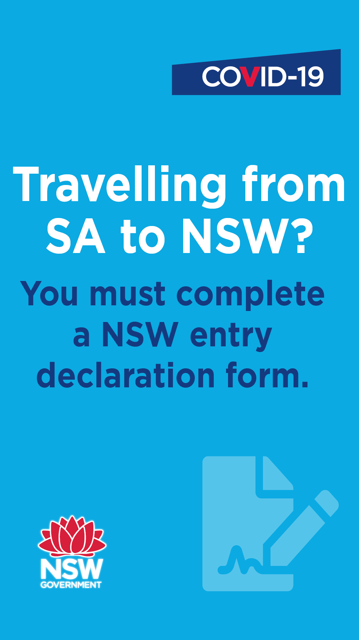
Newsletter / website copy (local government to NSW residents)
NSW entry declaration now in place for travellers from South Australia
While the borders between NSW and South Australia remain open, NSW residents are strongly urged to delay all non-essential travel to Adelaide.​
In response to the situation in South Australia, the NSW Minister for Health has implemented a travel declaration. This is to protect the community and help NSW stay COVID Safe.​
Traveling to NSW from South Australia
People coming into NSW from South Australia, by whatever mode of transport, need to complete a NSW entry declaration from that enables contact tracing if required. This can be done within the 24-hour period before entering NSW or when you enter NSW. The declaration form is available online at www.service.nsw.gov.au/transaction/complete-nsw-entry-declaration-form
If you are a NSW resident and have been to a listed area of concern in South Australia, you will be asked to be tested for COVID-19 and you must self-isolate immediately for 14 days upon arrival in NSW. The list of areas of concern can be found at: www.nsw.gov.au/covid-19/what-you-can-and-cant-do-under-rules/border-restrictions/areas-of-concern-south-australia
If you are not a NSW resident and you have been to a listed area of concern in South Australia, you will be unable to enter NSW. However, you will be able to enter if you need to transit through NSW by the most direct route. The list of areas of concern can be found at: www.nsw.gov.au/covid-19/what-you-can-and-cant-do-under-rules/border-restrictions/areas-of-concern-south-australia
If you arrive via the airport, you will be required to go through a screening process when you arrive – we're asking everyone to be considerate and patient.​
If you have been in South Australia, you should regularly monitor the SA Health Alert page. If you have any COVID-19 symptoms, even if mild, or if you have been identified as a close contact associated with a confirmed case of COVID-19, please follow the advice from SA Health and do not travel to NSW. Stay in your accommodation and get tested immediately.​
This includes immediately self-isolating if you have been to any of the venues of concern where this is advised. The most up to date list of venues of concern can be found at www.nsw.gov.au/covid-19/what-you-can-and-cant-do-under-rules/border-restrictions/areas-of-concern-south-australia
If you have already returned to NSW when your symptoms begin get tested immediately and self-isolate until you receive a negative COVID-19 test result. COVID-19 testing is free for everyone, safe and easy. Most people receive their test result within 24 hours.​
For more information visit nsw.gov.au (www.nsw.gov.au/covid-19/what-you-can-and-cant-do-under-rules/border-restrictions/areas-of-concern-south-australia ) or SA Health (www.covid-19.sa.gov.au/response ) ​

Slide 6
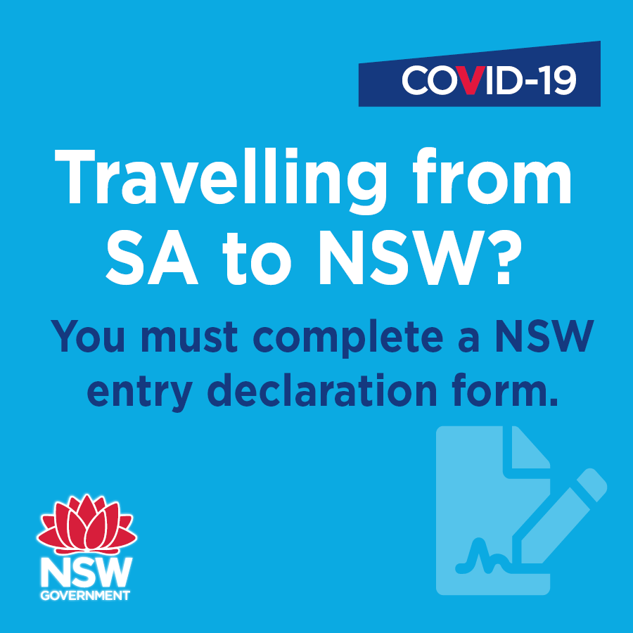
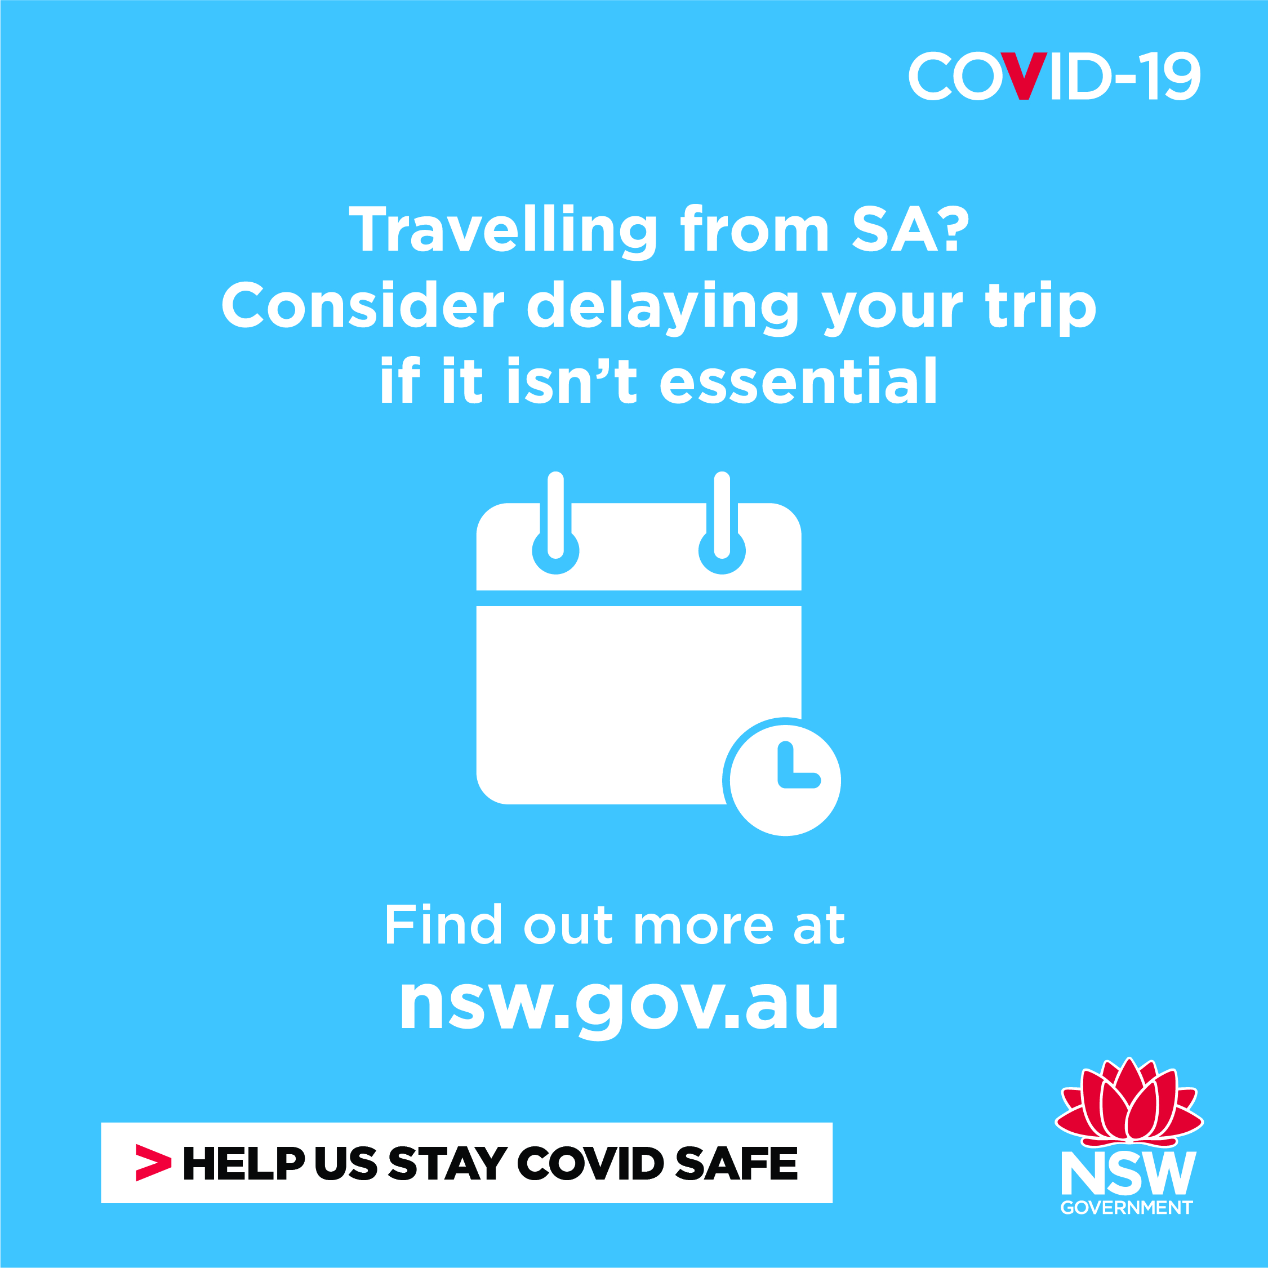
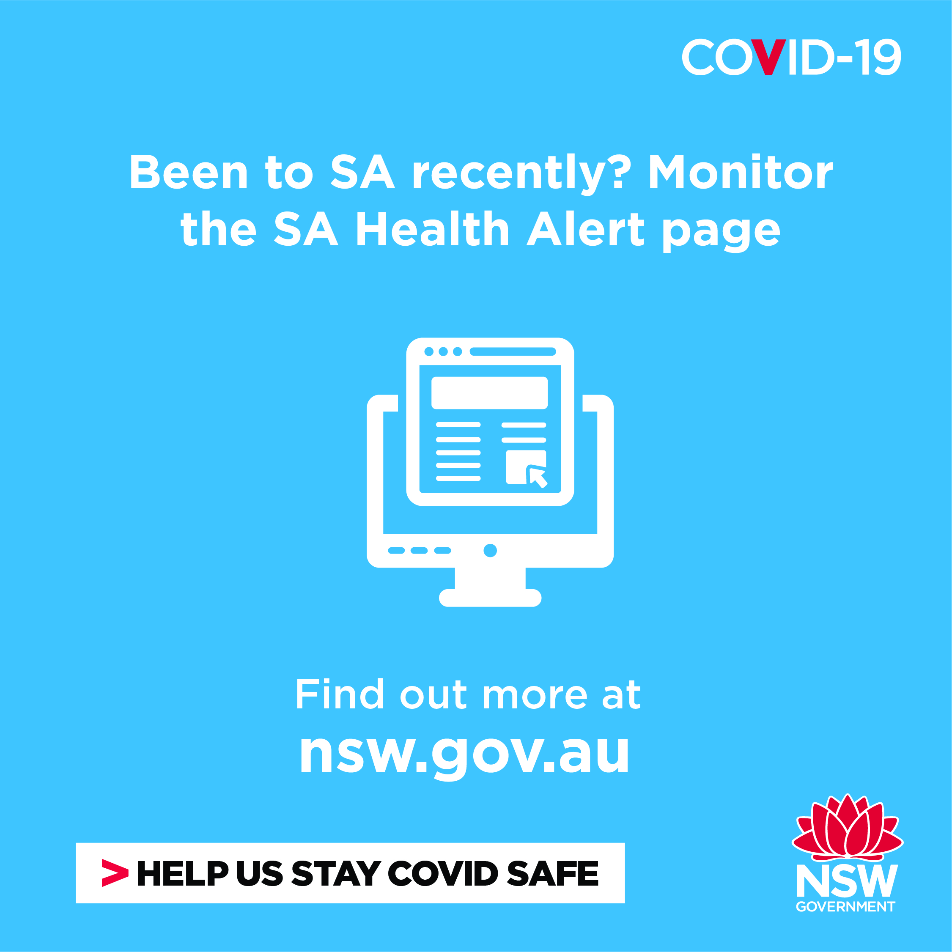
Branded social posts (local government to consumers)
To download the tiles, right click on the image and choose ‘Save As’
Tiles:
Post: If you're travelling into NSW from SA, you must complete a NSW entry declaration form in the 24 hours prior to or when you enter NSW. You can access the form online at service.nsw.gov.au/transaction/complete-nsw-entry-declaration-form
Post: You should consider delaying your trip to South Australia if it isn't for essential reasons. If you must travel, you may be required to self-isolate on your return. For more information visit nsw.gov.au
Post: If you've been to South Australia you should regularly monitor the SA Health Alert page to keep up to date on venues of concern and follow health advice.

Slide 7
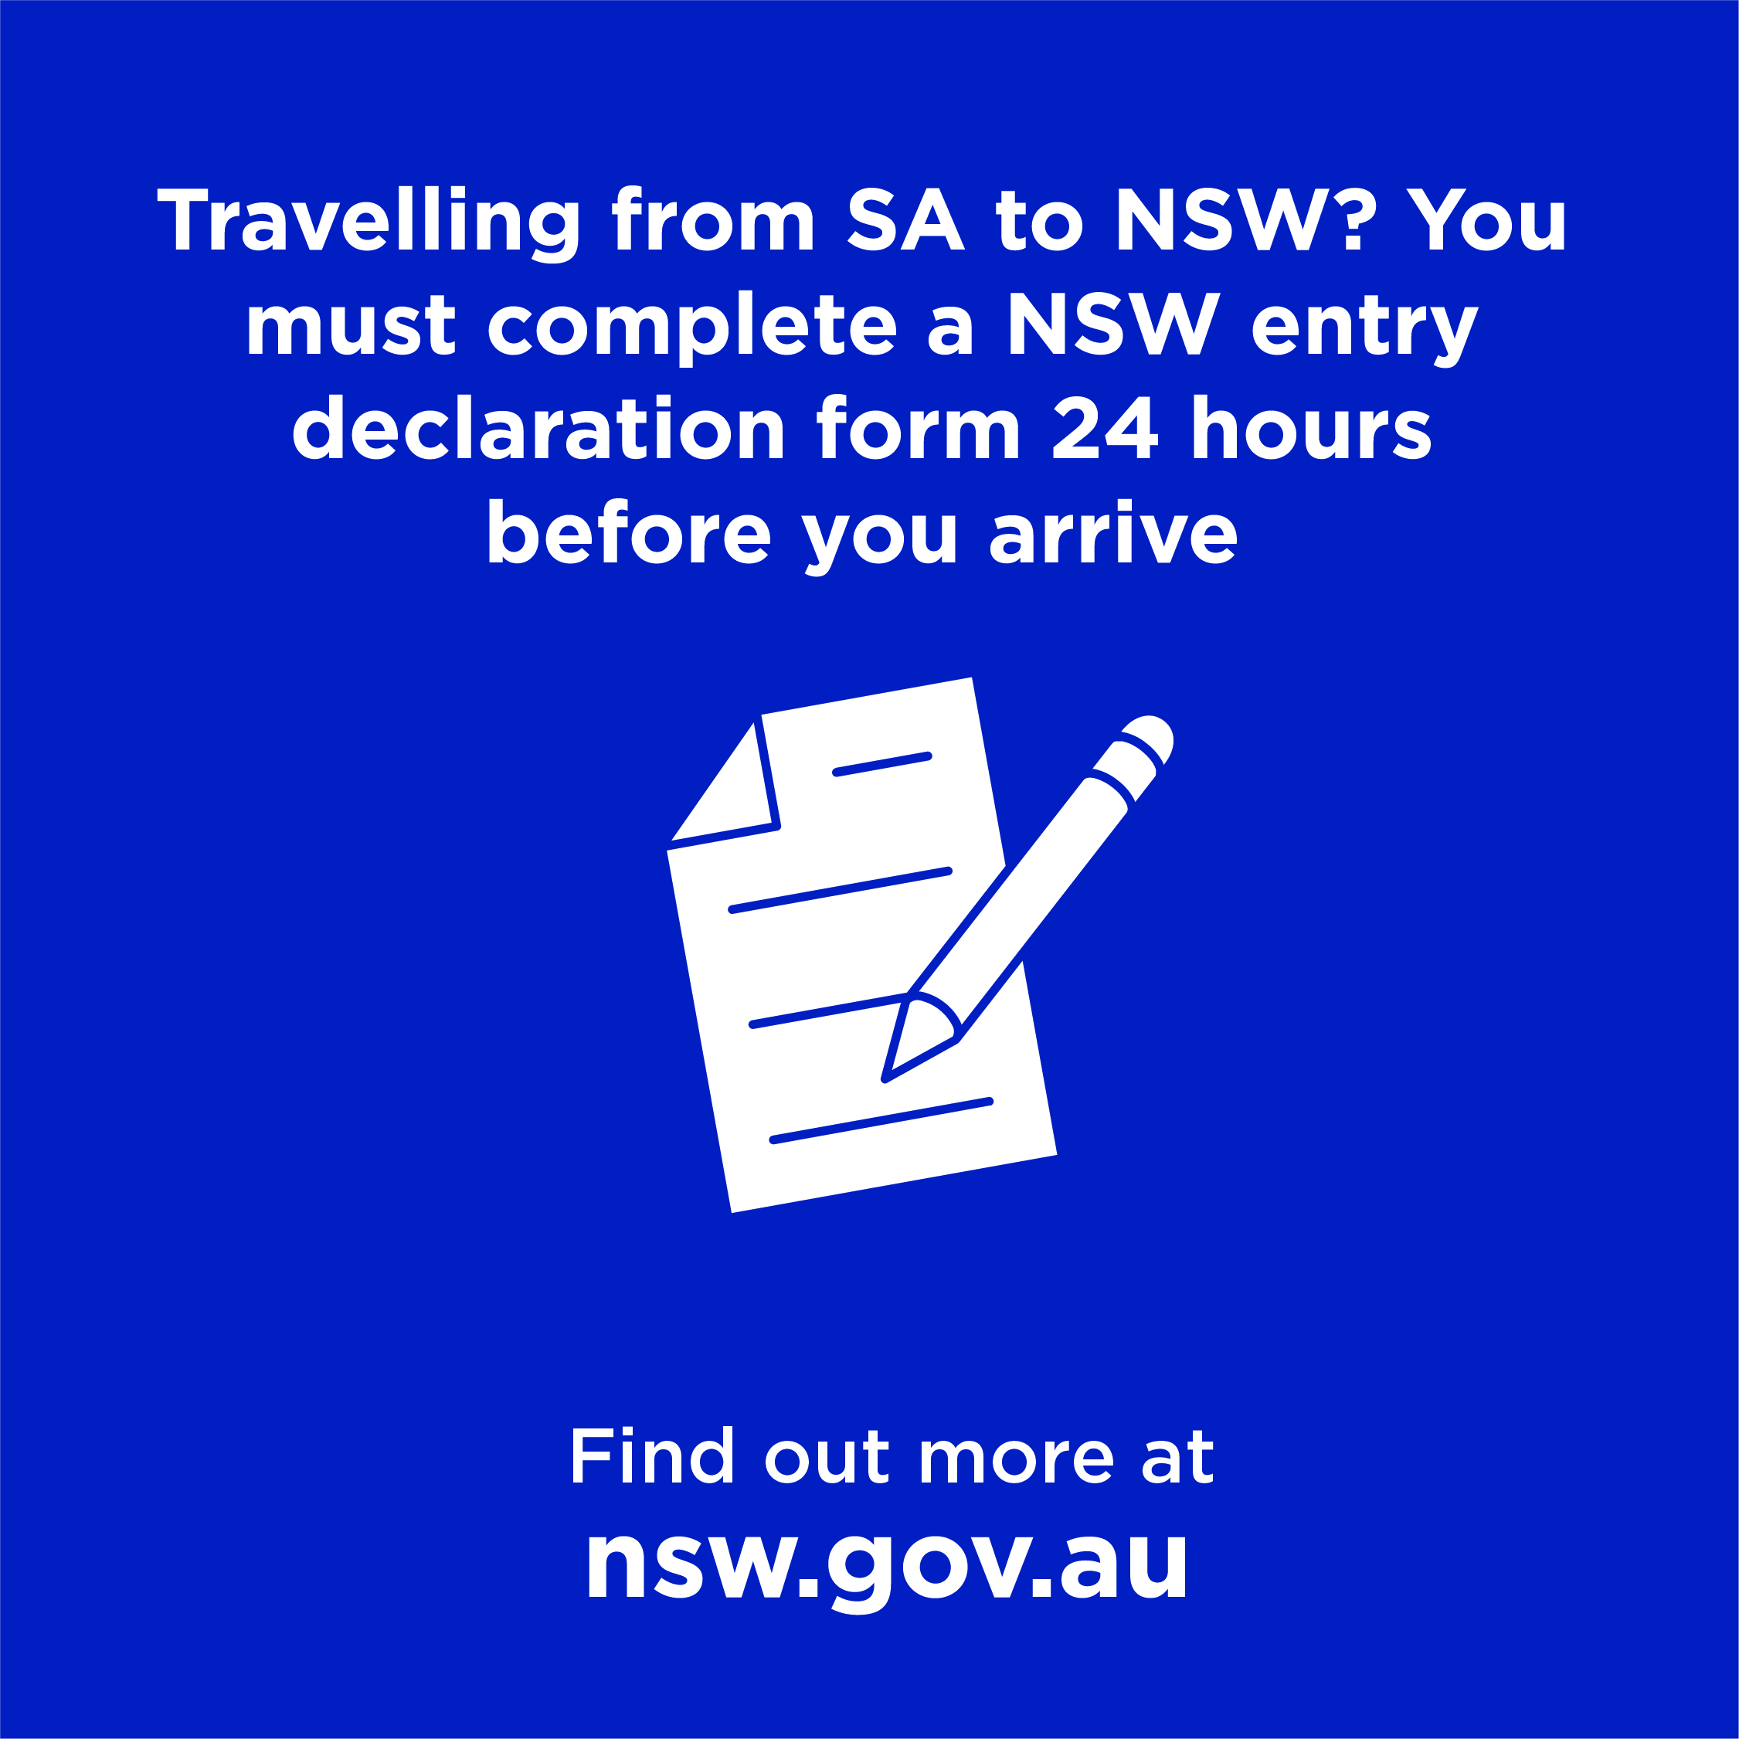
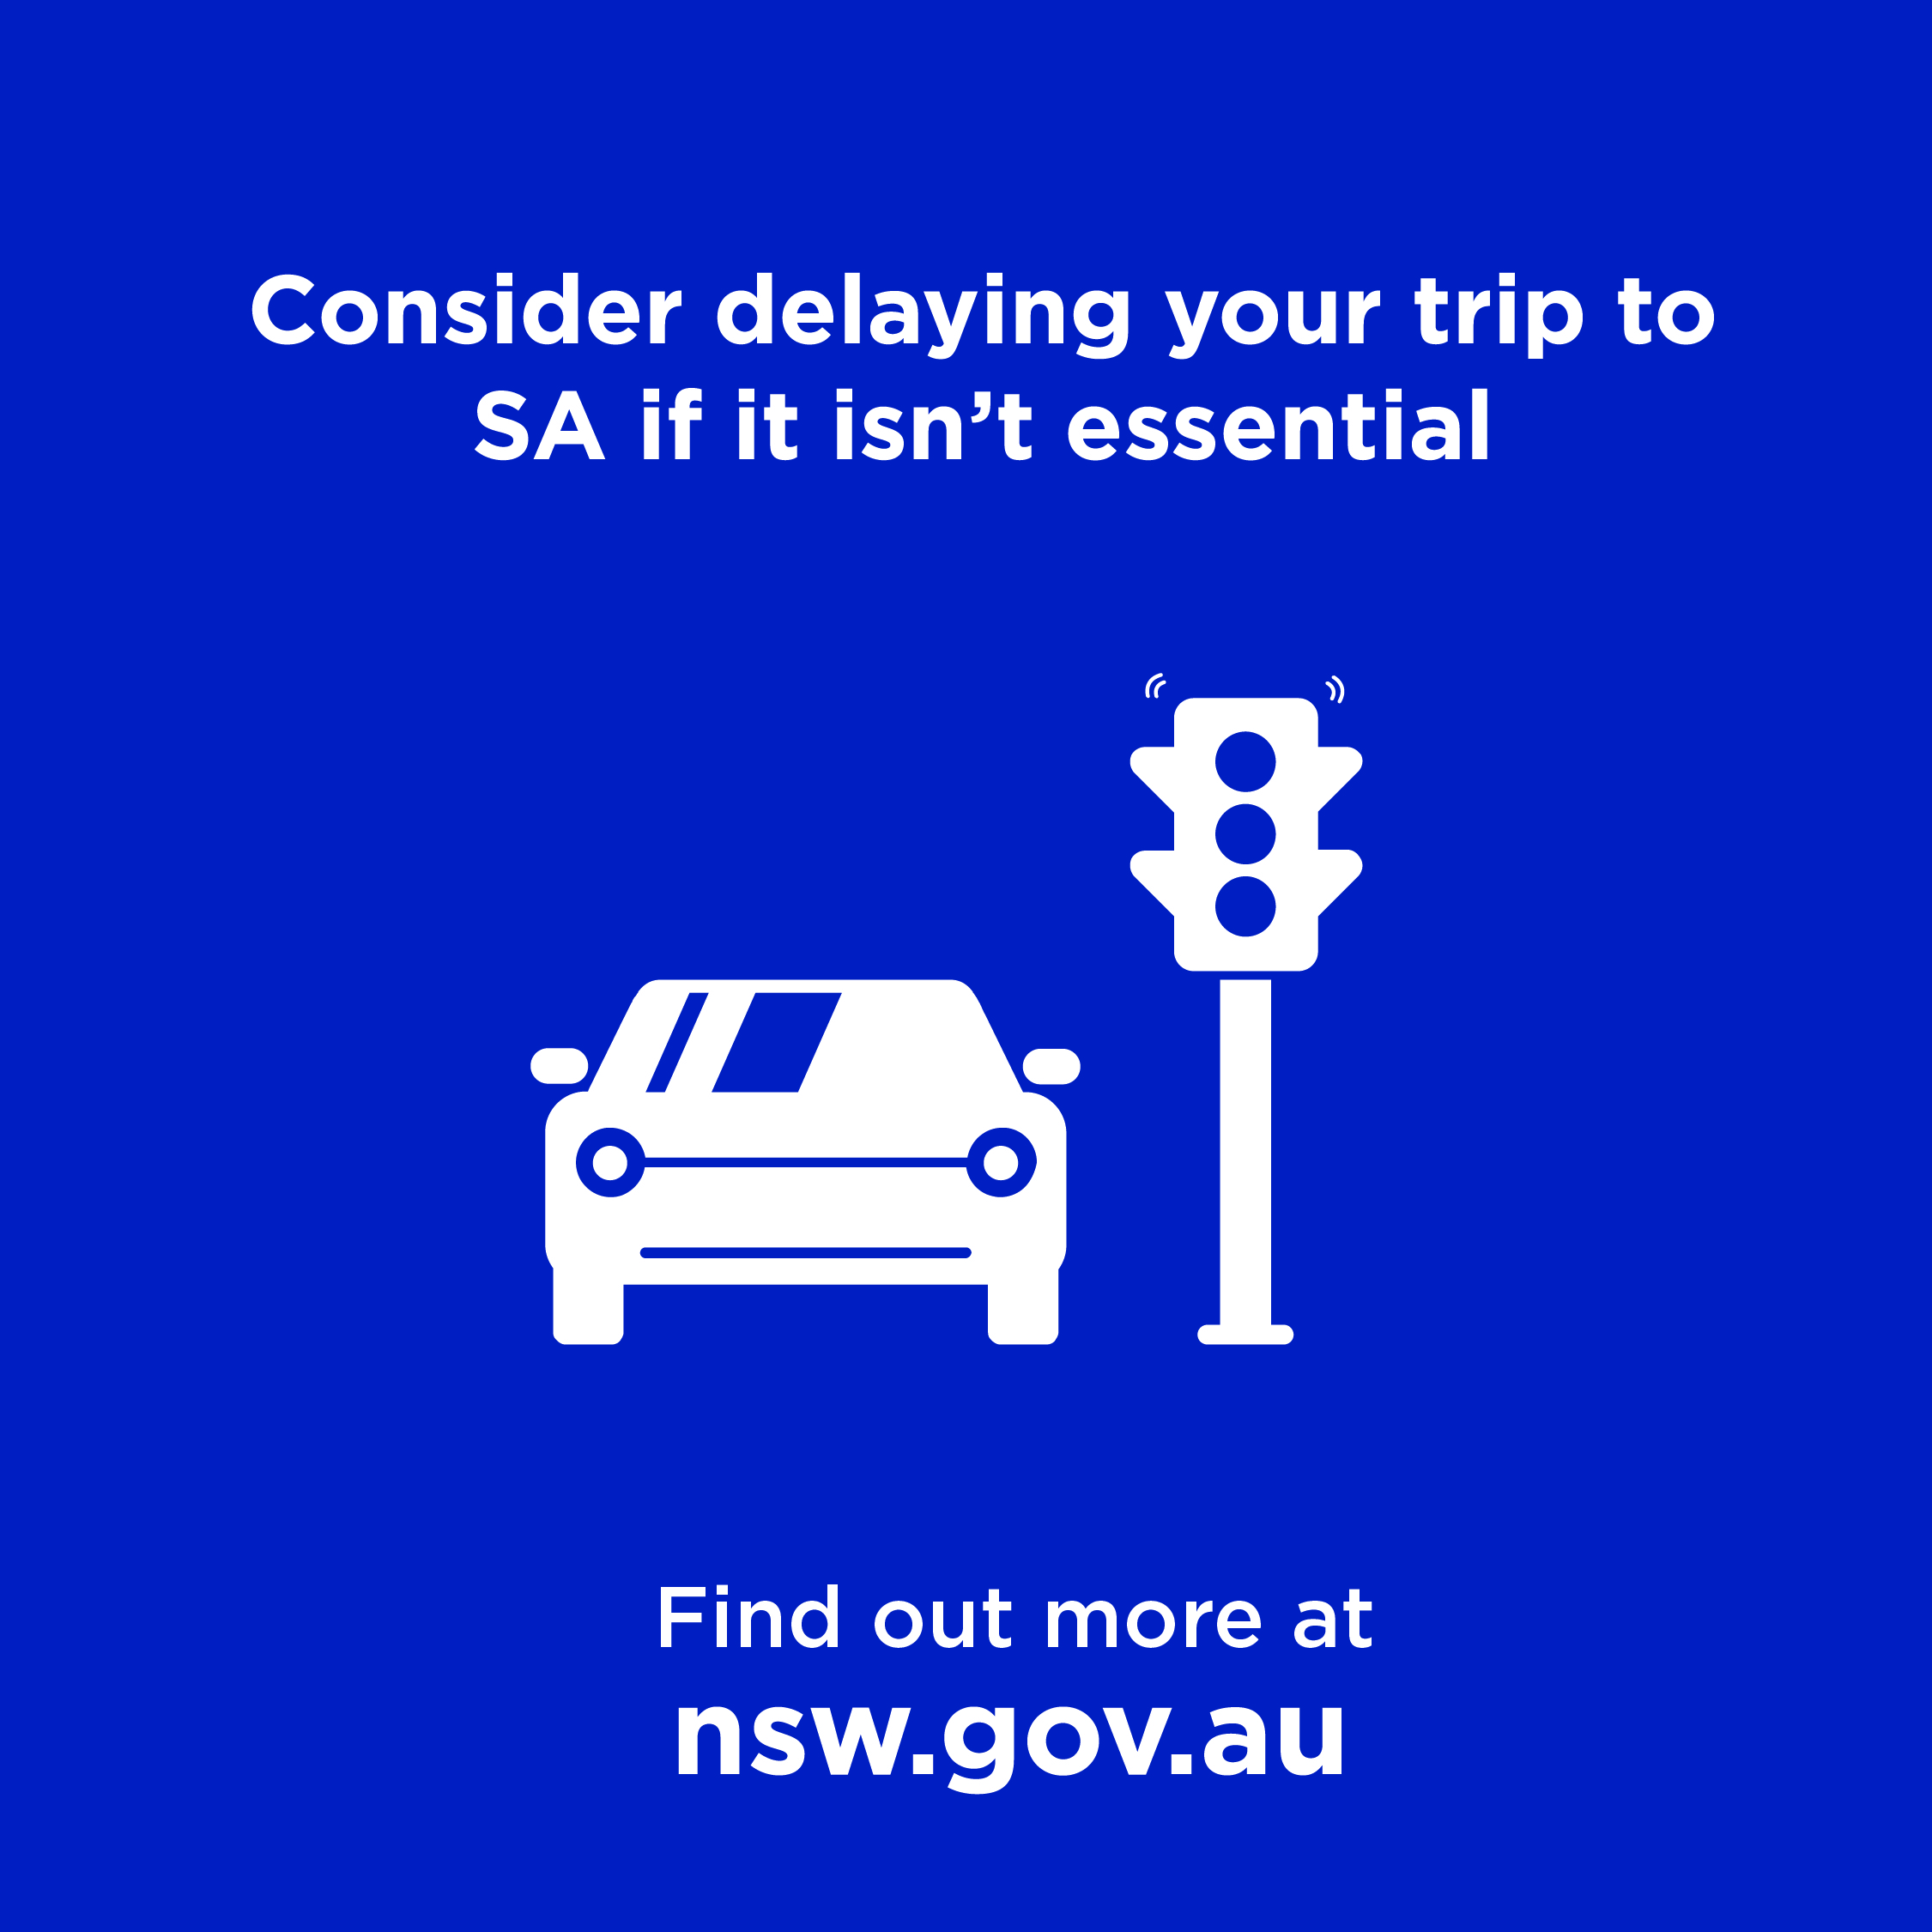
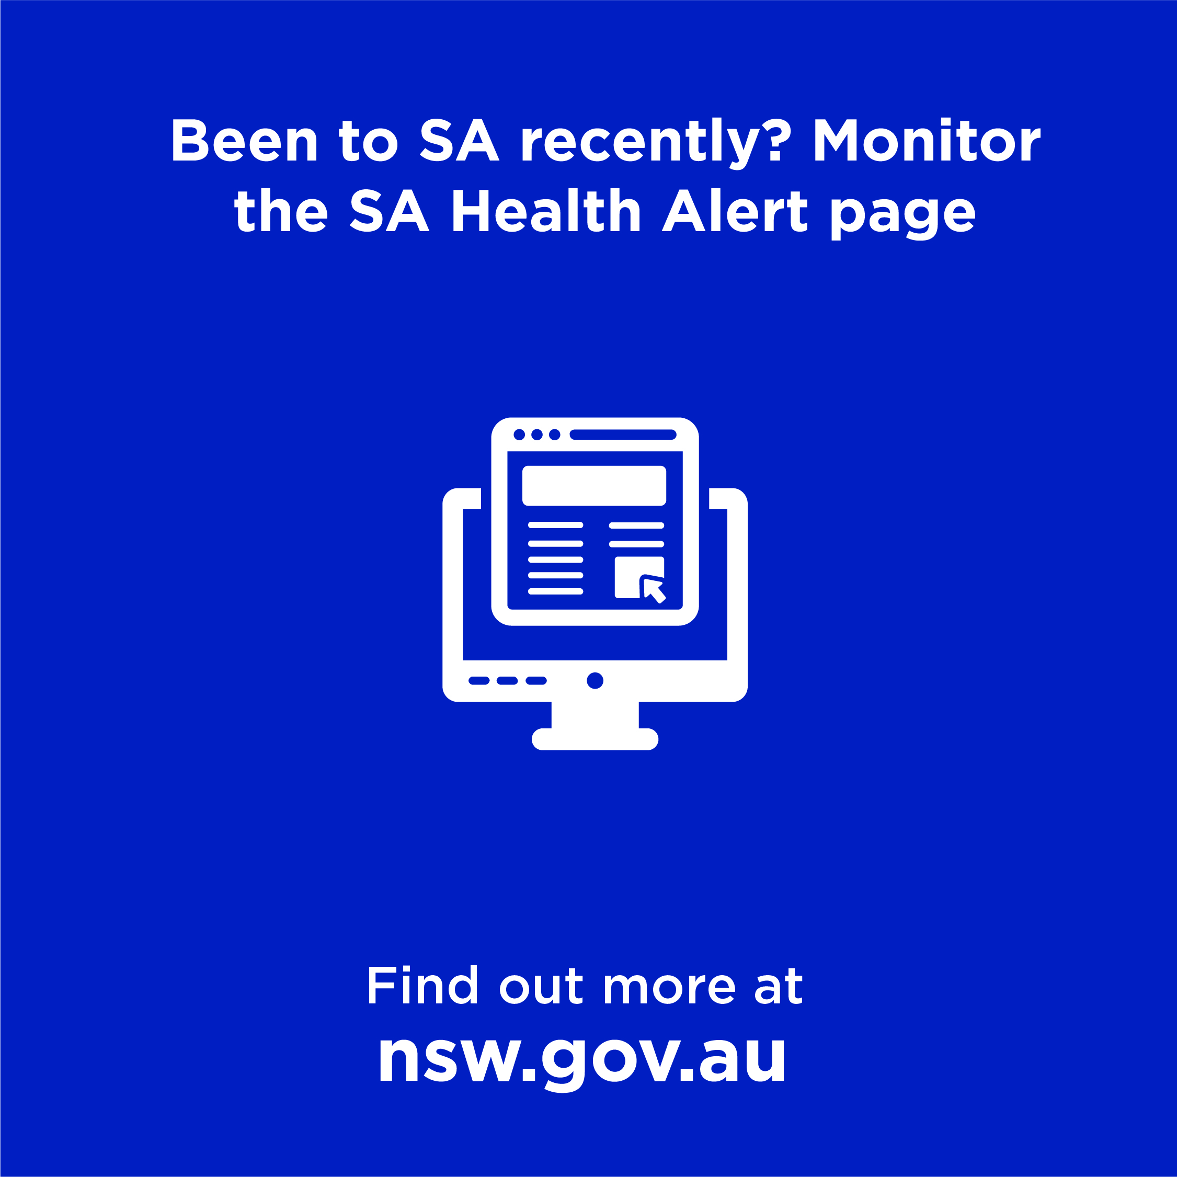
Non-branded social posts (local government to consumers)
To download the tiles, right click on the image and choose ‘Save As’
Tiles:
Post: If you're travelling into NSW from SA, you must complete a NSW entry declaration form in the 24 hours prior to or at the time you enter NSW. You can access the form online at service.nsw.gov.au/transaction/complete-nsw-entry-declaration-form
Post: Thinking of heading to South Australia? You should consider delaying your trip to South Australia if it isn't for essential reasons. This will help keep NSW COVID Safe. For more information visit nsw.gov.au
Post: If you've been to South Australia you should regularly monitor the SA Health Alert page to keep up to date on venues of concern and follow health advice.

Slide 8
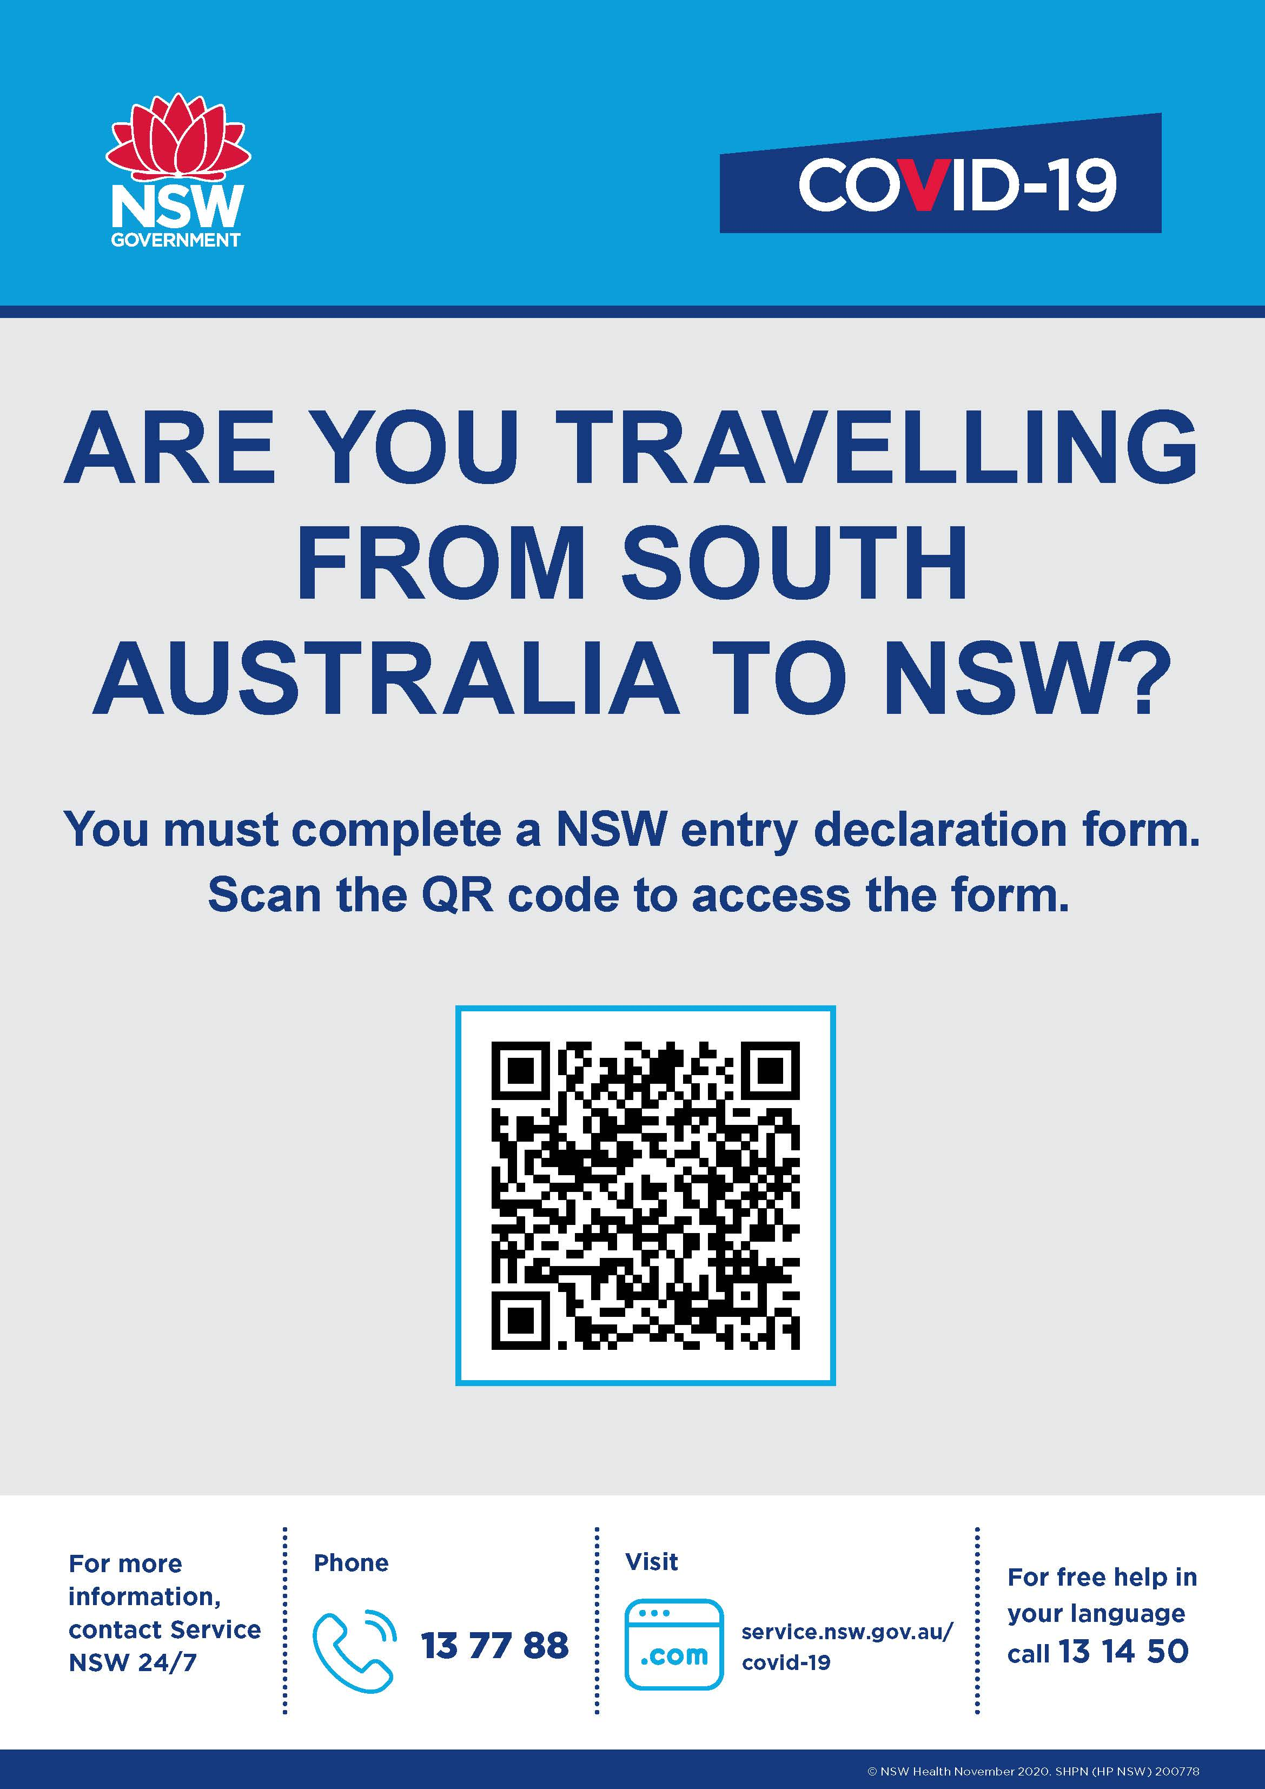
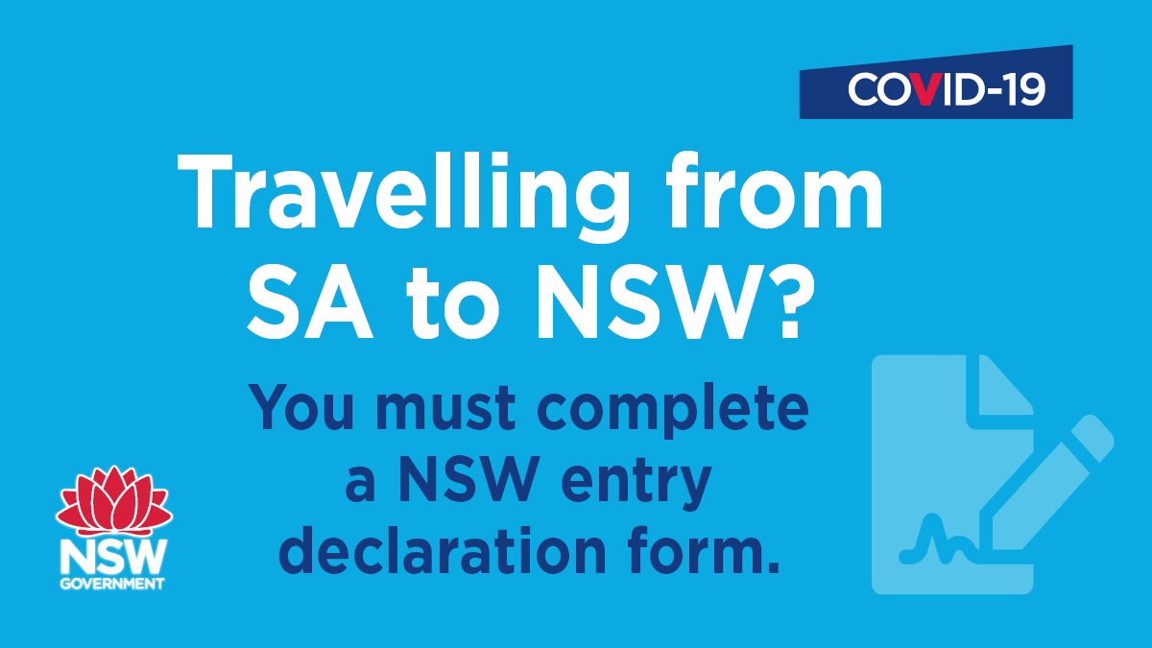
Other assets available to you
To download the tiles, right click on the image and choose ‘Save As’
Poster – see accompanying PDF
Landscape social media image

