Slide 1

LPA Immigration Services

Slide 2

What we will cover in this session
1
What is a 408 Visa and who needs one?
What immigration services does LPA provide?
What LPA needs from members for a 408 Visa?
Step by step IMMI application guide
Common Errors
Questions
2
3
4
5
6

Slide 3

1. What is a 408 Temporary Activity Visa and who needs one?

Slide 4

Temporary Activity Visa (subclass 408) Entertainment Activities
Anyone entering Australia to work in the entertainment industry on film
TV and live productions as a performer, production or support staff, and
Anyone who is not an Australia citizen, permanent resident or New Zealand citizen.
How long can applicants stay in Australia?
3 months without sponsorship or 2 years with sponsorship
2 years maximum stay
Multiple entry
No extensions

Slide 5


Cost
The cost is $325.00 (there is an additional charge for each family member)
Concessions and fee waivers
If your organisation is:
A registered charity with the ACNC
A foreign government agency, embassy or consulate
A state, territory or commonwealth government agency

Slide 6
Scope’s Annual Awards
2. What immigration services does LPA provide?

Slide 7
Consult with the relevant union on your behalf
Check applications in your organisation's IMMI account to ensure they are correct, attach relevant documents/evidence to applications
Lodge payment on your behalf using your credit card details provided
Correspond with the Department of Home Affairs when needed
Assist with queries and matters related to 408 visas

Slide 8
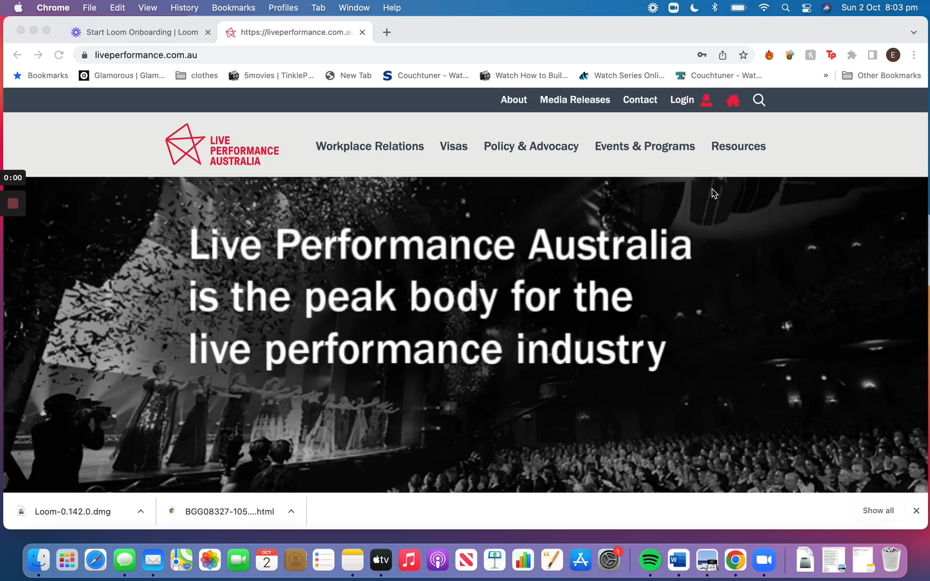
Resources For Members
Scope’s Annual Awards

Slide 9
Department of Home Affairs current processing times
Scope’s Annual Awards
25% of applications: 4 Days
50% of applications: 9 Days
75% of applications: 15 Days
90% of applications: 30 Days

Slide 10
Scope’s Annual Awards
3. What LPA needs from members for a 408 Visa?

Slide 11
Please provide us with documentation 6 WEEKS PRIOR to the applicant's departure.
We will need…
A completed 956A form signed by each Applicant
A signed Letter of Invitation on your organisation’s letterhead
A completed NEB statement (Net Employment Benefit Statement)
A contract of employment/performing contract
A clear scan of each Applicant’s passport photo page
A personnel list that includes each Applicant’s name and role
Travel/insurance documents providing evidence of cover (in English)
Where relevant, a 1229 parental consent form if accompanying family members are under 18 years of age.
Notes:
We ask that you please provide us with the documentation 6 weeks prior to your applicant's departure.
(If your applicant has character/health issues or may requires biometrics, allow an additional 4 weeks for the processing of the application )
You will need to provide us with the following documents
A completed 956A form signed by each Applicant
A signed Letter of Invitation on your organisation’s letterhead
A completed NEB statement (Net Employment Benefit Statement)
A contract of employment/performing contract
A clear scan of each Applicant’s passport photo page
A personnel list that includes each Applicant’s name and role
Travel/insurance documents providing evidence of cover (in English)
Where relevant, a 1229 parental consent form if accompanying family members are under 18 years of age.

Slide 12
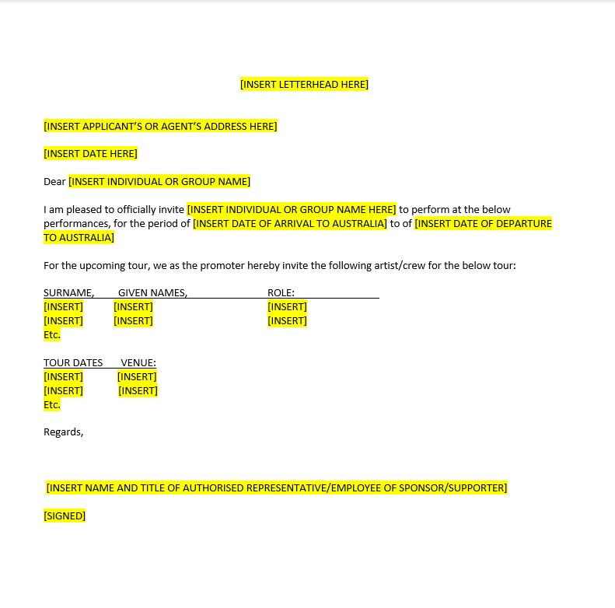
Template: Letter of Invitation
Scope’s Annual Awards

Slide 13
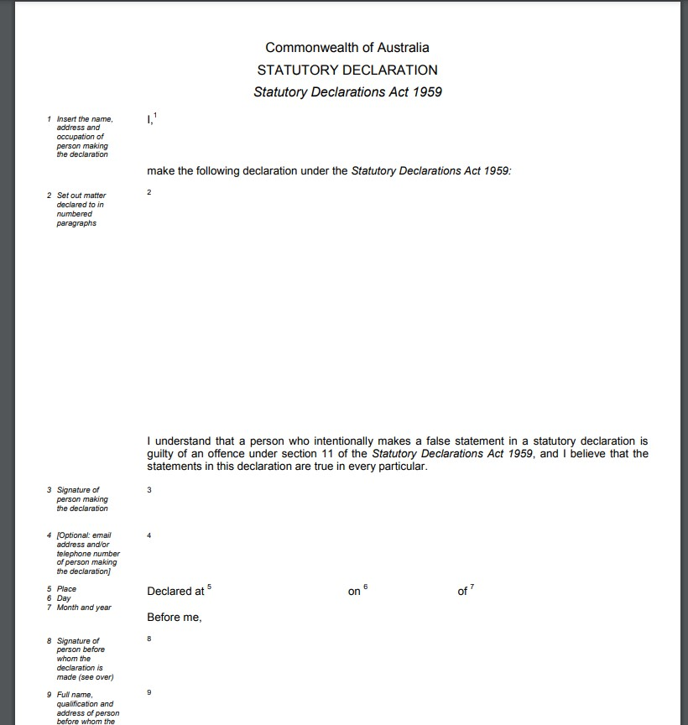
Character Issues
Extra Documents We Will Need
U.S
United States you will also need to provide an FBI report* and a State Police Clearance
A police certificate from their country of residence and any country they have resided in for more than 12 months over the last 10 years
A commonwealth statutory declaration form detailing all previous charges and outcomes

Slide 14
Health Issues
To meet the health requirement an Applicant must be free from any disease or health condition
If an Applicant has health issues or are from a high-risk tuberculosis country, they might have to have health examinations to prove they meet the health requirement. You can find more information here.
Albania
American Samoa
Andorra
Antigua and Barbuda
Argentina
Aruba
Australia
Bahamas
Bahrain
Barbados
Belgium
Belize
Bermuda
Bonaire
Bouvet Island
Bulgaria
Canada
Cayman Islands
Chile
Christmas island
Coco (Keeling) Islands
Cook Islands
Costa Rica
Croatia
Cuba
Curacao
Cyrpus
Czech Republic
Denmark
Dominica
Egypt
Estonia
Falkland Islands
Faroe Islands
Finland
France
French Polynesia
Germany
Gibraltar
Heard and McDonald Islands
Hungary
Iceland
Israel
Italy
Jamaica
Japan
Jordan
Kosovo
Kuwait
Lebanon
Lichtenstein
Luxembourg
Macedonia
Malta
Mauritius
Mexico
Monaco
Montenegro
Montserrat
Netherlands
Netherlands Antilles
New Caledonia
New Zealand
Niue
Norfolk Island
Norway
Oman
Palestinian Authority
Pitcairn Island
Poland
Portugal
Puerto Rico
Reunion Island
Saint Eustatius & Saba
Saint Halena
Saint Kitts and Nevis
Saint Lucia
Saint Martin
Samoa
San Marino
Saudi Arabia
Serbia
Seychelles
Slovakia
Slovenia
South Georgina and South Sandwich Islands
Spain
Svalbard & Jan Mayen
Sweden
Switzerland
Tokelau
Tonga
Trinidad and Tobago
Tunisia
Turkey
Turks and Caicos
United Arab Emirates
United Kingdom
USA
Uruguay
Vatican City
Virgin Islands
Wallis and Futuna Islands

Slide 15
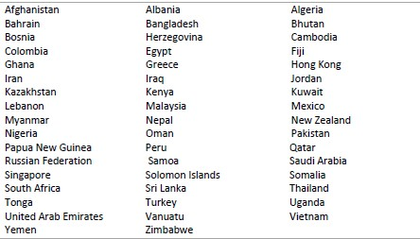
Biometrics
Biometrics are personal identifiers such as digital scanned fingerprints and/or digital facial photographs. A letter requesting biometrics may be sent to a visa applicant after their 408-visa application is submitted.

Slide 16
Sponsorship
You will need to apply to be a sponsor if:
the Applicant intends to stay in Australia for three months or more
or the Applicant is in Australia at the time of the application.

Slide 17
TIMELINE FOR VISA SERVICES
Submit your applicants' documents to LPA 6-10 weeks before departure
*LOI, LOA, NEB
LPA will consult with the union on your behalf (the union can take up to 5 days to respond)
1
2
If you have not already done so, create a 408 Visa Application in your IMMI account- share your IMMI login with LPA
3
LPA will send you a visa lodgment receipt and communicate requests for additional information from HA.
Once the visa has been approved we will send you the grant notification
5
LPA will check your application for errors and may ask you for more documentation or to provide further details. If the application has no issues, will be submitted.
4

Slide 18

URGENT VISA REQUESTS
Call the LPA office and let us know!
Send the union consultation documents to us ASAP
Letter of Authorisation
Letter of Invitation
NEB form

Slide 19
Scope’s Annual Awards
4. A Step-By-Step IMMI application tutorial

Slide 20
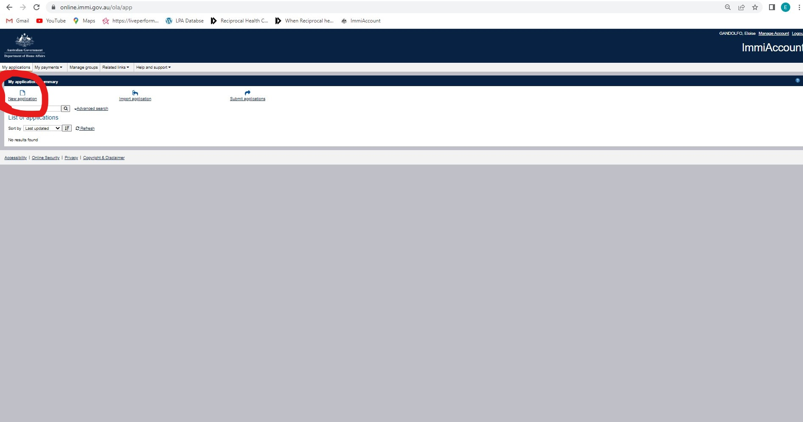

Slide 21
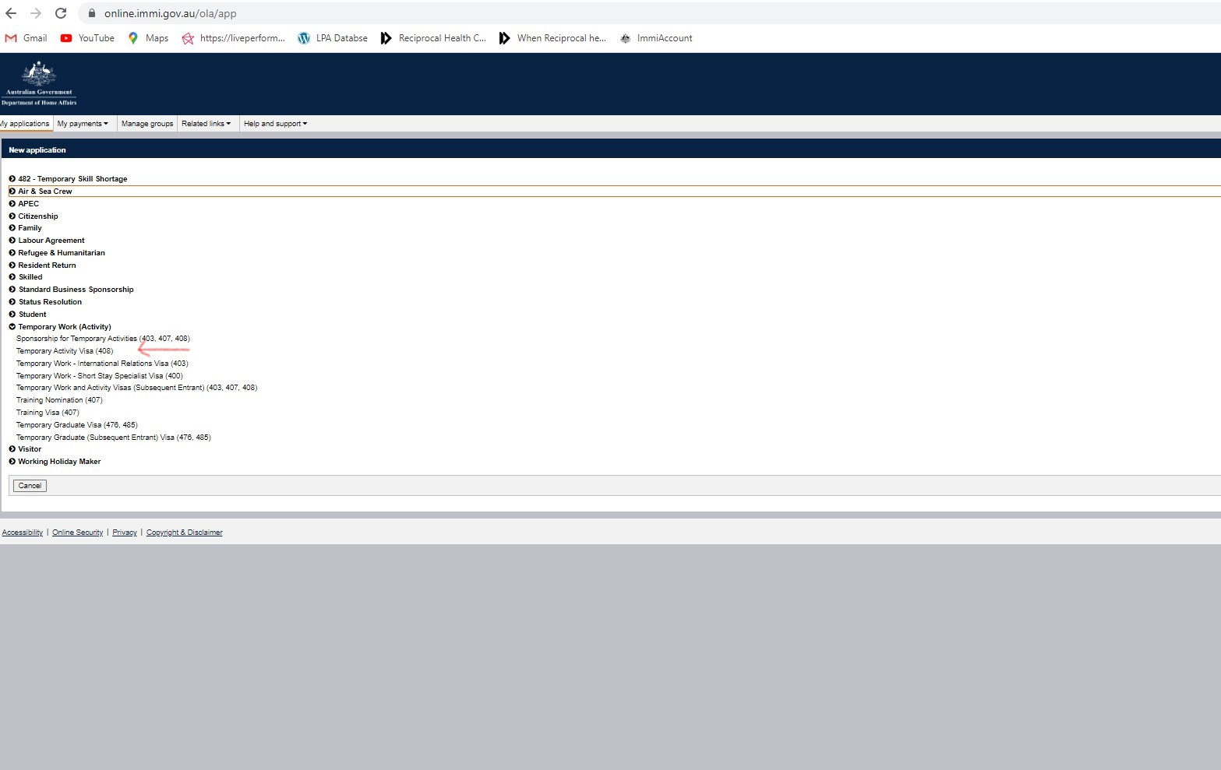

Slide 22
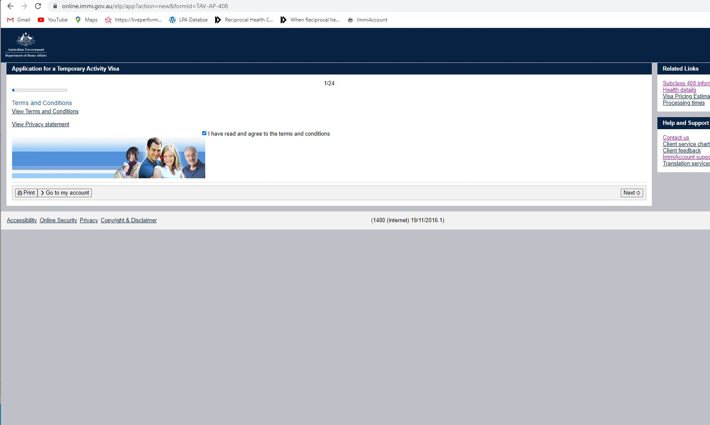

Slide 23
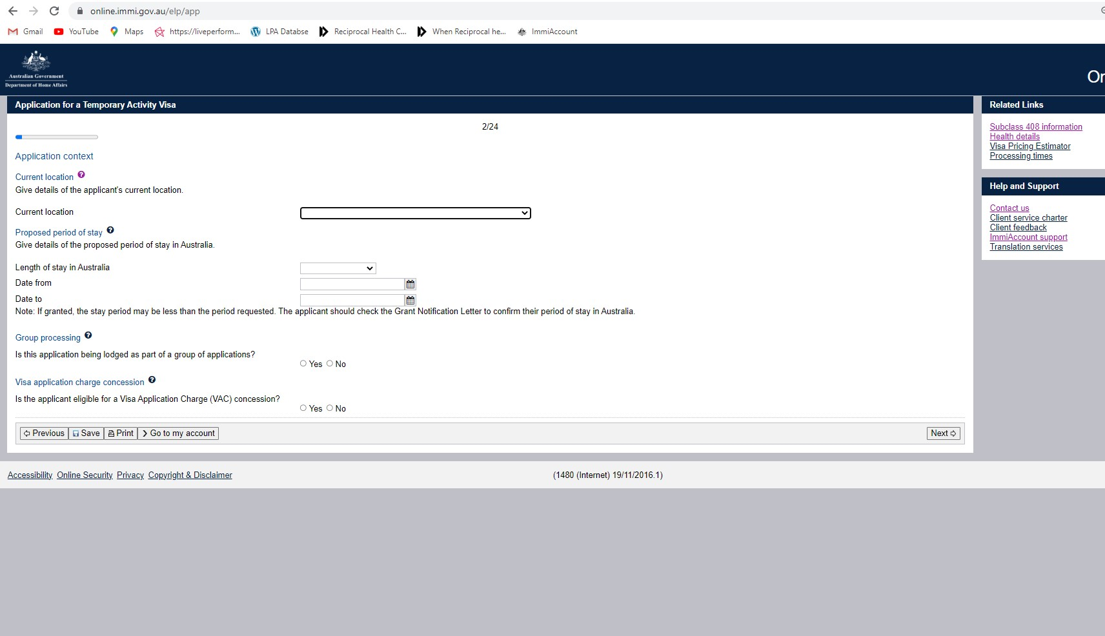

Slide 24
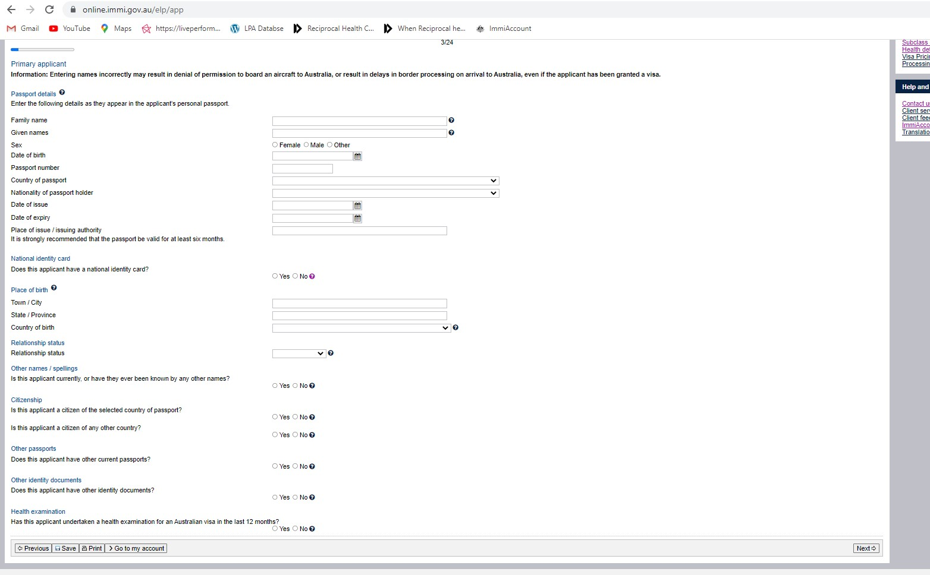

Slide 25
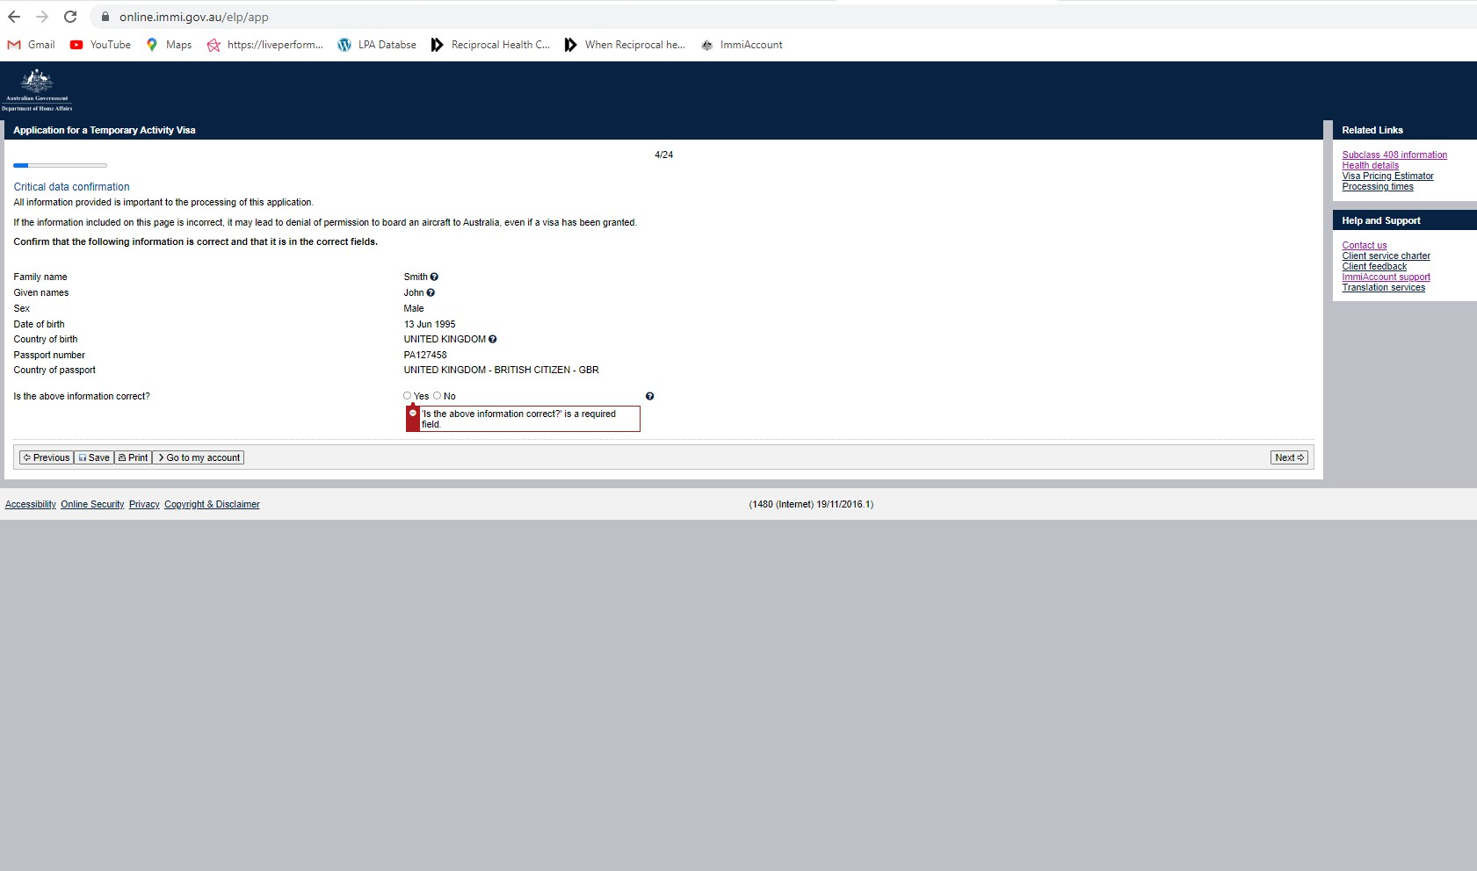

Slide 26
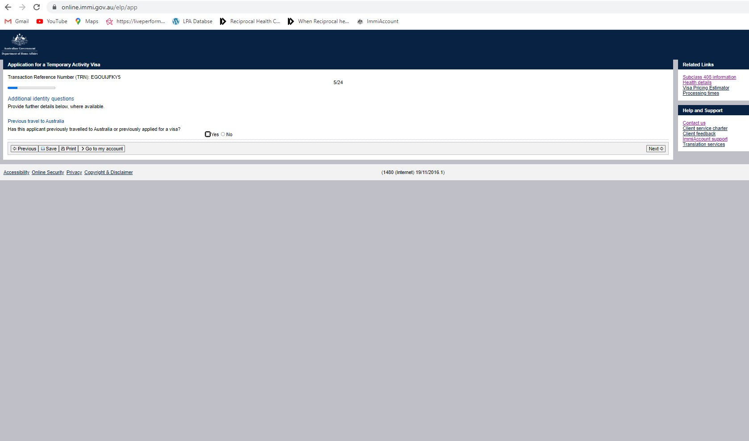

Slide 27
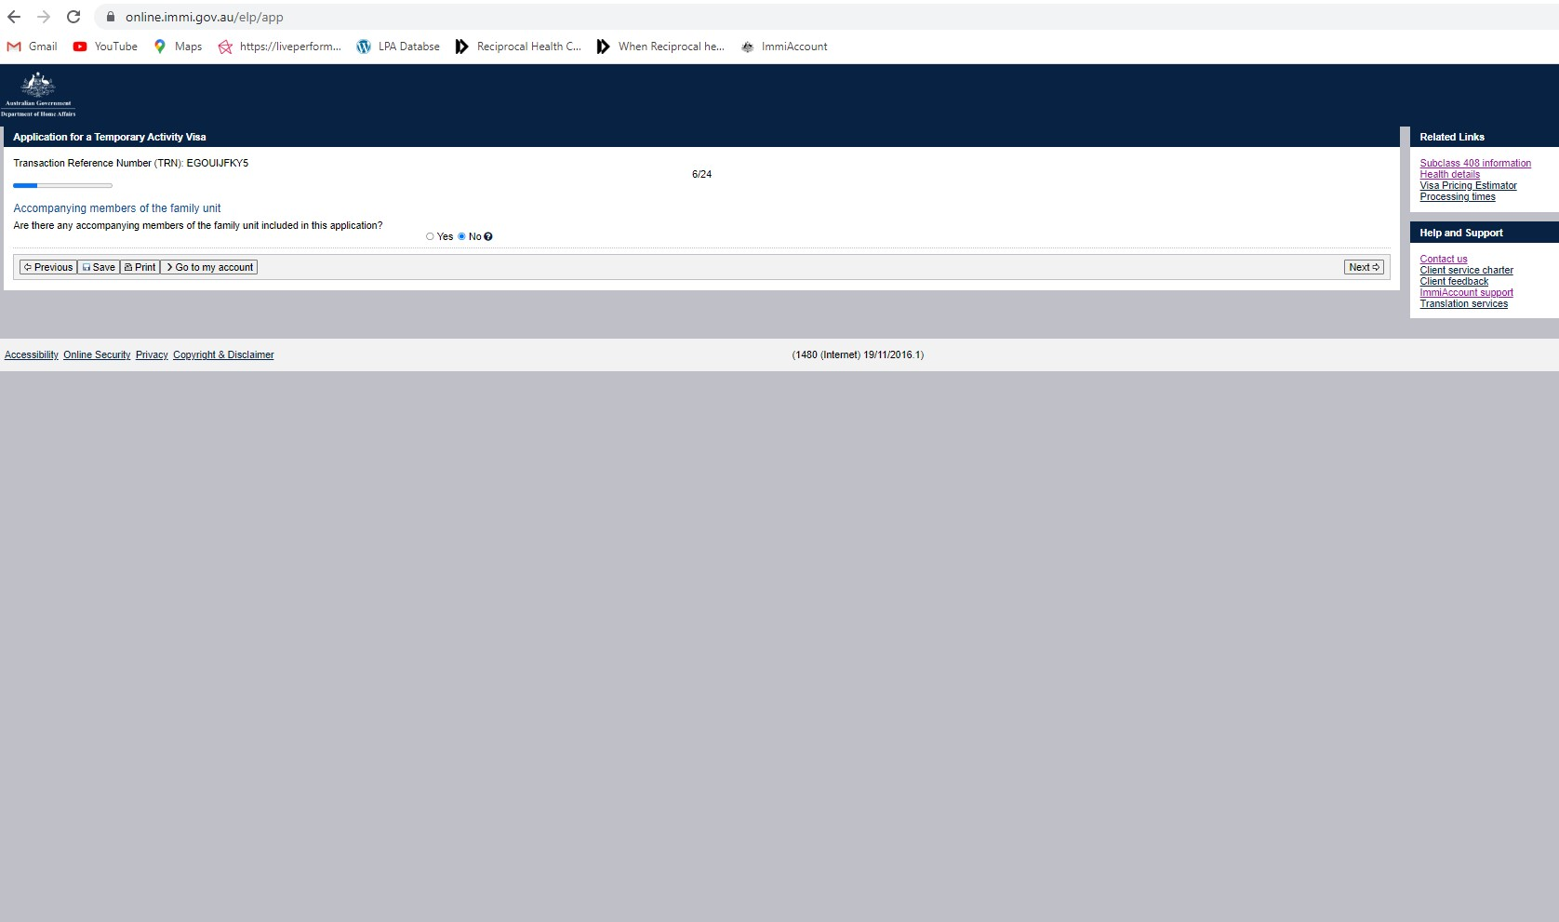

Slide 28
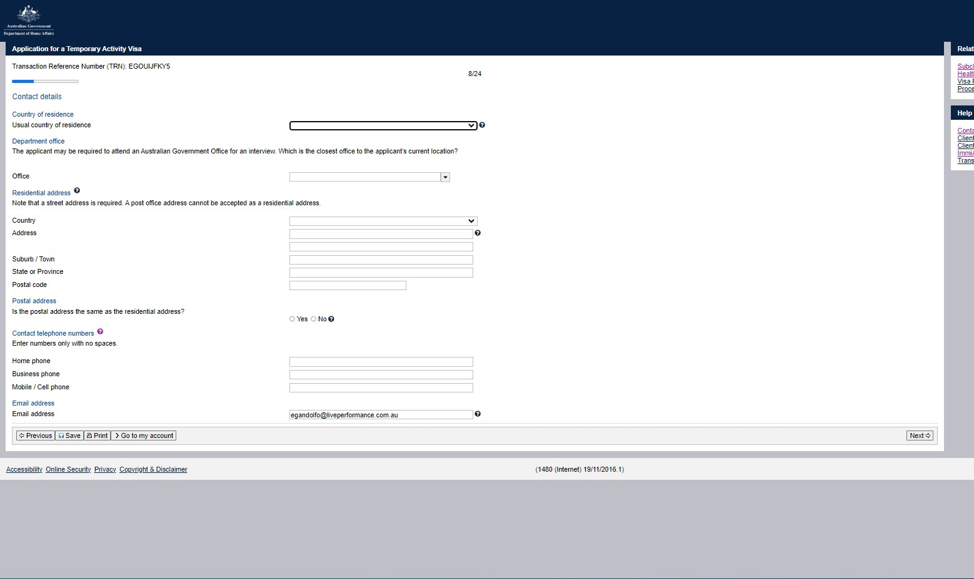

Slide 29
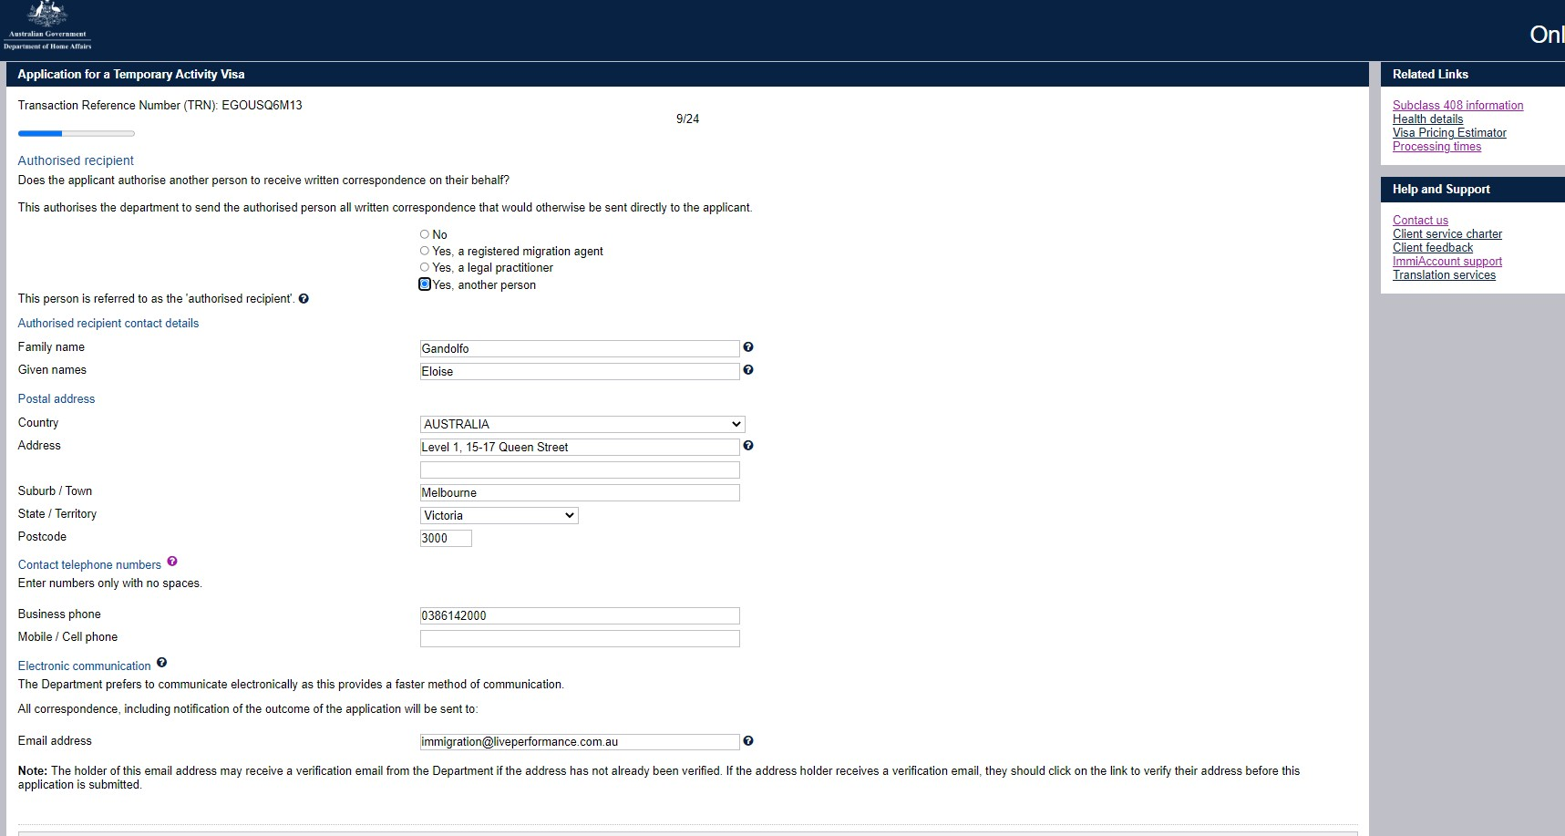

Slide 30
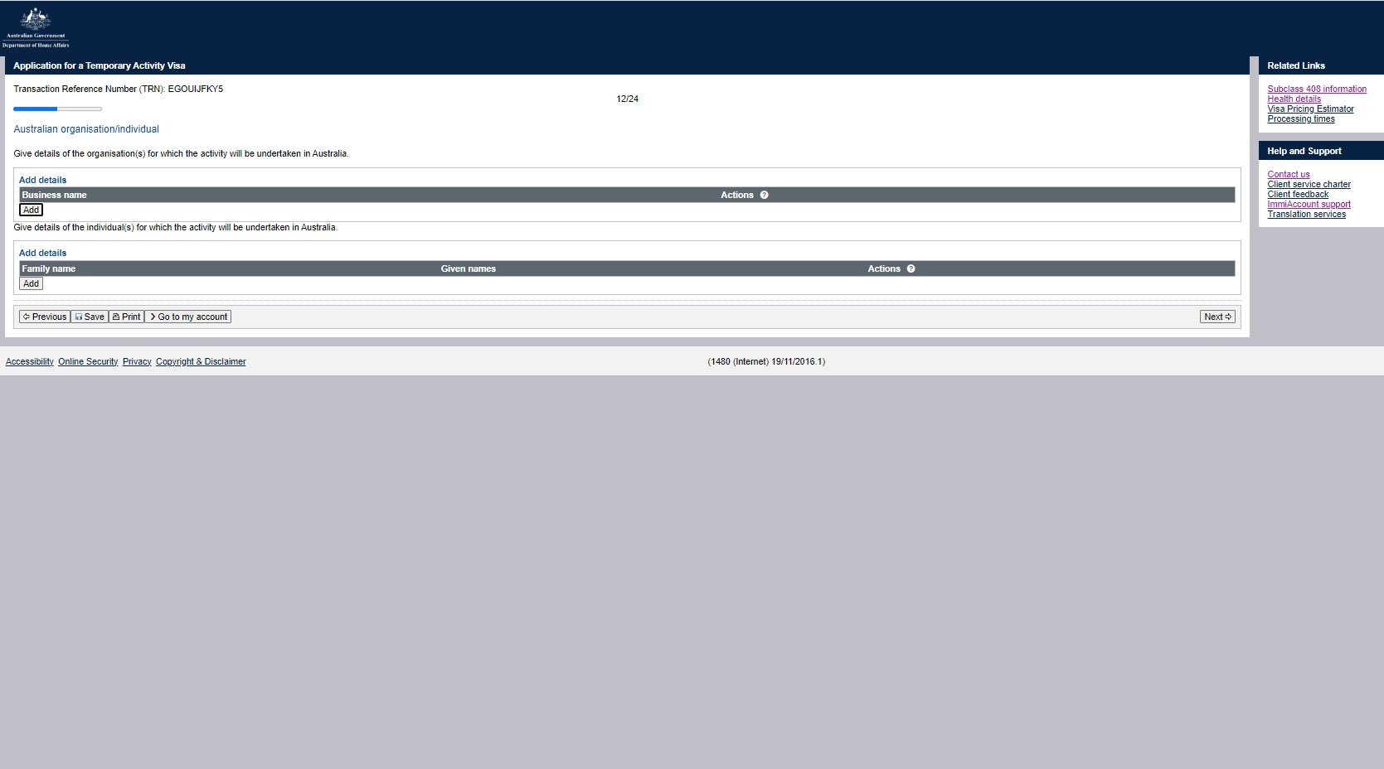

Slide 31
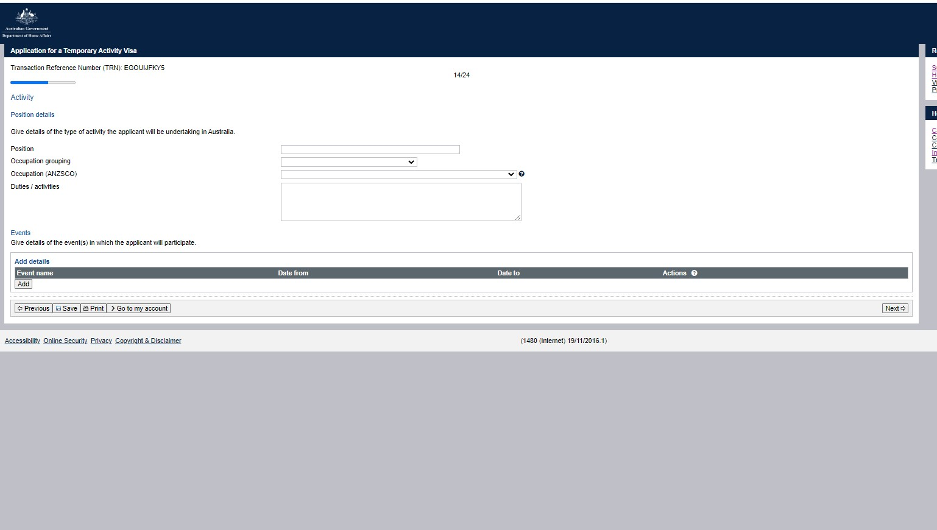

Slide 32
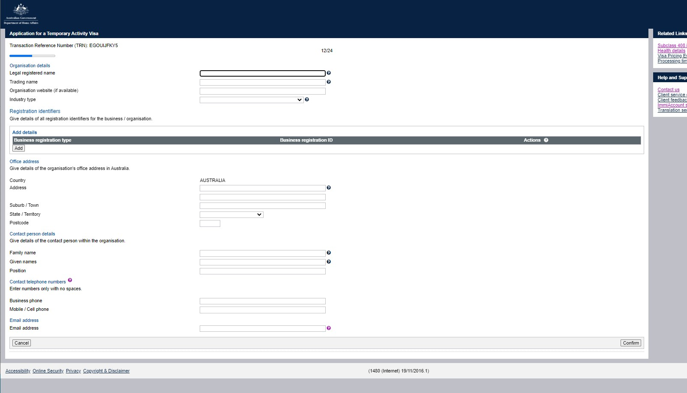

Slide 33
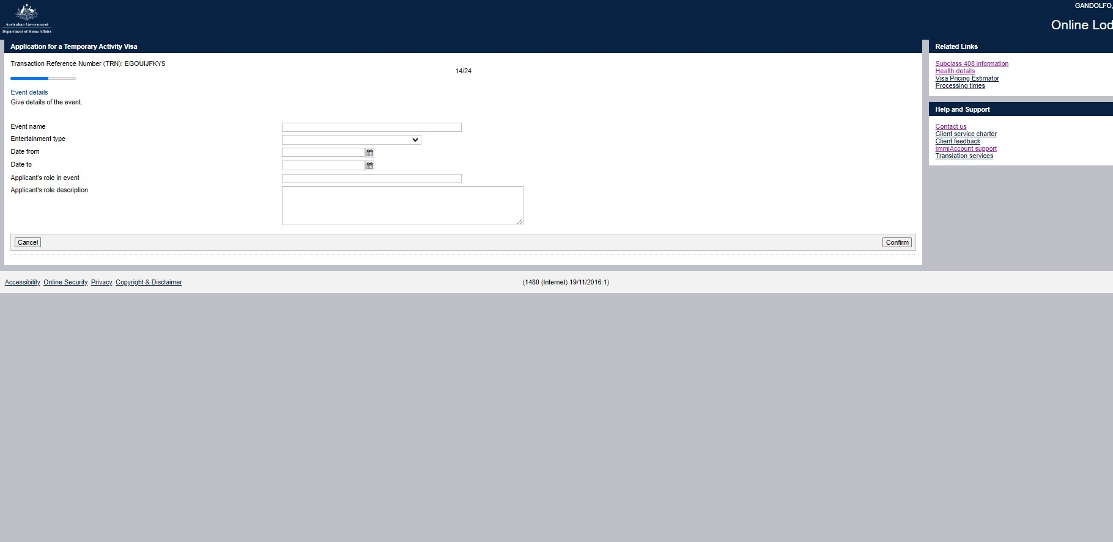

Slide 34
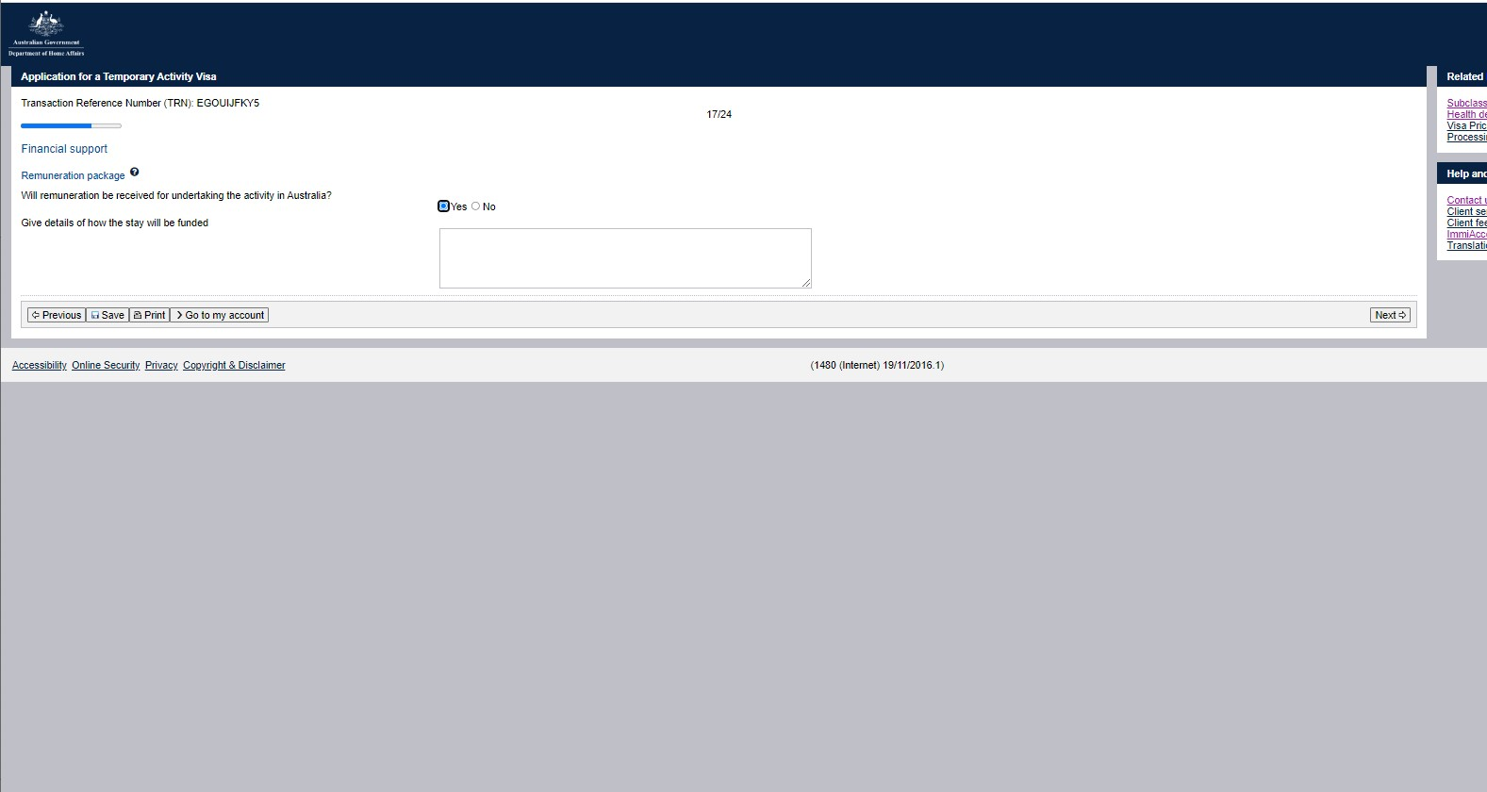

Slide 35
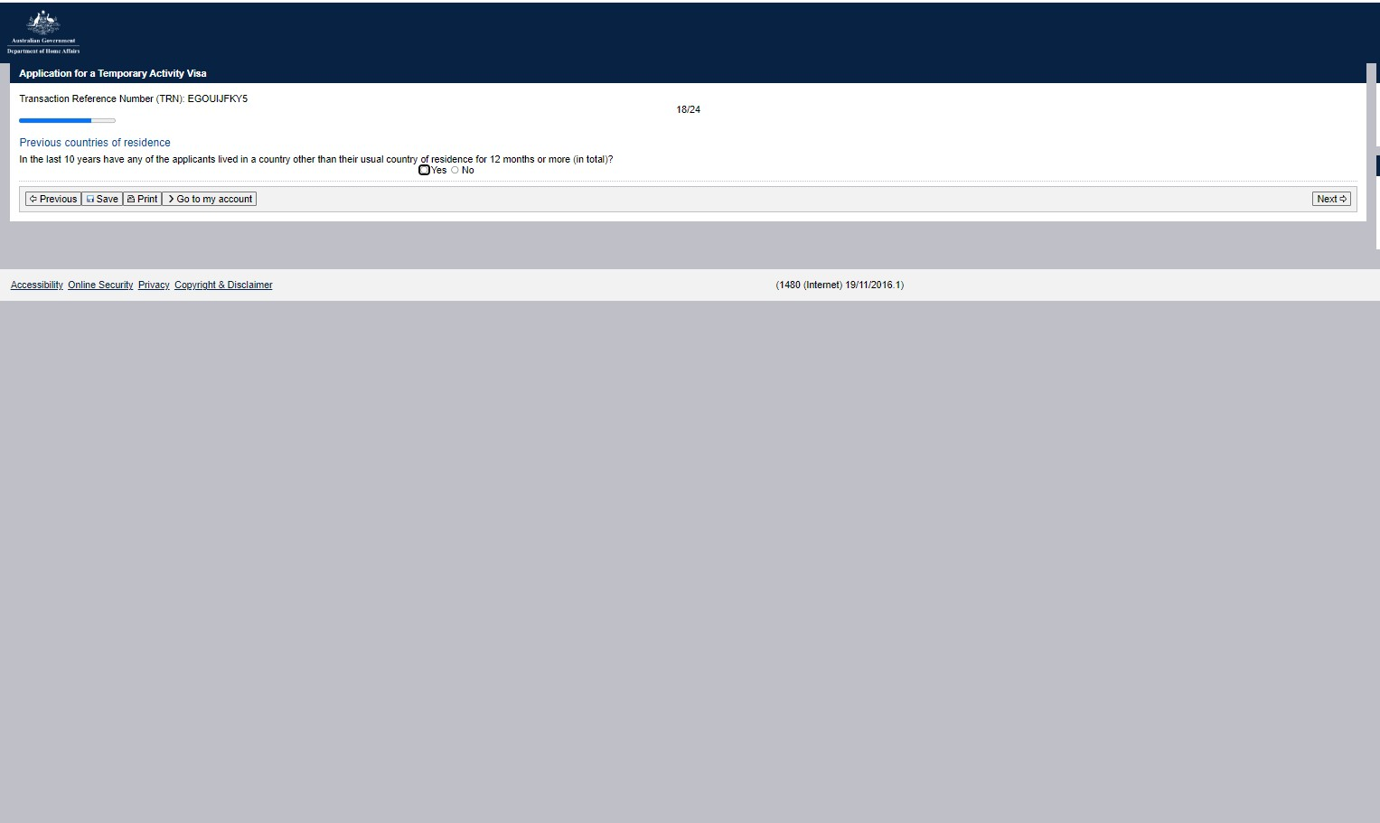

Slide 36
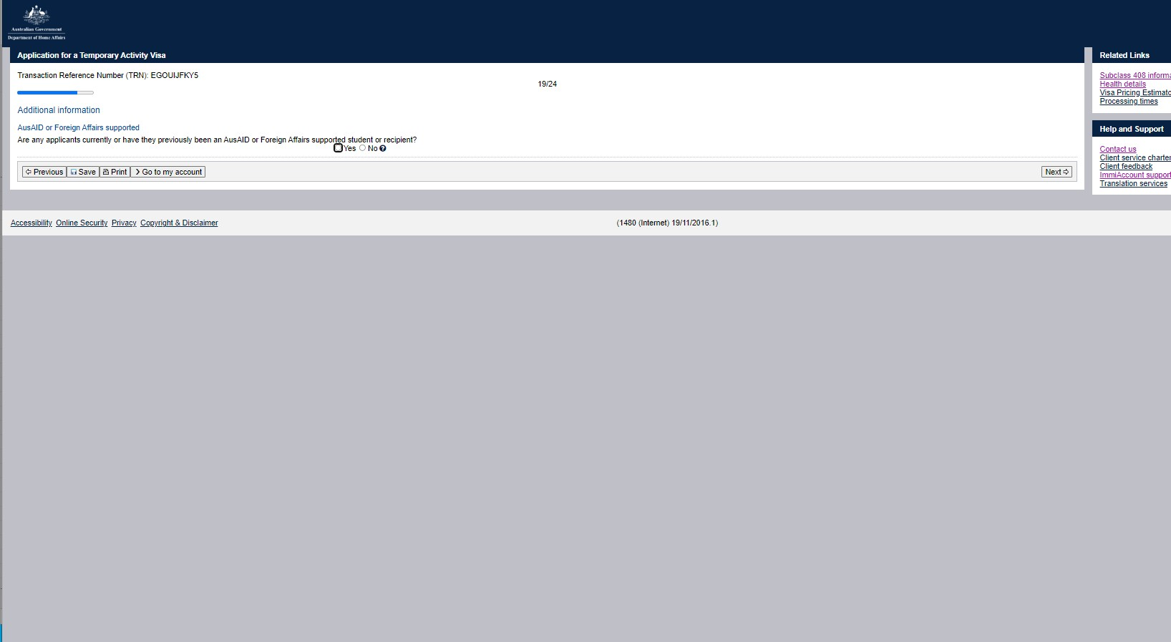

Slide 37
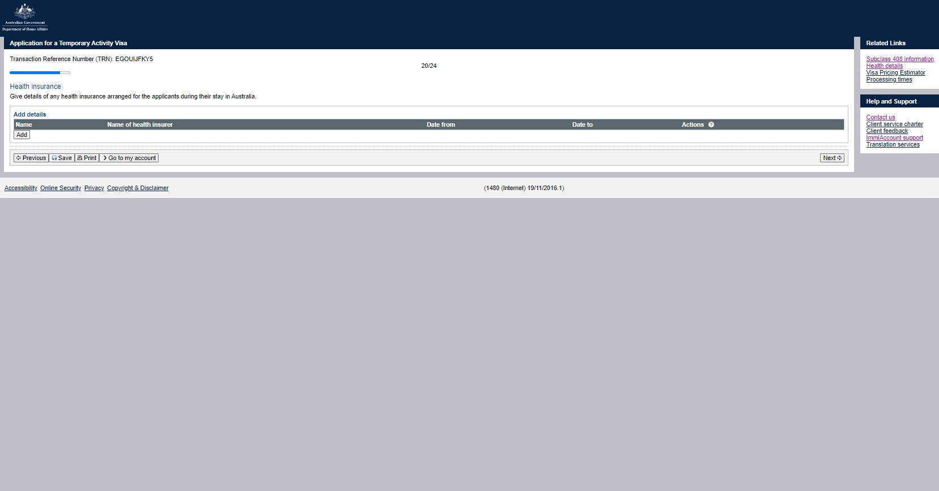

Slide 38
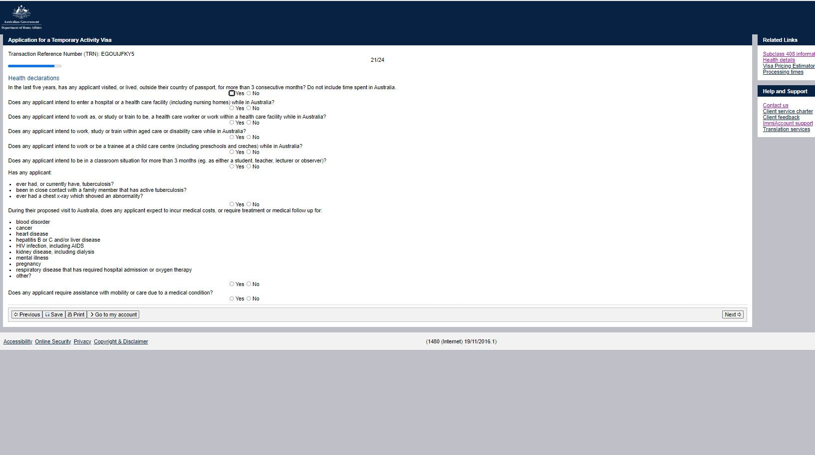

Slide 39
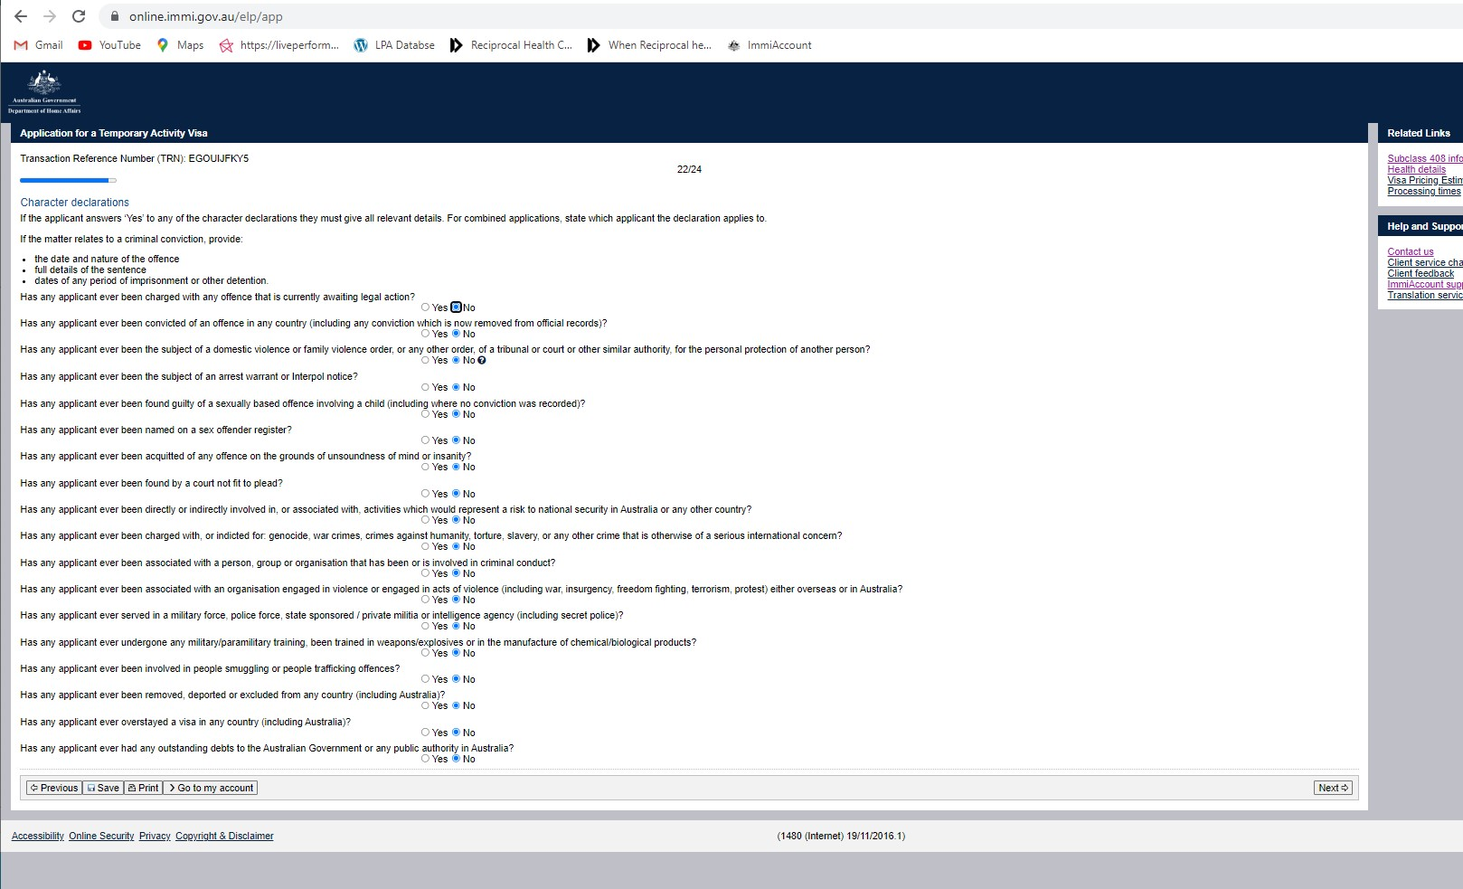

Slide 40
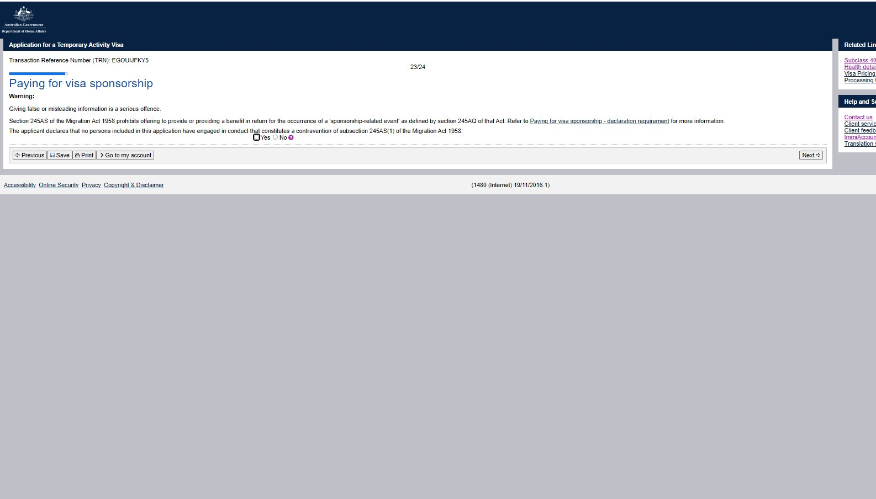

Slide 41
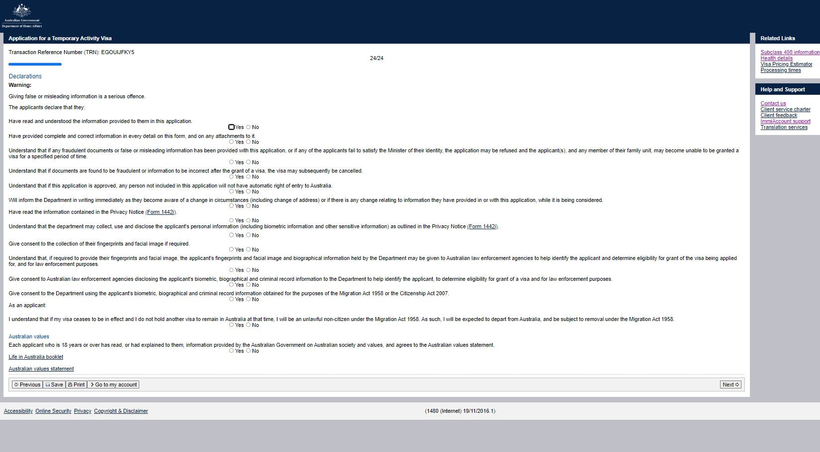

Slide 42
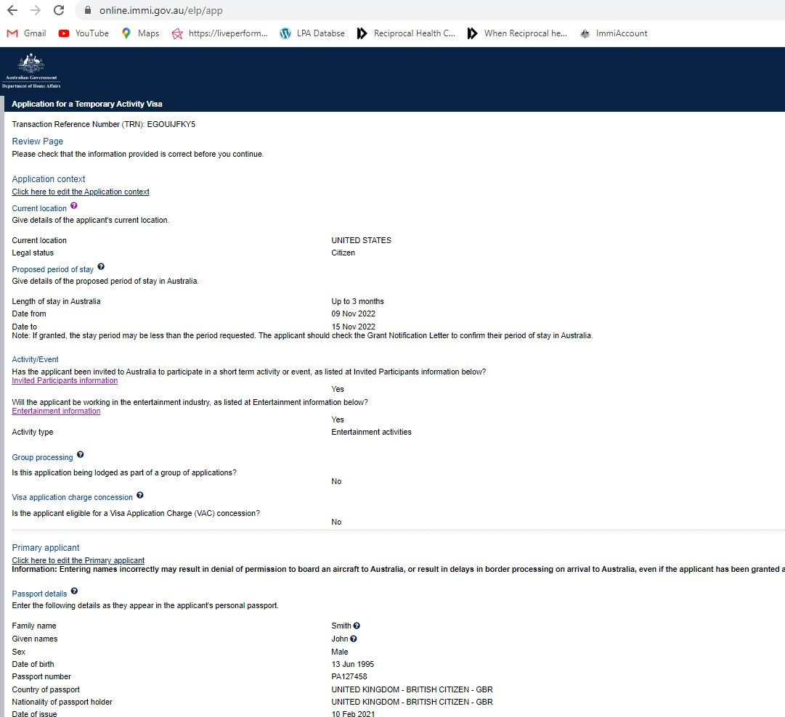

Slide 43
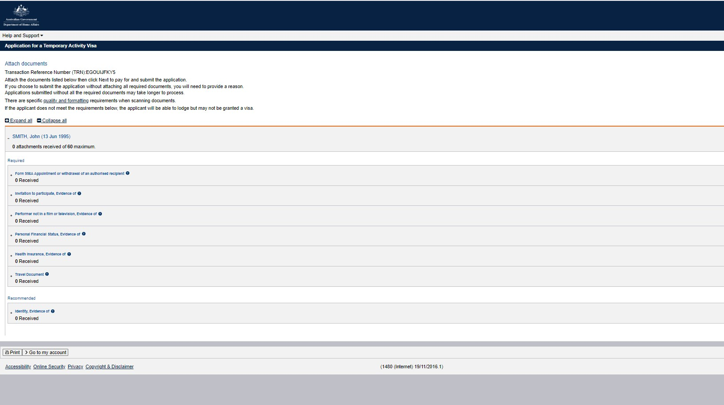

Slide 44
Scope’s Annual Awards
5. Common Errors

Slide 45
Letter of Invitation not being correct
Name changes
NIL VAC – no fee
Payment of performer

Slide 46
Template: Letter of Invitation
Scope’s Annual Awards

Slide 47
Scope’s Annual Awards
6. Questions

Slide 48
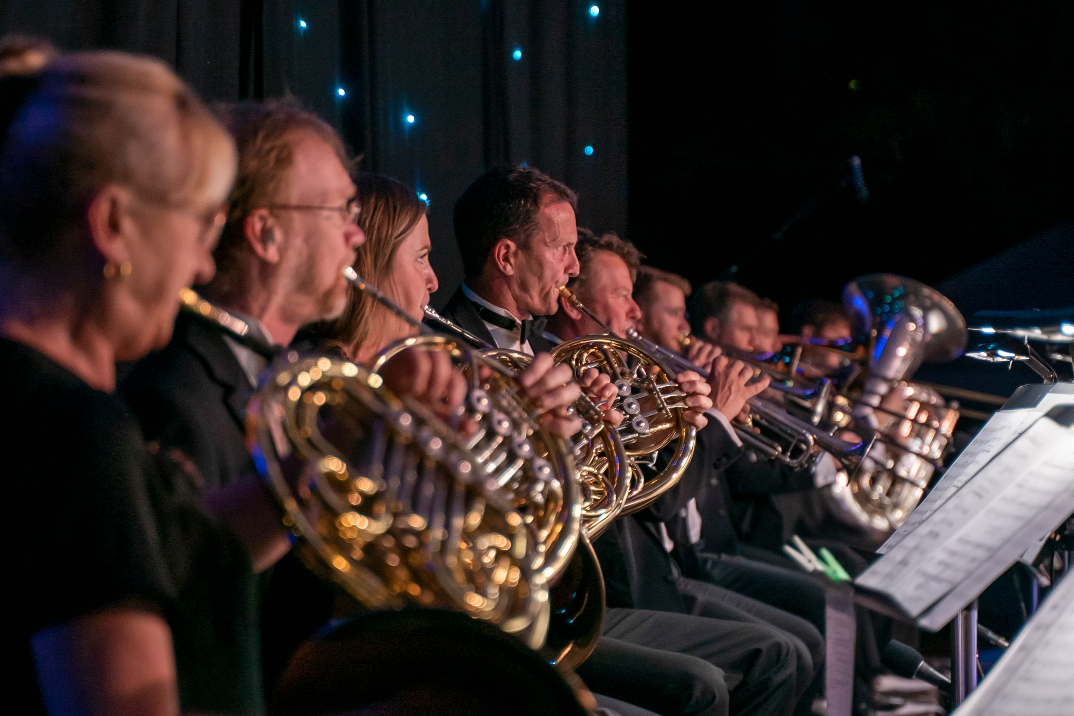

Thank you for your attendance!
Queensland Symphony Orchestra Photo: Joel Tronoff

