Slide 1
Changes to 408 Visa Processing

Slide 2
Overview
1
2
3
4
5
6
7
Why has the LPA visa process has changed?
Updated Resources
The documents Members need to provide to LPA when lodging a visa
How to correctly attach evidence documentation in Immi
How to download a pdf copy of your visa application in Immi
How to pay for and lodge your visa applications in Immi
Questions

Slide 3
Why has the LPA visa process has changed?
On 18 June 2025, the Department of Home Affairs introduced compulsory use of multi- factor authentication (MFA) for ImmiAccount.
Because of that change, LPA has reviewed its procedures and determined (for both practical and policy reasons) that it will no longer be able to log in to Members' ImmiAccounts or process the payment of visa applications in Immi.
Going forward, Members will need to:
Answer all questions in the 408 Visa application/s in Immi
Attach evidence documents
Before the application is lodged:
Download a PDF copy of the completed 408 visa application
Send all required documents AND the pdf copy of the 408 visa application to LPA in one email.
Pay for and lodge their visa applications through Immi

Slide 4
New Timeline for Visa Applications
Fill in 408 Visa Application in your IMMI
account
Submit your applicants' documents to LPA 10-12 weeks before departure
LPA will consult with the union on your behalf (the union can take up to 5 days to respond). LPA will send the consult letter from the union to you, so you can upload this to the IMMI application
1
2
3
6
Once the visa
application has been approved, LPA will send you the visa grant notice.
LPA will check your pdf application and documents for errors. We may ask you for more documentation or to edit any errors in the Immi application. We will ask for a copy of the application again if any amendments are made. If the application has no issues, LPA will let you know the application can be lodged.
5
LPA communicates requests for additional information from HA.
4

Slide 5
Department of Home Affairs current processing times
50% of applications: 33 business Days
90% of applications: 61 business Days

Slide 6
Updated Resources
408 Visa Information Pack
The Visa Pack reflects this new process, and includes the following:
A new document checklist
A new Letter of Authorisation
A guide on how to save a pdf copy of your Immi application
A guide on how to lodge and pay for 408 visa applications in Immi

Slide 7
The documents Members need to provide to LPA when lodging a visa
A signed 956a form with the LPA Immigration Services Manager's signature and the applicant's signature
A Letter of Authorisation
A Letter of Invitation
A Union Consult Personnel list
A clear colour copy of the applicant's passport photo page
Travel insurance
A copy of the deal memo/contract
A PDF copy of the completed application downloaded from Immi

Slide 8
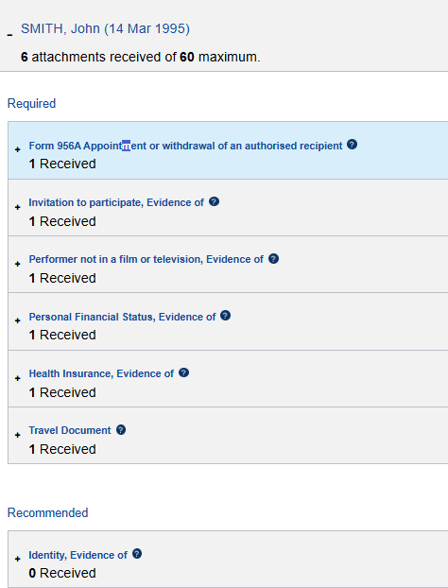
How to correctly attach evidence documentation in Immi
Form 956a Appointment
956a with my signature and the applicants signature
Evidence of Invitation to participate
Letter of invitation
Evidence of Performer not in film or television
Letter of invitation
Evidence of Personal Financial Status
Copy of the contract/deal memo
Evidence of Health Insurance
Travel insurance cert (in English) OR copy of passport if eligible for reciprocal health care
Travel Document
Clear colour copy of the applicant's passport

Slide 9
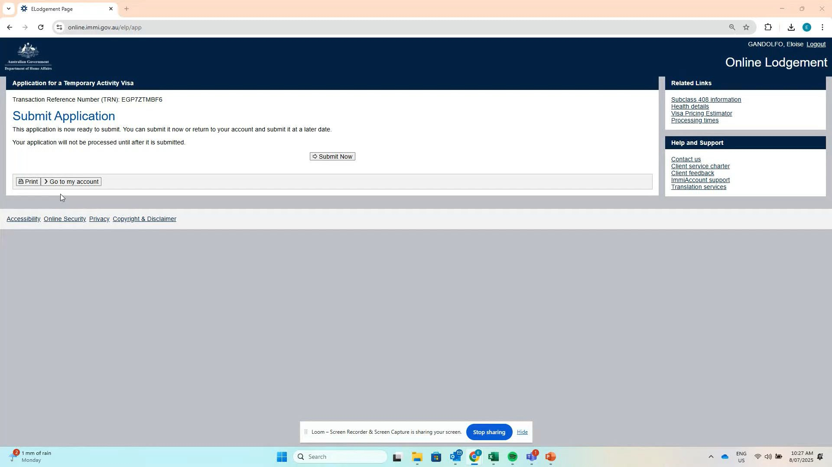
How to download a pdf copy of your visa application in Immi

Slide 10
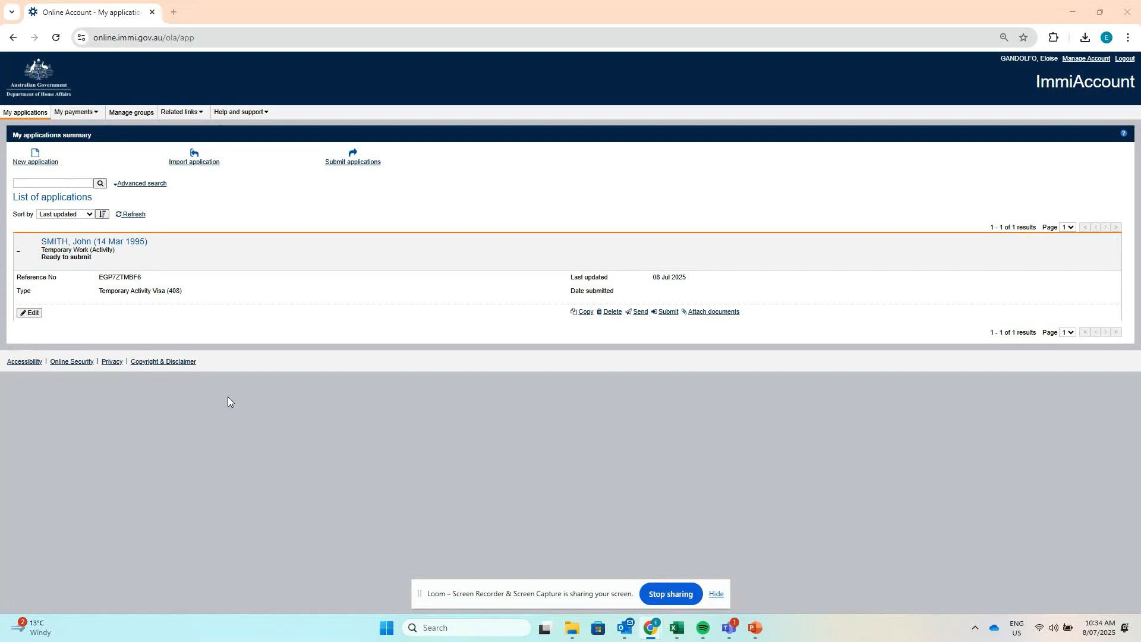
How to pay for and lodge your visa applications in Immi

Slide 11
Questions
Immigration Services Manager Live Performance Australia
T: 03 8614 2005
E: egandolfo@liveperformance.com.au

