Slide 1

Changes to 408 Visa Processing

Slide 2

Overview
1
Why the LPA visa process has changed
The resources that have been updated
The documents Members need to provide to LPA when lodging a visa
How to download a pdf copy of your visa application in Immi
How to pay for and lodge your visa applications in Immi
Questions
2
3
4
5
6

Slide 3


Why the LPA visa process has changed
On 18 June 2025, the Department of Home Affairs introduced compulsory use of multi-factor authentication (MFA) for ImmiAccount.
Because of that change, LPA has reviewed its procedures and determined (for both practical and policy reasons) that it will no longer be able to log in to Members' ImmiAccounts or process the payment of visa applications in Immi.
Going forward, Members will need to:
Answer all questions in the 408 Visa application/s in Immi
Attach evidence documents
Before the application is lodged:
  Download a PDF copy of the completed 408 visa application
  Send all required documents AND the pdf copy of the 408 visa application to LPA in one email.
Notes:
As a consequence of that change, LPA has reviewed its procedures and determined (for both practical and policy reasons) that it will no longer be able to log in to Members' ImmiAccounts or process the payment of visa applications in Immi.

Slide 4

NEW TIMELINE FOR VISA SERVICES
Fill in 408 Visa Application in your IMMI account- share your IMMI login with LPA
Submit your applicants' documents to LPA 8-12 weeks before departure
1
2
LPA will consult with the union on your behalf (the union can take up to 5 days to respond)
3
LPA communicate requests for additional information from HA.
Once the visa has been approved, we will send you the grant notification
LPA will check your pdf application and documents for errors. We may ask you for more documentation or to edit any errors in the Immi application. We will ask for a copy of the application again if any amendments are made. If the application has no issues, LPA will let you know the application can be lodged.
5
4

Slide 5

Department of Home Affairs current processing times
Scope’s Annual Awards
50% of applications: 33 business Days
90% of applications: 61 business Days
Notes:
50% of applications: 12 business Days
90% of applications: 17 business Days
Please note that these times are a guide as published by Home Affairs. These figures can change at any time.
Applications CAN take longer to process if:
Character issues for example criminal records
Delayed documentation
Further information requests and delayed response to this
Health assessments

Slide 6
The resources that have been updated
408 Visa Information Pack
The Visa Pack reflects this new process, and includes the following:
  A new document checklist
  A new Letter of Authorisation
  A guide on how to save a pdf copy of your Immi application
  A guide on how to lodge and pay for 408 visa applications in Immi

Slide 7

The documents Members need to provide to LPA when lodging a visa
Scope’s Annual Awards
A signed 956a form with the LPA Immigration Services Manager's signature and the applicant's signature
A Letter of Authorisation
A Letter of Invitation
A Union Consult Personnel list
A clear colour copy of the applicant's passport photo page
Travel insurance
A copy of the deal memo/contract
A PDF copy of the completed application downloaded from Immi

Slide 8
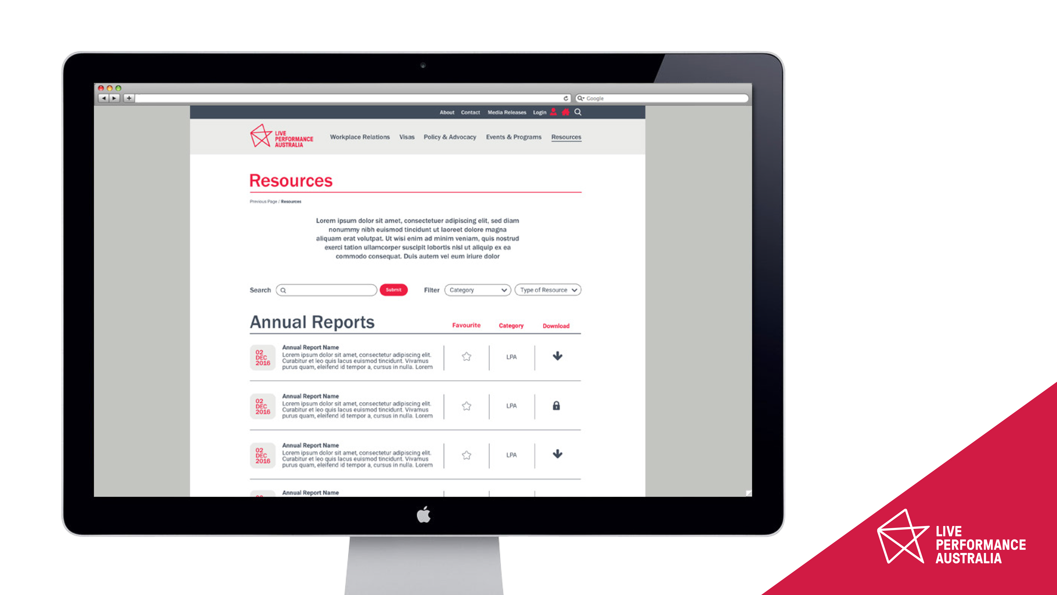
Scope’s Annual Awards

Slide 9
How to download a pdf copy of your visa application in Immi
Scope’s Annual Awards
INSERT VIDEO HERE

Slide 10
How to pay for and lodge your visa applications in Immi
Scope’s Annual Awards
INSERT VIDEO HERE

Slide 11

Scope’s Annual Awards
Questions

